Slide 1
Translocation in the Phloem

Slide 2
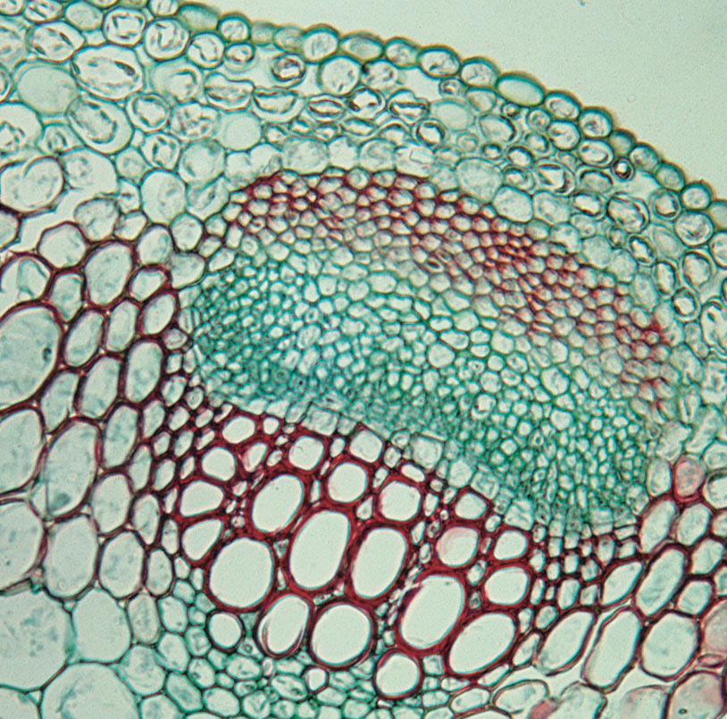
Fig. 10.1
Phloem
xylem
Notes:
PP1001.jpg

Slide 3
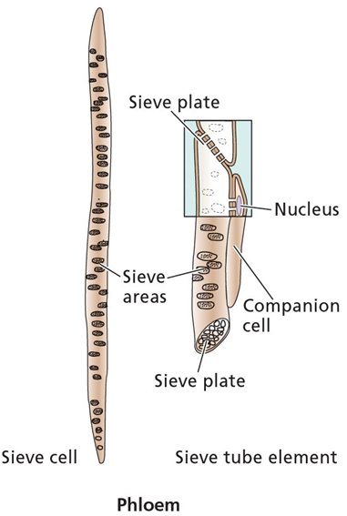
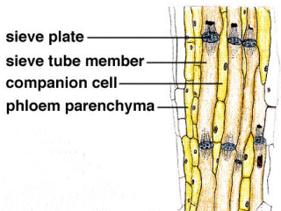
Phloem Structure
The main components of phloem are
sieve elements
companion cells.
Sieve elements have no nucleus and only a sparse collection of other organelles . Companion cell provides energy
so-named because end walls are perforated - allows cytoplasmic connections between vertically-stacked cells .
conducts sugars and amino acids - from the leaves, to the rest of the plant

Slide 4
Phloem transport requires specialized, living cells
Cells called “sieve tube elements” join to form a continuous tube
Sieve tube elements lack some structures and organelles - no nuclei, vacuole, Golgi, ribosomes, or microtubules
Pores in sieve plate between sieve tube elements are open channels for transport

Slide 5
Phloem transport requires specialized, living cells
Each sieve tube element is associated with one or more companion cells.

Slide 6
Phloem transport requires specialized, living cells
Companion cells:
Transport products of photosynthesis from cells in leaves to sieve tube elements through plasmodesmata
Synthesize the various proteins used in the phloem
Contain many, many mitochondria for cellular respiration to provide the cellular energy required for active transport

Slide 7
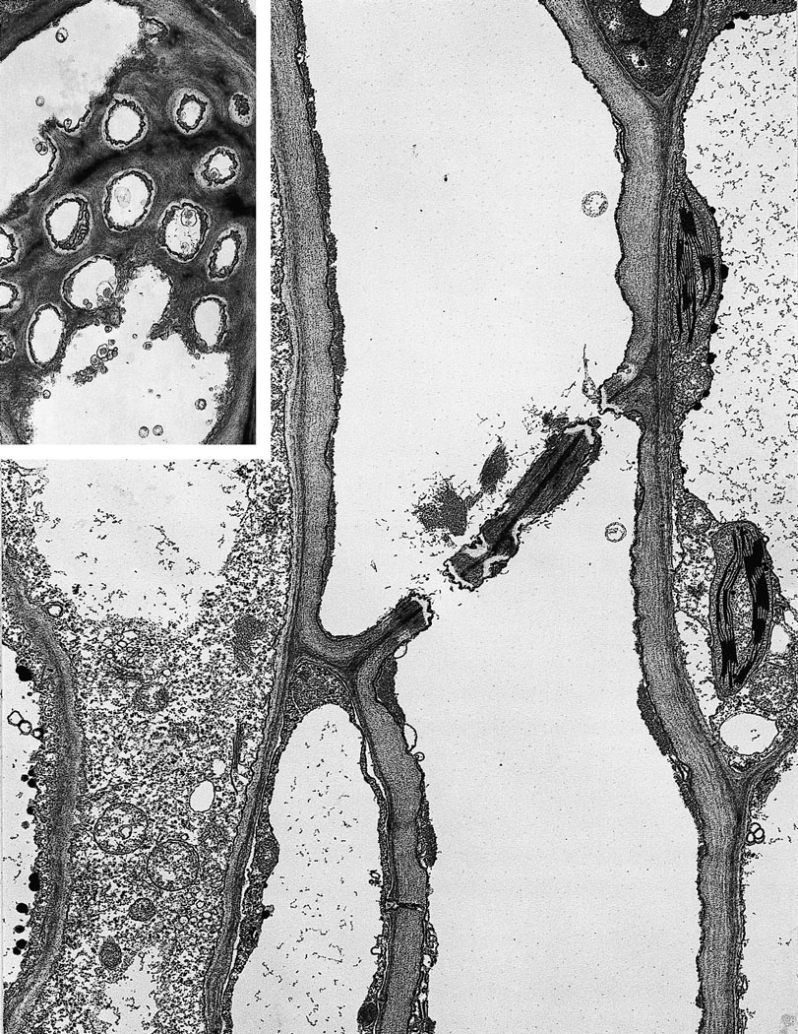
Cell wall between
sieve elements
Sieve plate pore
Companion cell
Notes:
PP1005.jpg

Slide 8
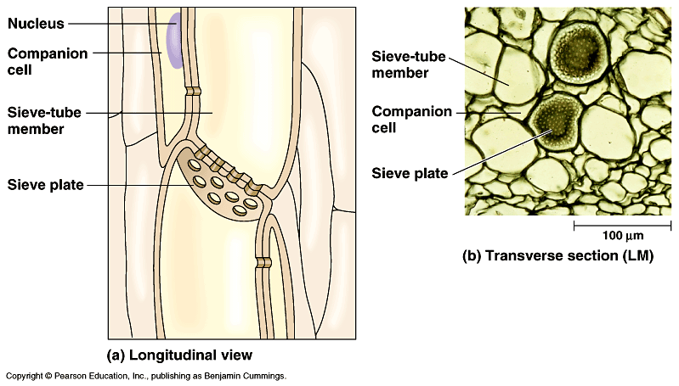

Slide 9
What is transported in phloem?
The phloem is the vascular system for moving (translocating) sugars produced in photosynthesis and other substances throughout the plant.

Slide 10
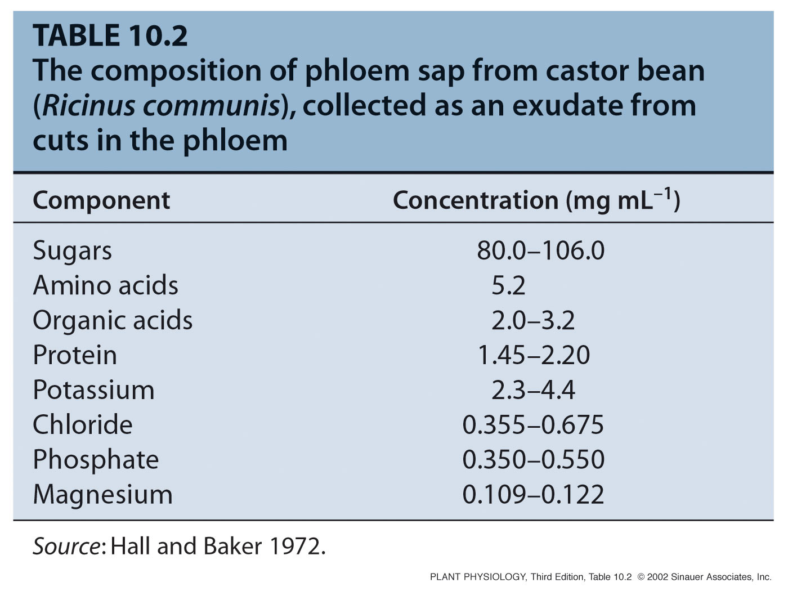

Slide 11
Sugars in the phloem
Carbohydrates transported in phloem are all non-reducing sugars.
Reducing sugars, such as glucose are too chemically reactive to be transported in the phloem
The most common transported sugar is sucrose.
A disaccharide made up from glucose & fructose

Slide 12
The mechanism of phloem transport
The Pressure-Flow Model

Slide 13
Phloem transports sugars from a “source” to a “sink”
Source:
Any exporting region that produces sugars above and beyond that of its own needs
Sink:
Any area that does not produce enough sugar to meets its own needs

Slide 14
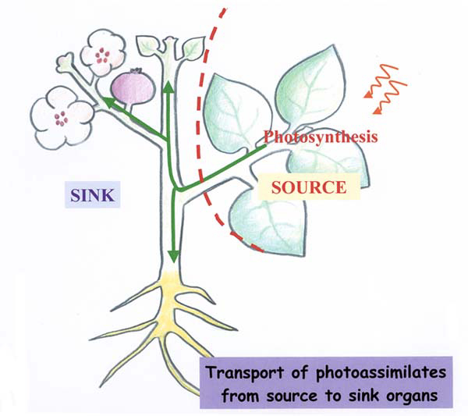

Slide 15
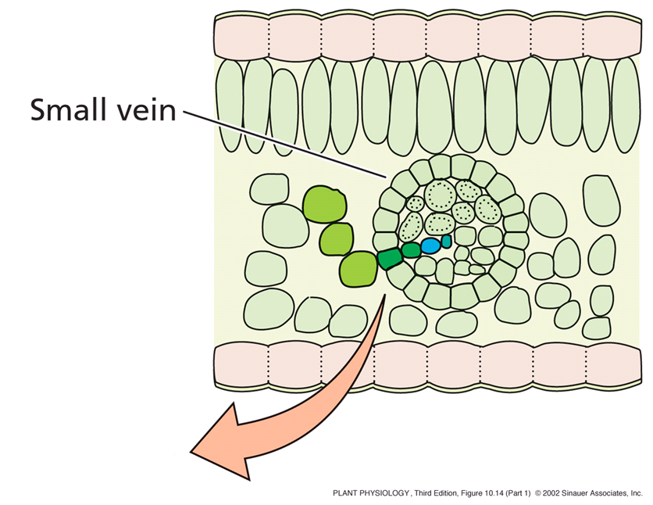
In source tissue…
sugars are moved from photosynthetic cells and actively loaded (uses ATP energy) into companion cells and sieve tube elements.
Notes:
PP10141.jpg

Slide 16
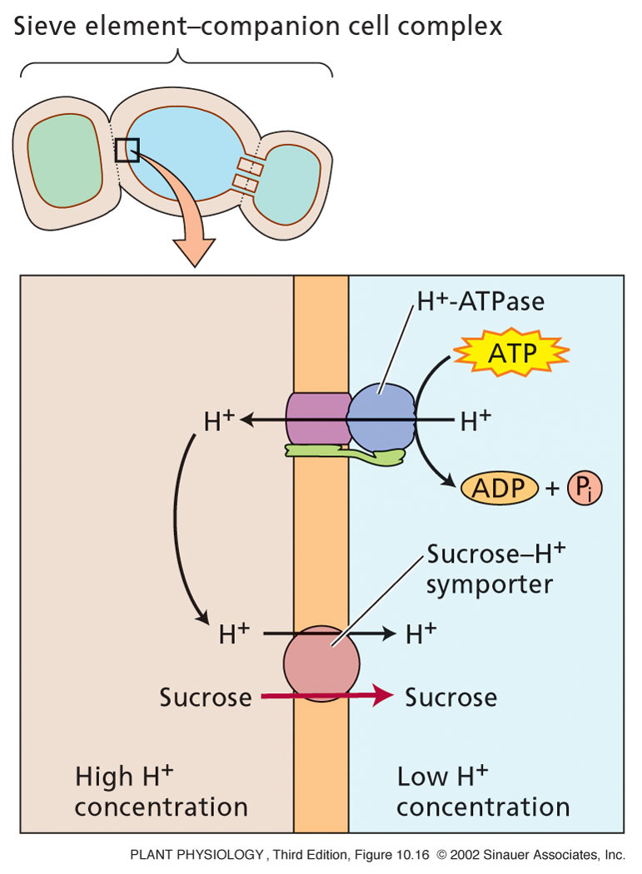
Phloem loading uses a
proton/sucrose co-transport protein.
Notes:
PP10160.jpg

Slide 17
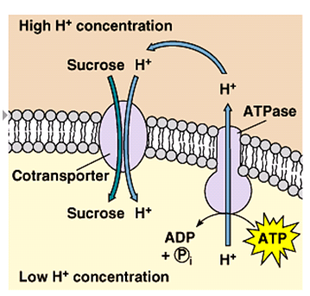

Slide 18
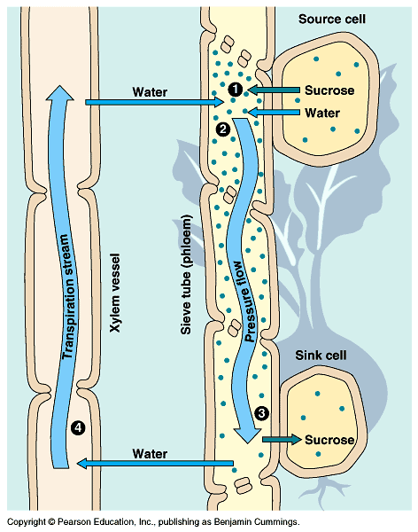
The Pressure -Flow Model
Phloem loading leads to a buildup of sugars (the phloem cells become hypertonic)
In response, water enters sieve elements from xylem via osmosis
Thus phloem turgor pressure increases

Slide 19
The Pressure -Flow Model
In sink tissue…
Phloem unloading leads to lower sugar concentration (the phloem cells become hypotonic)
Water leaves the phloem and enters sink sieve elements and xylem (via osmosis)
Thus phloem turgor pressure decreases

Slide 20
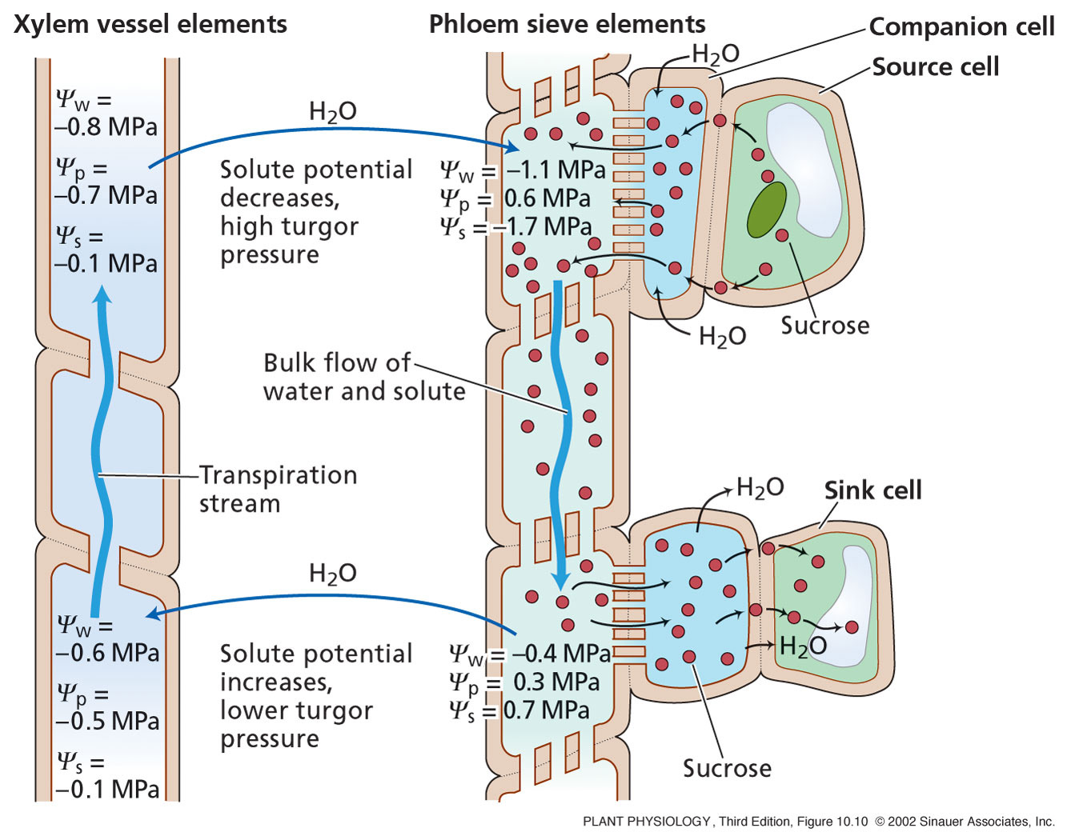
Phloem solution moves along a gradient of pressure generated by a solute concentration difference between source and sink ends of the pathway
Fig. 10.10
Notes:
PP10100.jpg

Slide 21
Summary
Materials translocated in phloem:
Translocated solutes are mainly carbohydrates
Sucrose is the most common translocated sugar
Phloem also contains:
Amino acids, proteins, inorganic ions, and plant hormones
Rate of translocation:
Movement in the phloem is rapid, well in excess of rates of diffusion
Average velocity is 1 meter per hour

Slide 22
Summary
Pathway of translocation:
Sugars and other organic materials are conducted throughout the plant in the phloem by means of sieve tube elements
Sieve tube elements display a variety of structural adaptations that make the well suited for transport
Materials are translocated in the phloem from sources (usually mature leaves) to sinks (roots, immature leaves)

Slide 23
Summary
The pressure-flow model of phloem translocation
At source end of pathway
Active transport of sugars into sieve cells
Water flows into sieve cells and turgor pressure increases
At sink end of pathway
Unloading (active transport again) of sugars
Water flows out of sieve cells and turgor pressure decreases
Flow is driven by a gradient of pressure.
Energy is required to establish the pressure gradient, but energy is not required by cells of the pathway itself.
Animation

