Slide 1
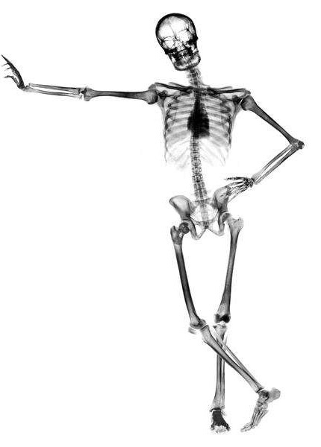
11.2
Movement
Essential idea: The roles of the musculoskeletal
system are movement, support and protection.
The rigid nature of bone both supports and
protects organs within the body. It also gives a
structure for muscles to pull, by their contraction,
to create movement.
http://everydaylife.globalpost.com/DM-
Resize/photos.demandstudios.com/getty/article/39/211/dv385032.jpg?w=600&h=

Slide 2
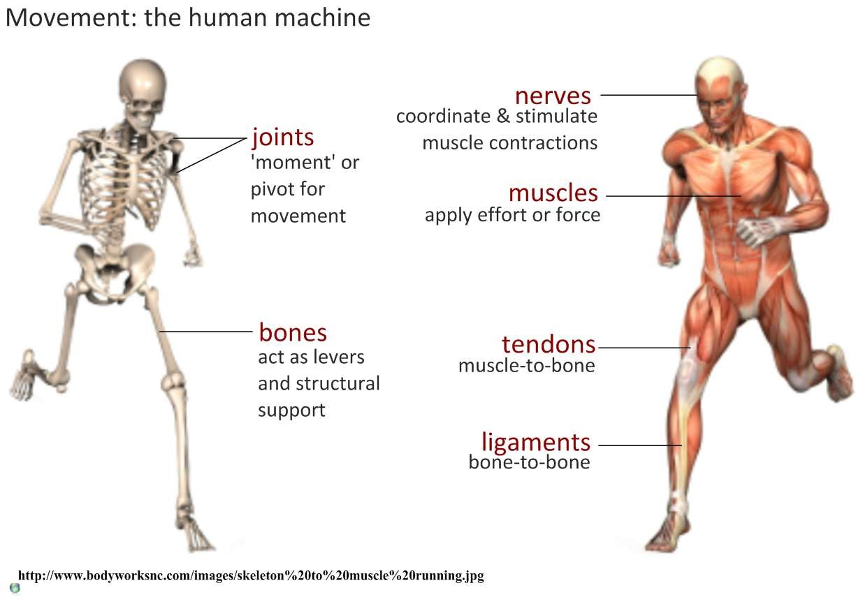

11.2.U1 Bones and exoskeletons provide anchorage for muscles and act as levers.

Slide 3
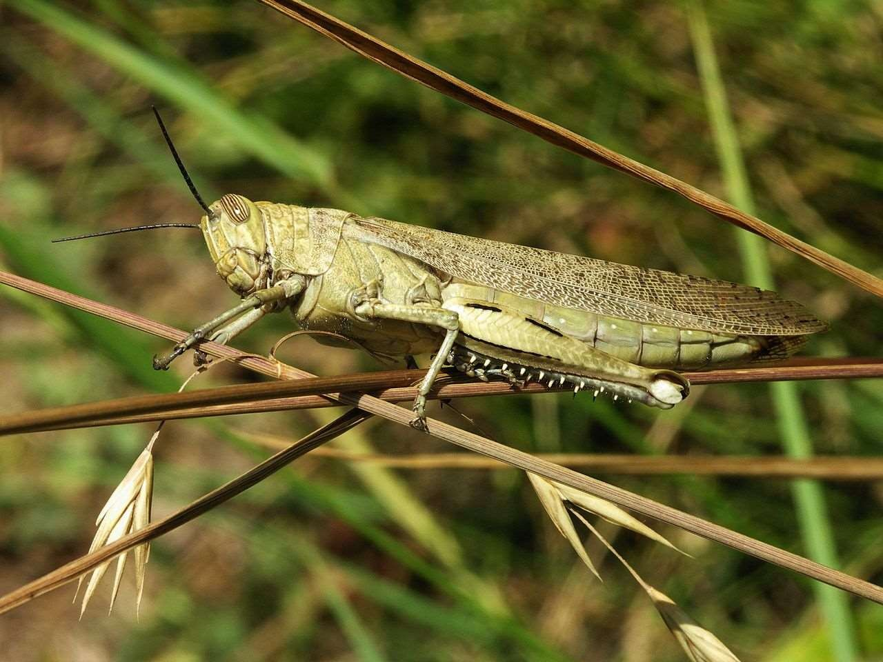
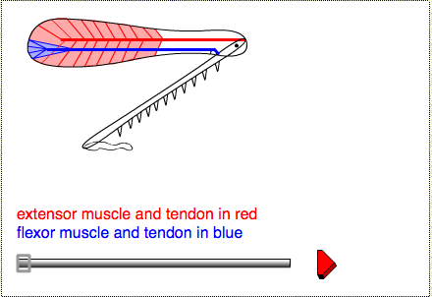
11.2.A1 Antagonistic pairs of muscles in an insect leg.
Grasshoppers (Acrididae) are insects, and insects have a skeleton on the
outside of the body called an exoskeleton. The muscles are inside the hard shell.
The back leg is much longer than the others to aid jumping. Long legs
increase the distance over which the jumper can push on the ground.
The two main muscles inside are the extensor tibiae
muscle which contracts to extends the leg, and the flexor
tibiae muscle which contracts to flex the leg. These
muscles pull on tendons which are attached to the tibia on
either side of the joint pivot.
Skeletal muscles, such as the extensor and flexor that
occur in pairs are often antagonistic: when one contracts
the other relaxes to produce controlled movement in
opposite directions.
https://www.st-
andrews.ac.uk/~wjh/jumping/legwrk.htm
https://en.wikipedia.org/wiki/File:Acrididae_grasshopper-2.jpg

Slide 4
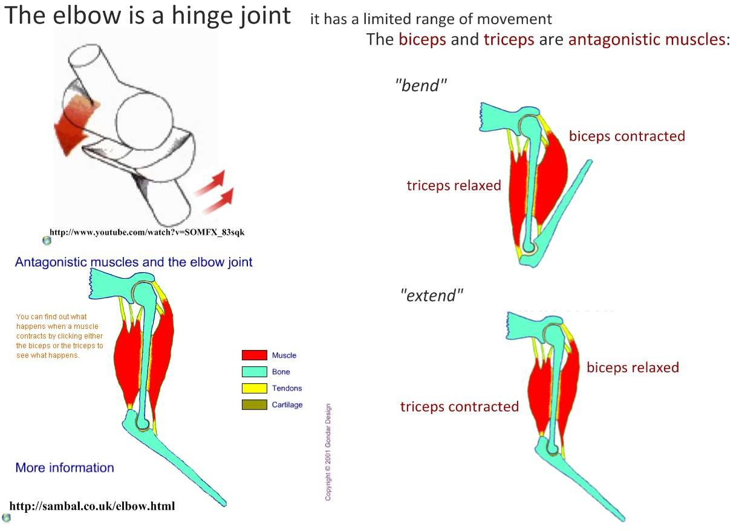
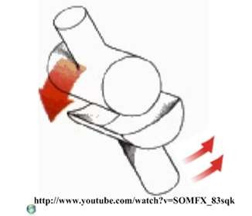
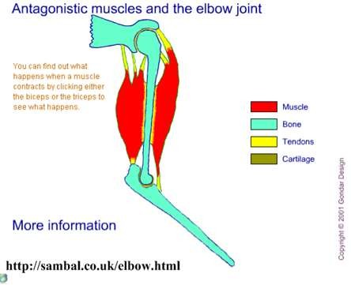
11.2.U3 Movement of the body requires muscles to work in antagonistic pairs.
The triceps and
biceps are working in
opposite directions
and hence are
examples of
antagonistic muscles.
https://youtu.be/SOMFX_83sqk
http://purchon.com/flash/elbow.swf

Slide 5
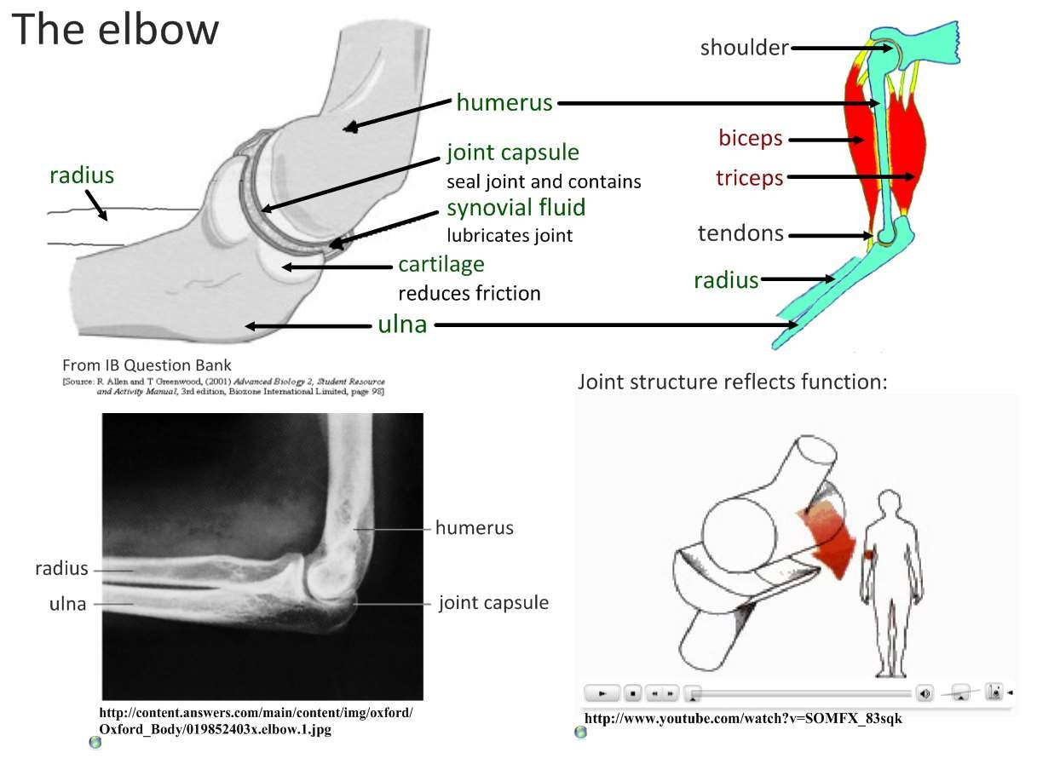
11.2.S1 Annotation of a diagram of the human elbow.
Can you annotate the structures? Remember structure dictates function
Structure
Function
Biceps
Triceps
Humerus
Radius / Ulna
Cartilage
Synovial fluid
Joint capsule
Tendons
Ligaments

Slide 6
11.2.S1 Annotation of a diagram of the human elbow.
Can you annotate the structures? Remember structure dictates function
Structure
Function
Biceps
Bends the arm (flexor)
Triceps
Straightens the arm (extensor)
Humerus
Anchors the muscle (muscle origin)
Radius / Ulna
Acts as forearm levers (muscle insertion) – radius for the biceps, ulna for the triceps
Cartilage
Smooth surface to allow easy movement, absorbs shock and distributes load
Synovial fluid
Provides lubrication, reduces friction in the joint.
Joint capsule
Seals the joint, contains the synovial fluid.
Tendons
non-elastic tissue connecting muscle to bone
Ligaments
non-elastic tissue connecting bone to bone

Slide 7
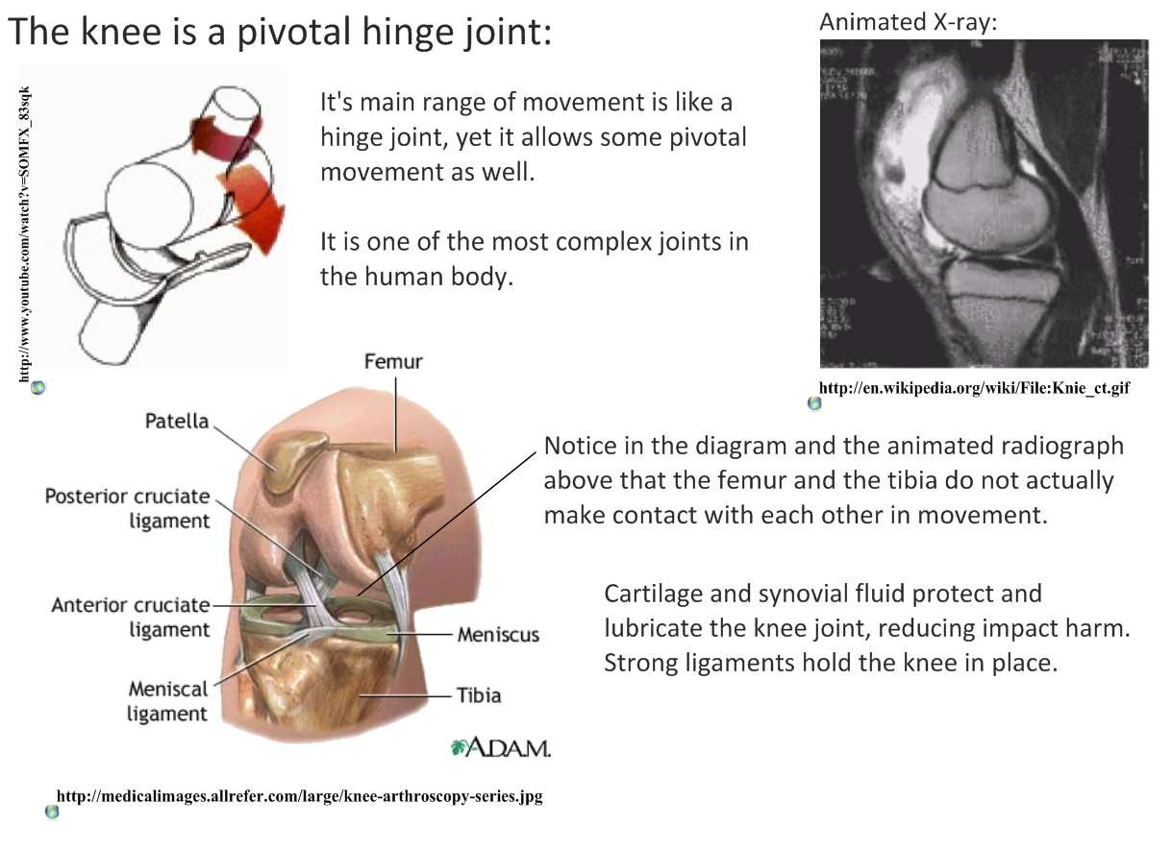
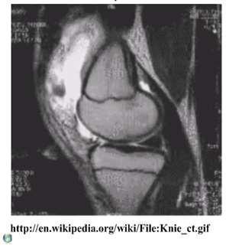
11.2.U2 Synovial joints allow certain movements but not others.
https://en.wikipedia.org/wiki/File:Knie_
ct.gif

Slide 8
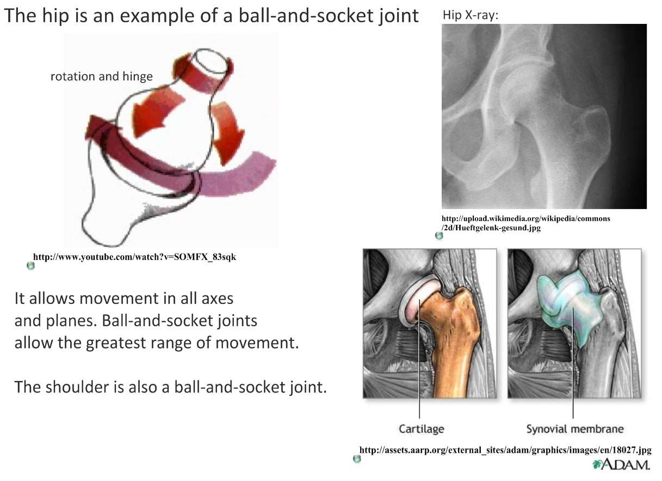
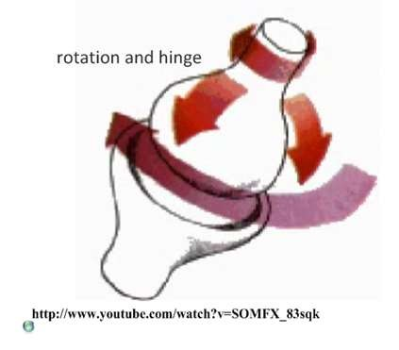
11.2.U2 Synovial joints allow certain movements but not others.
https://youtu.be/SOMFX_83sqk

Slide 9

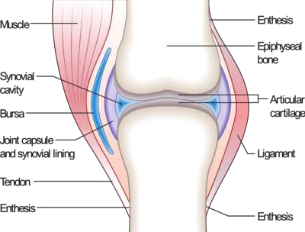
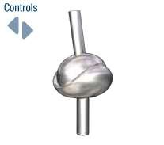
11.2.U2 Synovial joints allow certain movements but not others.
More about synovial joints:
http://www.midsouthorthopedics.com/education.htm
http://www.mananatomy.com/basic-anatomy/synovial-
joints
http://www.bbc.co.uk/science/human body/body/factfiles/joints/saddle_joint
.shtm

Slide 10
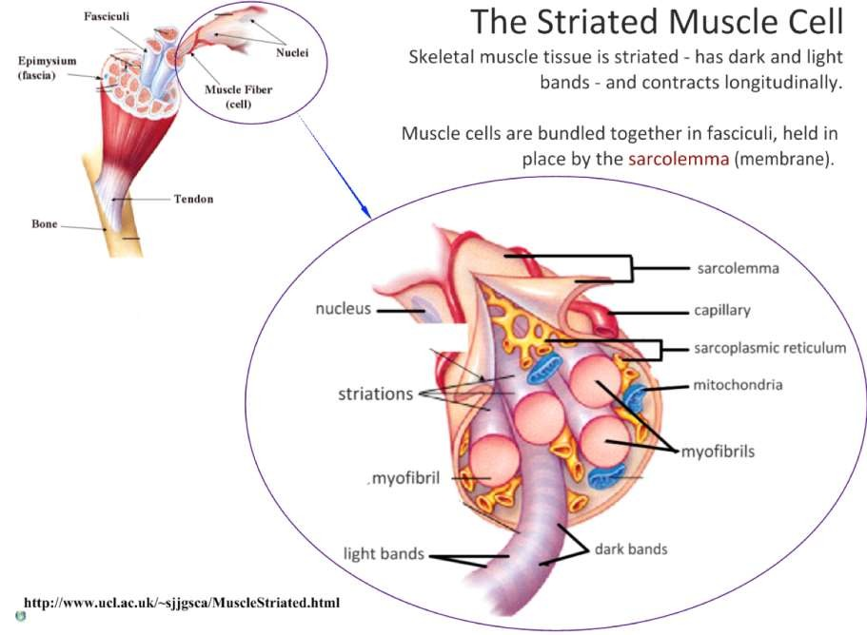
11.2.U4 Skeletal muscle fibres are multinucleate and contain specialized endoplasmic reticulum. AND 11.2.U5
Muscle fibres contain many myofibrils.
Muscle fibre cells are held together by the plasma
membrane referred to as the sarcolemma.
A single skeletal muscle cell is
multinucleated, with nuclei
positioned along the edges
Many mitochondria are
present due to the high
demand for ATP
edited from: http://www.slideshare.net/gurustip/muscles-and-movement

Slide 11
11.2.U4 Skeletal muscle fibres are multinucleate and contain specialized endoplasmic reticulum. AND 11.2.U5
Muscle fibres contain many myofibrils.
Muscle fibre cells are held together by the plasma
membrane referred to as the sarcolemma.
Muscle cells contain sarcoplasmic
reticulum, a specialised type of
endoplasmic reticulum*, that
stores calcium ions and
pumps them out into the
sarcoplasm when the
muscle fiber is stimulated.
* Remember (from 1.2
Ultrastructure of cells) that normal endoplasmic reticulum synthesizes molecules.
edited from: http://www.slideshare.net/gurustip/muscles-and-movement

Slide 12
11.2.U4 Skeletal muscle fibres are multinucleate and contain specialized endoplasmic reticulum. AND 11.2.U5
Muscle fibres contain many myofibrils.
Myofibrils are the basic rod-like
contractile units with a muscle
cells. Myofibrils are grouped
together inside muscle cells,
which are known as muscle
fibres.
edited from: http://www.slideshare.net/gurustip/muscles-and-movement

Slide 13
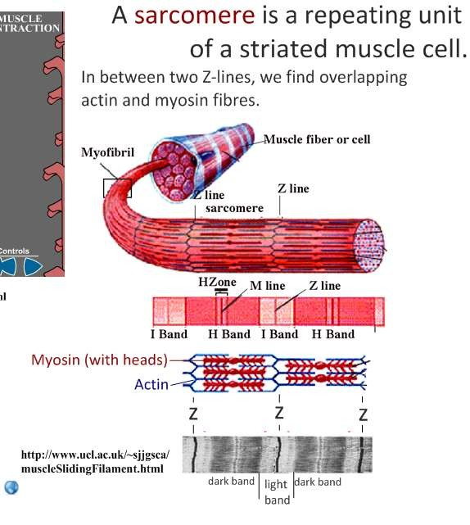
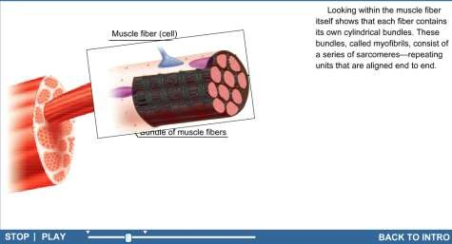
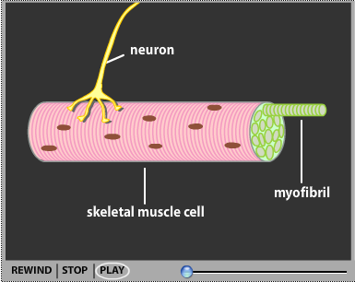
11.2.U6 Each myofibril is made up of contractile sarcomeres.
http://wps.prenhall.com/wps/media/objects/2688/2752944/Web_Tu torials/25_A01.swf
http://www.sumanasinc.com/webcontent/animati
ons/content/muscle.html
edited from: http://www.slideshare.net/gurustip/muscles-and-movement

Slide 14
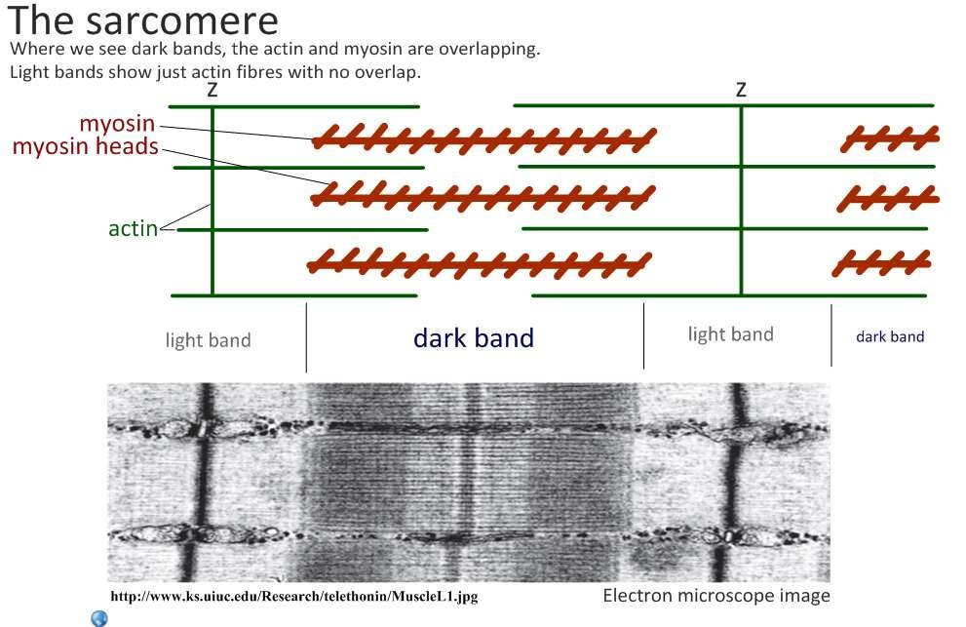
11.2.S2 Drawing labelled diagrams of the structure of a sarcomere.

Slide 15
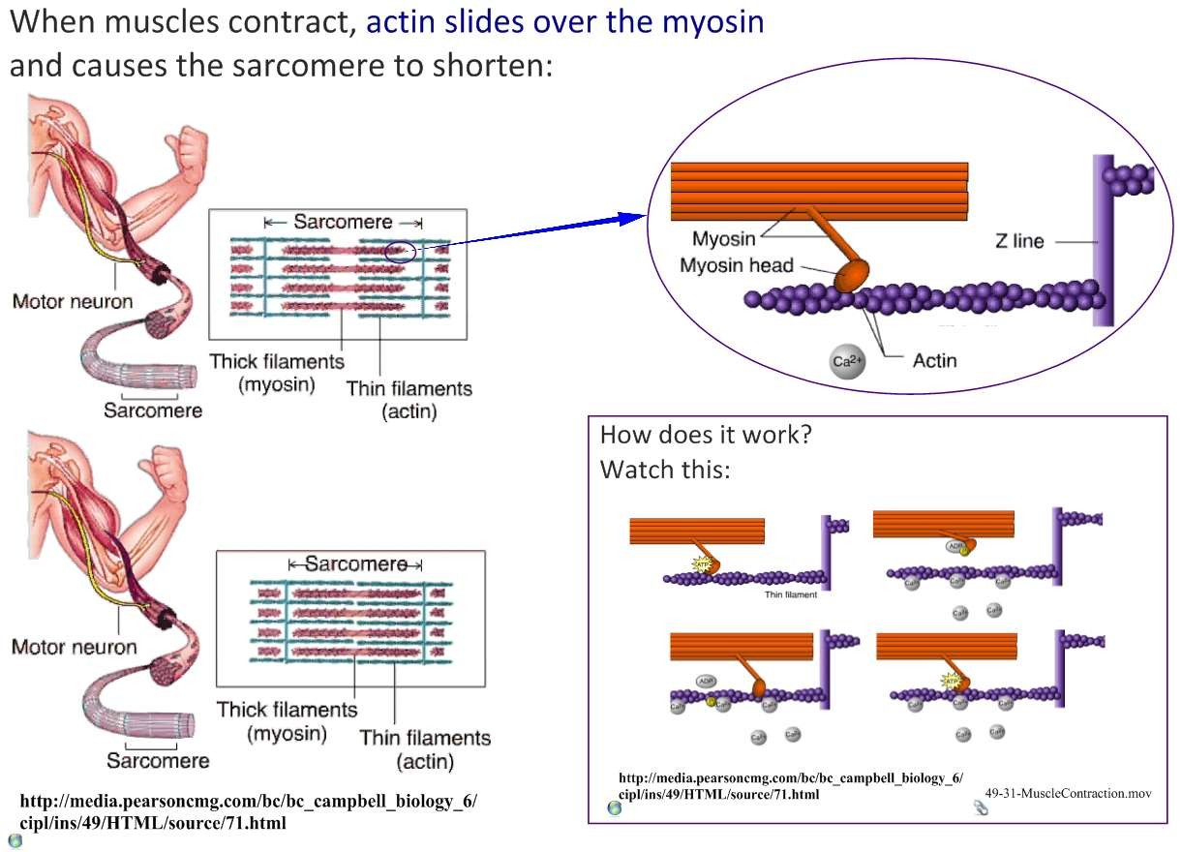
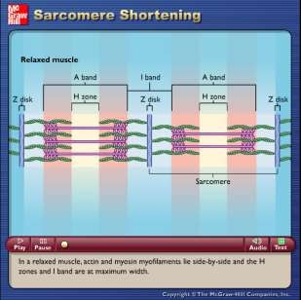
11.2.U7 The contraction of the skeletal muscle is achieved by the sliding of actin and myosin filaments.
http://highered.mheducation.com/olc/dl/12
0104/bio_b.swf
edited from: http://www.slideshare.net/gurustip/muscles-and-movement

Slide 16
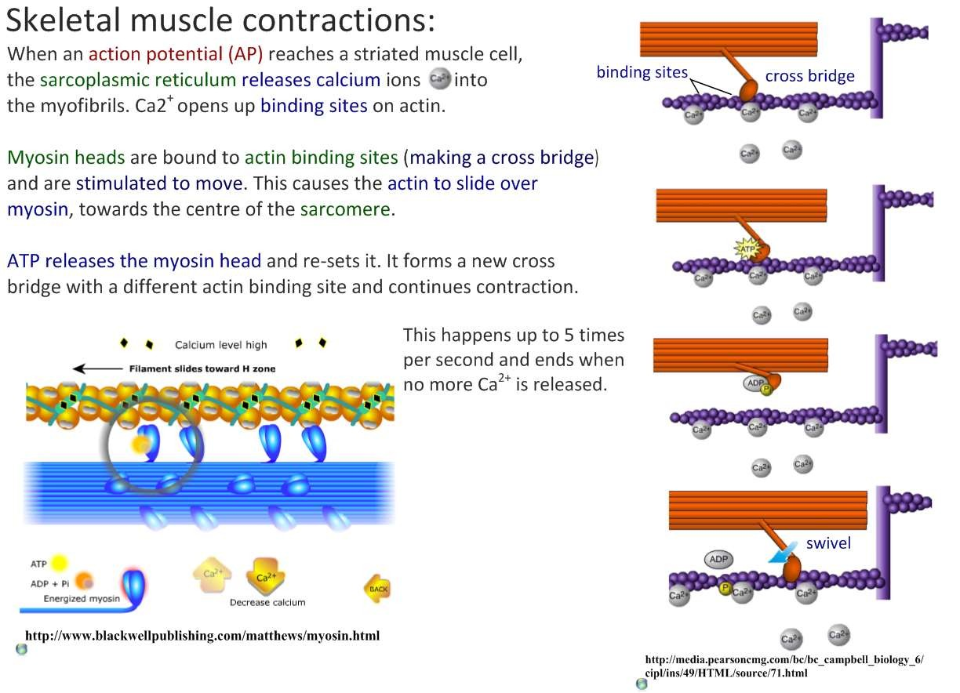
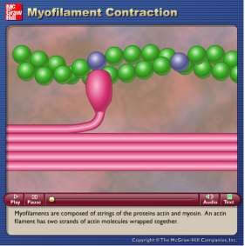
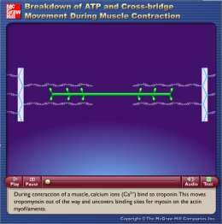
11.2.U8 ATP hydrolysis and cross bridge formation are necessary for the filaments to slide. AND 11.2.U9 Calcium
ions and the proteins tropomyosin and troponin control muscle contractions.
http://highered.mheducation.com//site
http://highered.mheducation.com/si
akdwnDrngCntrctn.swf
s/dl/free/0072495855/291136/myofila ment.swf
tes/dl/free/0072495855/291136/Bre
edited from: http://www.slideshare.net/gurustip/muscles-and-movement

Slide 17


Slide 18
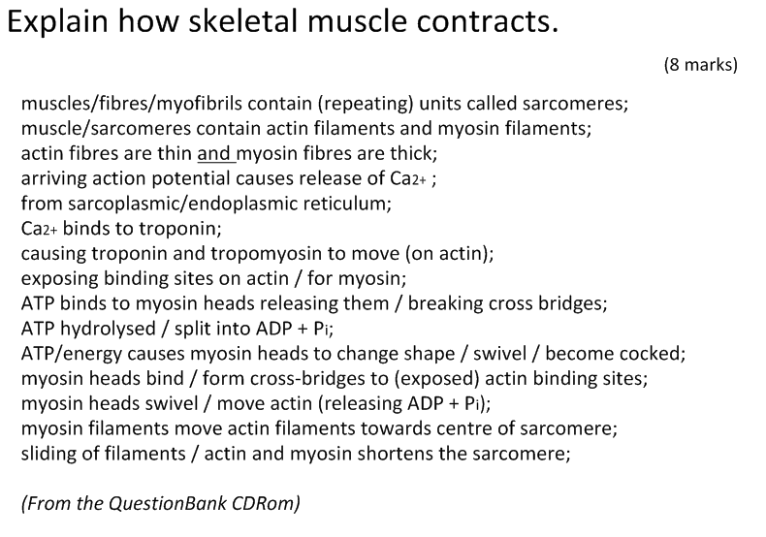

Slide 19
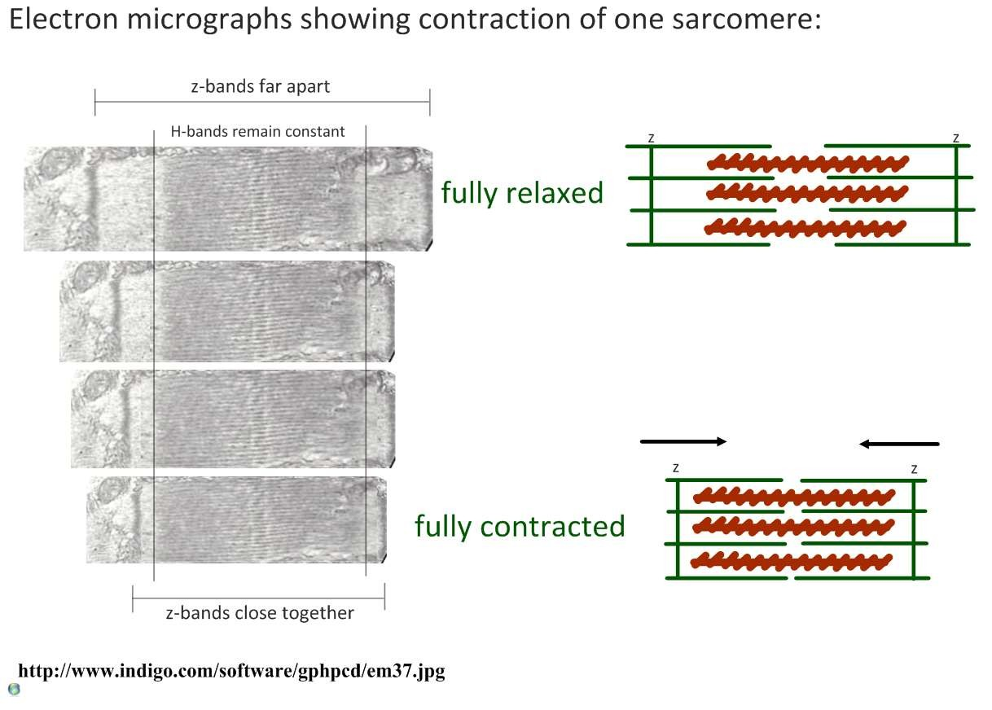
11.2.S3 Analysis of electron micrographs to find the state of contraction of muscle fibres.

Slide 20
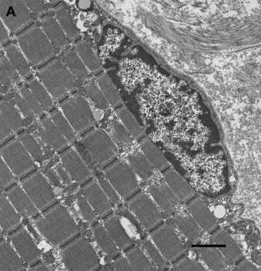
11.2.S3 Analysis of electron micrographs to find the state of contraction of muscle fibres.
Electron
micrograph
of
human
skeletal
muscle
Analyse the micrograph and use it to answer the following:
1.
Deduce whether the myofibrils are
contracted or relaxed
Calculate the magnification of the
electron micrograph
Measuring an individual sarcomere
accurately is difficult due to their
small size. Commonly scientists
use the formula below:
2.
3.
mean
sarcomere
length
(μm)
= total length of n sacromeres
n
a.
Measure the total length of
five sarcomere from z-line to
z-line
Calculate the mean length of a
sarcomere
b.
1μm
http://darwin.wcupa.edu/beneski/bio-515/f12/westervelt/Main/ImageAnalysis?p=2

Slide 21
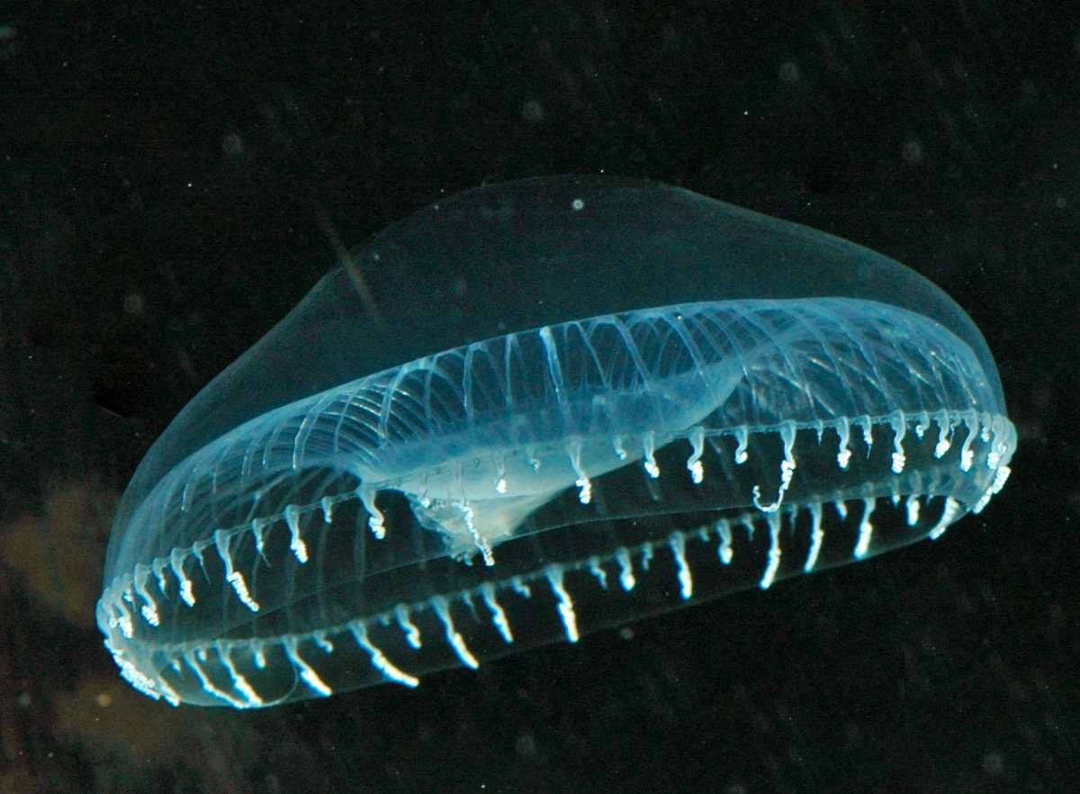
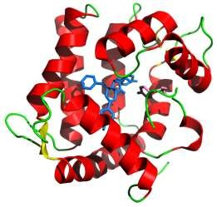
Nature of science: Developments in scientific research follow improvements in apparatus - fluorescent calcium
ions have been used to study the cyclic interactions in muscle contraction. (1.8)
Ashley and Ridgway (1968) were the first to study the role that
Calcium ions (Ca²⁺) plays in the coupling of nerve impulses and
muscle contraction. Their work was made possibly by the use of
aequorin, a
Ca²⁺
binding bioluminescent protein. Upon Ca2+-
binding aequorin emits light. The timing of light emission peaks
between the arrival of an electrical impulse at the muscle fibre and
the contraction of the muscle fibre. This is consistent with theory of
release of Ca2+ from the sarcoplasmic reticulum
https://commons.wikimedia.org/wiki
/File:Aequorea4.jpg
Deduce the structure of aequorin from the molecular visualization.
The light emissions are detected and recorded using
specially adapted microscopes and cameras.
A number of researchers have used fluorescent dyes to
visualise and measure the movement of myosin and actin.
aequorin and the fluorescent dyes used in research only emit
for a few short nano-seconds making them ideal to measure
the rapid movements found in muscle cells.
https://www.uic.edu/classes/phyb/phyb516/BaranyUpdate4/Regulatio
https://commons.wikimedia.org/wiki/File:Aequorin_1EJ3.png
nofMuscleContraction/RegulationofMuscleContraction.html

