Slide 1
Muscle Contraction
Muscle structure
Actin and myosin filaments
Sliding filament theory

Slide 2
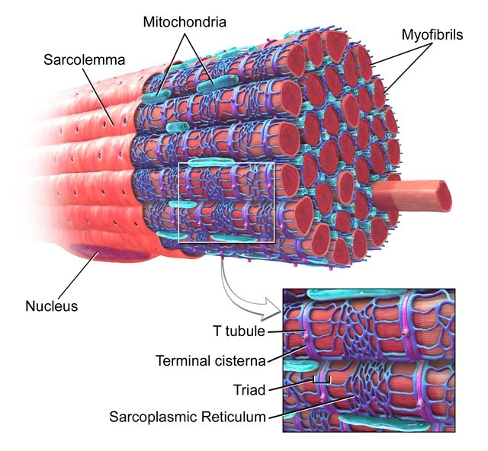
Muscle fibres and myofibrils
Skeletal muscle fibres are
Multinucleate
They contain specialized endoplasmic reticulum called “sarcoplasmic reticulum”.
Muscle fibres contain many myofibrils.
Each myofibril is made up of
contractile sarcomeres.
“SkeletalMuscle" by BruceBlaus. Wikiversity Journal of Medicine. - CC BY 3.0 via Wikimedia Commons - http://commons.wikimedia.org/wiki/File:Blausen_0801_SkeletalMuscle.png#mediaviewer/File:Blausen_0801_SkeletalMuscle.png

Slide 3
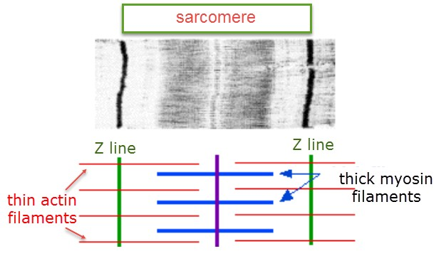
Sarcomeres contain thick myosin and thin actin filaments

Slide 4
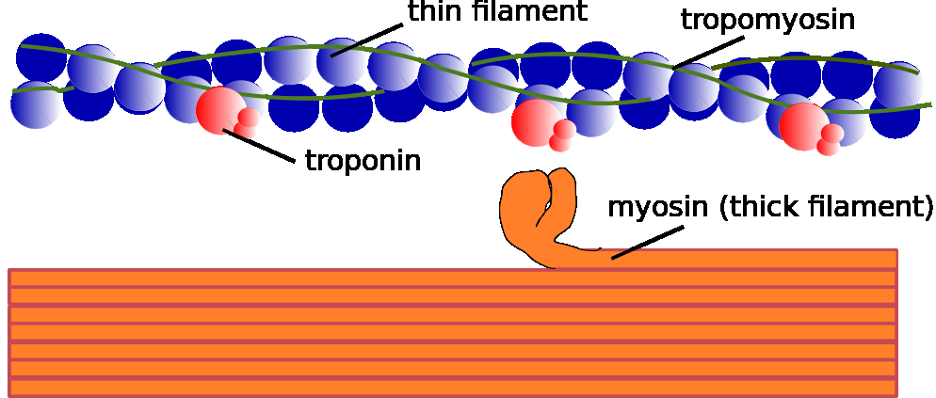
Myosin and Actin filament
Image – public domain by Häggström, Mikael. "Medical gallery of Mikael Häggström 2014". Wikiversity

Slide 5
The sliding filament theory of muscle contraction
When a muscle contracts, the actin is pulled along myosin toward the centre of the sarcomere.
The actin and myosin filaments become completely overlapping.
There is no pale area in the centre.
The muscle shortens.
Note:
The actin & myosin filaments don’t change length, they just slide past each other.

Slide 6
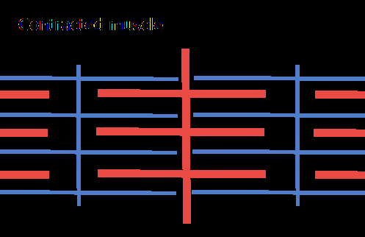
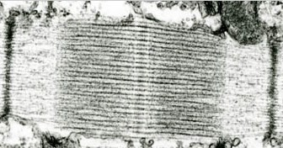
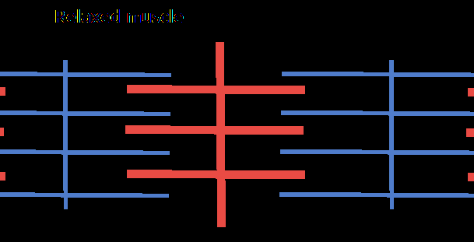
Sliding filament theory
Z line
Z line
Z line
Z line

