Slide 1
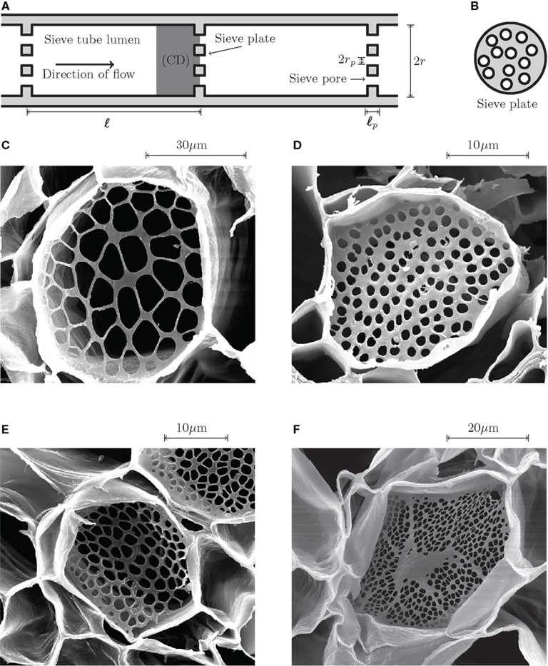
9.2 Transport in the phloem of plants AHL
Essential idea: Structure and function are correlated in the phloem of plants.
The lower power scanning electron micrograph images show the sieve end plates found on phloem sieve tubes. These perforated walls (in combination with the reduced cytoplasm in sieve cells) gives sieve cells a low resistance to the flow of sap enabling efficient translocation of substances, e.g. sucrose throughout the plant.
http://www.frontiersin.org/files/Articles/26855/fpls-03-00151-r4/image_m/fpls-03-00151-g001.jpg

Slide 2
Review: 9.1.S1 Drawing the structure of primary xylem vessels in sections of stems based on microscope images.
AKA 9.2.S1 Identification of xylem and phloem in microscope images of stem and root.
In a cross section (transverse section, TS) of a stem each vascular bundle consists of large xylem vessels toward the inside and smaller phloem cells toward the outside. Xylem vessels can be identified by their large empty lumens and the thickened cell walls.
n.b. Some plant stems, such as monocotyledons, do not possess a cambium and so it is not easy to distinguish between the cortex and pith (both are usually labeled together). In these stems the vascular bundles are not arranged in a ring.
Edited from: http://www.slideshare.net/gurustip/transport-in-angiospermophytes

Slide 3
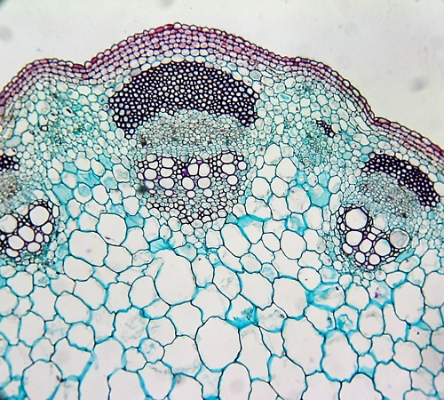
Review: 9.1.S1 Drawing the structure of primary xylem vessels in sections of stems based on microscope images.
Task: draw tissue diagrams of the light micrograph and label the different tissues you can identify.
Species unknown
http://plantphys.info/plant_physiology/images/stemvb.jpg

Slide 4
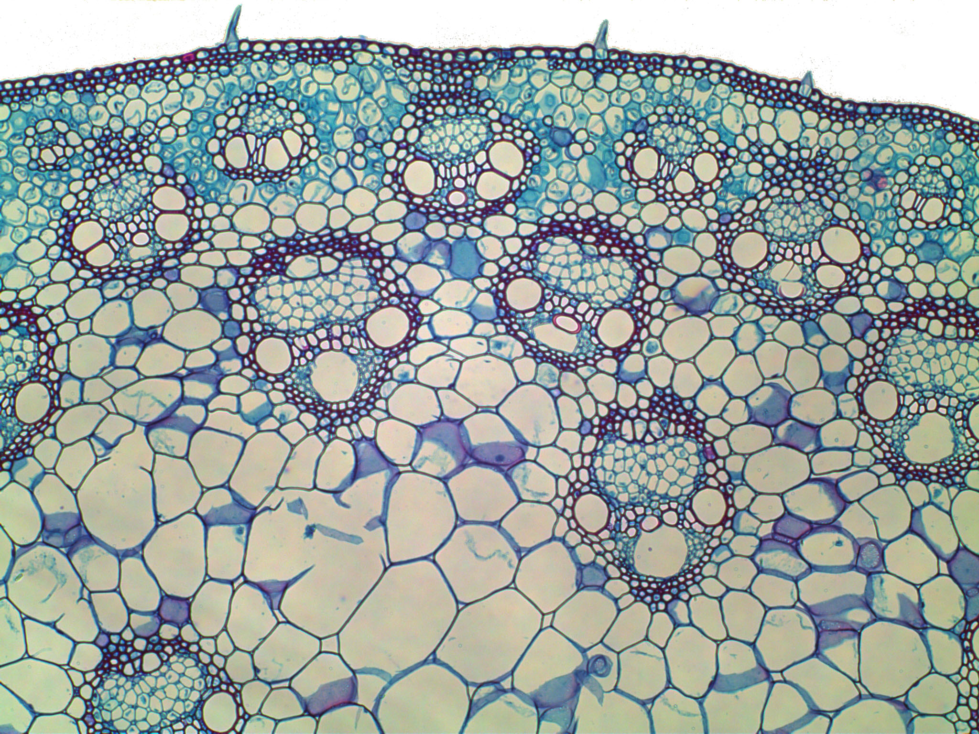
Review: 9.1.S1 Drawing the structure of primary xylem vessels in sections of stems based on microscope images.
Task: draw tissue diagrams of the light micrograph and label the different tissues you can identify.
Zea mays (Corn) stem
http://emp.byui.edu/wellerg/Roots%20and%20Shoots%20Lab/Images/Zea%20Mays%20Stem%20P.jpg

Slide 5
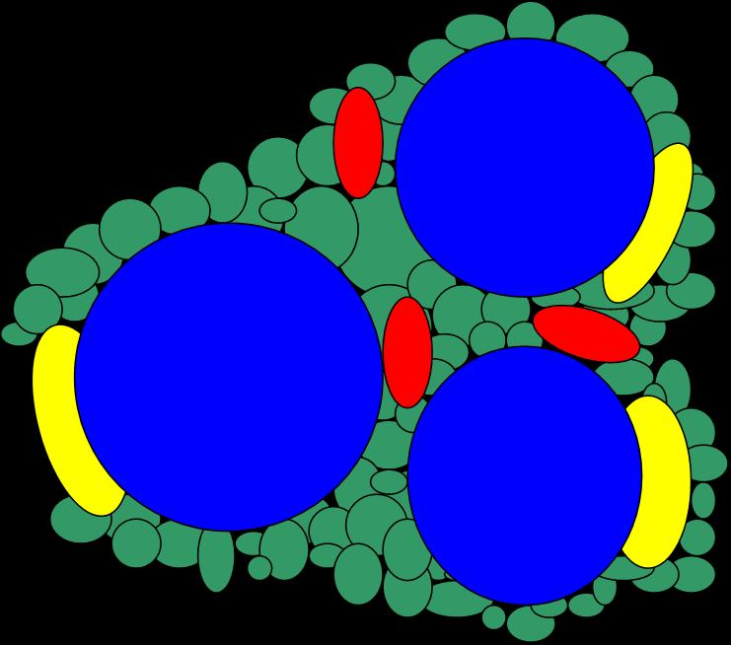
9.2.A1 Structure–function relationships of phloem sieve tubes.
How is the structure of phloem sieve tubes related to it’s function?
What are sieve element cells and how do they relate to other adjacent tissues?
Sieve element cells (form tubes) which transport water and solutes. To be efficient at transport they have reduced quantities of cytoplasm and no nucleus, ribosome or vacuole*.
Companion cells are "life support” for the sieve element cells as they perform certain metabolic functions for sieve elements. Therefore plasmodesmata (microscopic pores in the cell walls) between companion and sieve element cells are larger than in most plant cells to allow for the exchange of metabolites, e.g. ATP.
Diagram of a phloem tissue
cross-section
Fibers of sclerenchyma cells and provides structural support for the plant
Parenchyma acts as packing material between other cell types and helps transfer materials to the sieve elements and companion cells
https://www.msu.edu/~walwort8/page2.html#structure

Slide 6
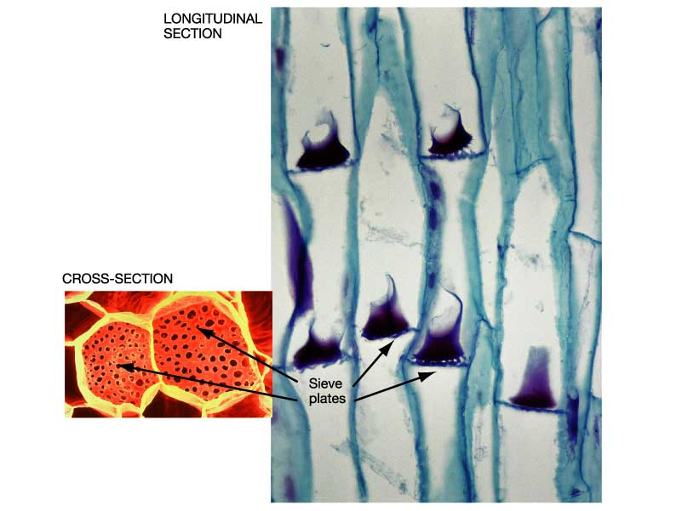
9.2.A1 Structure–function relationships of phloem sieve tubes.
How is the structure of phloem sieve tubes related to it’s function?
How are sieve tubes structured to function?
The rigid cell walls of the sieve tube allow for the building of the high pressures needed to generate hydrostatic pressure (the flow inside the tubes).
The ends of sieve element cells are connected with other sieve elements together they form a sieve tube.
Sieve plates are found at the interface between two sieve elements cells: they contain large pores in the cell walls speeding the transport of substances between sieve element cells
http://www.uic.edu/classes/bios/bios100/lectf03am/phloem.jpg

Slide 7
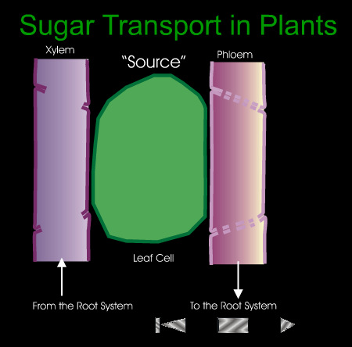
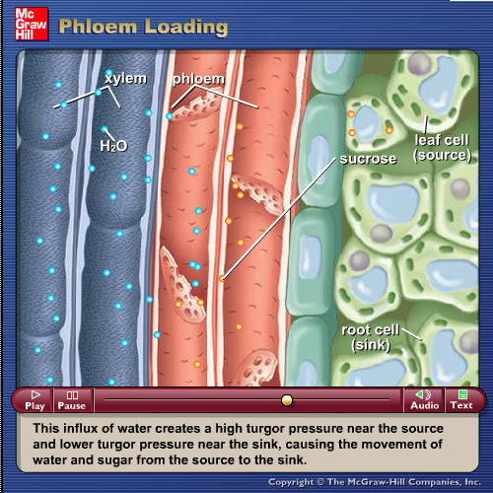
9.2.U1 Plants transport organic compounds from sources to sinks. AND 9.2.U2 Incompressibility of water allows transport along hydrostatic pressure gradients.
Two good animations that help to visualise how plants transport substances such as amino acids and sucrose in phloem vessels.
http://highered.mheducation.com/sites/9834092339/student_view0/chapter38/animation_-_phloem_loading.html
http://www.pearsoned.ca/school/science11/biology11/sugartransport.html
Watch, take notes and use the rest of the presentation to clarify your understanding and map your notes against objectives.

Slide 8
9.2.U1 Plants transport organic compounds from sources to sinks.

Slide 9
9.2.U1 Plants transport organic compounds from sources to sinks.

Slide 10
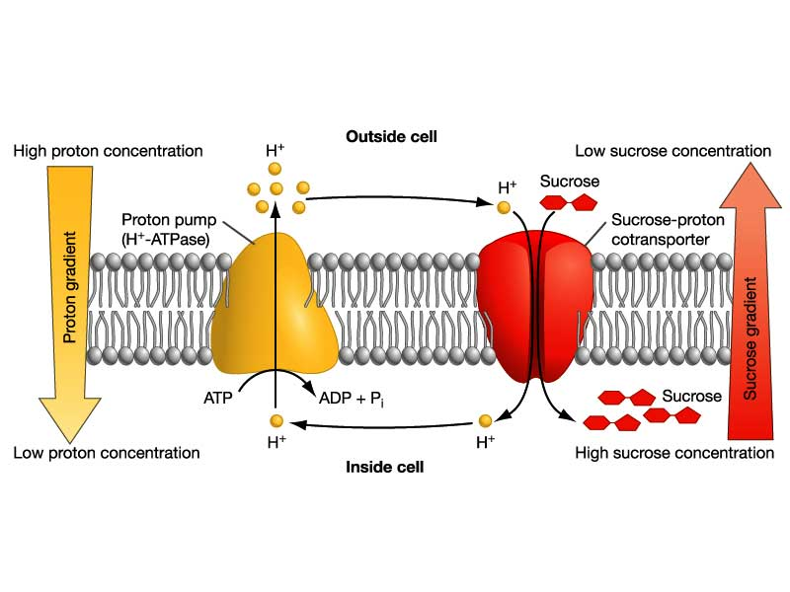
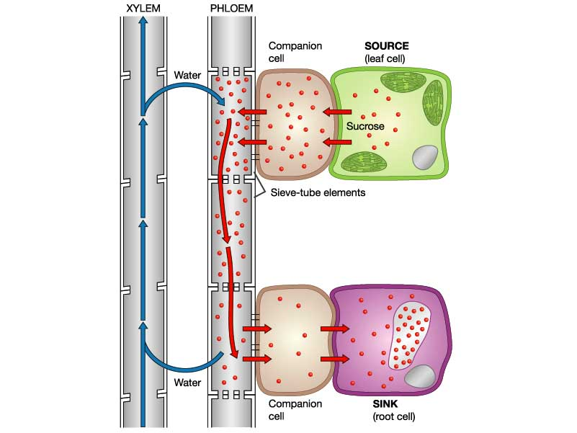
9.2.U3 Active transport is used to load organic compounds into phloem sieve tubes at the source. AND 9.2.U4 High concentrations of solutes in the phloem at the source lead to water uptake by osmosis.
Sucrose is actively transported into the phloem
H+ ions are actively transported (using ATP) out of the phloem cell
High H+ ion concentration gradient builds up outside the cell
H+ ions flow back into the cell, the energy released is used to co-transport sucrose into the phloem cell.
High concentrations of solutes cause water uptake by osmosis
Concentration of sucrose in phloem cells is relatively high
Consequently the water concentration is relatively low
Water moves down the concentration gradient from the xylem, through the membrane, into phloem cells, by osmosis
http://www.uic.edu/classes/bios/bios100/lecturesf04am/lect19.htm

Slide 11
9.2.U2 Incompressibility of water allows transport along hydrostatic pressure gradients. AND 9.2.U5 Raised hydrostatic pressure causes the contents of the phloem to flow towards sinks.
Phloem transports water and solutes along hydrostatic pressure* gradients
Relatively high concentration of sucrose and water in phloem sieve tubes
Water is incompressible, i.e. it occupies a fixed volume
The walls of the sieve tubes are rigid
These two factors cause a build-up of hydrostatic pressure at the source
Water and the solutes (sucrose and amino acids) flow down the hydrostatic gradient to the sink where pressure is relatively low
This is due to the active unloading of sucrose and hence loss of water by osmosis at the sink
*Pressure of water (hydro) before it moves (static)
http://www.uic.edu/classes/bios/bios100/lecturesf04am/lect19.htm

Slide 12
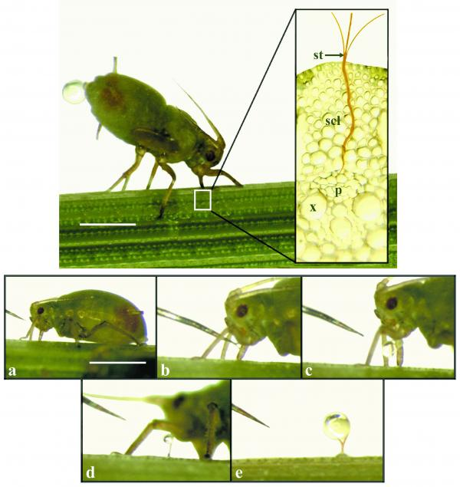
9.2.S2 Analysis of data from experiments measuring phloem transport rates using aphid stylets and radioactively-labelled carbon dioxide.
Aphids belong to the Hemiptera (true bugs), the only group of insects that have evolved the ability to feed primarily on the plant sap.
Aphids possess a stylet: a piercing and sucking mouthpart that is inserted into the plant sieve element to allow the sap to be extracted.
The images shows an aphid feeding and the subsequent flow of sap. The high pressure inside the sieve tube pushes sap into the aphid via the stylet.
Sap is sampled by cutting the aphids stylet after feeding has commensed. The severed stylet remains embedded in the plant and the sap continues to flow.
http://plantsinaction.science.uq.edu.au/sites/plantsinaction.science.uq.edu.au/files/imagecache/figure-medium/plate27AB.TIF-combined.jpg

Slide 13
9.2.S2 Analysis of data from experiments measuring phloem transport rates using aphid stylets and radioactively-labelled carbon dioxide.
Using aphids to measure rates of phloem transport.
A plant is grown in the lab and one leaf is exposed for a short time to CO₂ containing the radioactive isotope 14C.
The 14CO₂ will be taken and incorporated into glucose by the process of photosynthesis. Glucose is converted into sucrose for translocation via the phloem.
Aphids are encouraged to feed on the phloem in different locations of the stem at different times.
The phloem is then analysed for 14C content and the results can be used to calculate the rate at which substances move through the phloem
http://plantsinaction.science.uq.edu.au/sites/plantsinaction.science.uq.edu.au/files/imagecache/figure-medium/plate27AB.TIF-combined.jpg

Slide 14
Nature of Science: Developments in scientific research follow improvements in apparatus—experimental methods for measuring phloem transport rates using aphid stylets and radioactively-labelled carbon dioxide were only possible when radioisotopes became available. (1.8)
Using aphids to measure rates of phloem transport.
Measurement of phloem rates only became possible after the development of techniques that radioactively tagged compounds using 14C and then analyse it’s presence with electronic detectors or photographic film.
A plant is grown in the lab and one leaf is exposed for a short time to CO₂ containing the radioactive isotope 14C.
The 14CO₂ will be taken and incorporated into glucose by the process of photosynthesis. Glucose is converted into sucrose for translocation via the phloem.
Aphids are encouraged to feed on the phloem in different locations of the stem at different times.
The phloem is then analysed for 14C content and the results can be used to calculate the rate at which substances move through the phloem
http://plantsinaction.science.uq.edu.au/sites/plantsinaction.science.uq.edu.au/files/imagecache/figure-medium/plate27AB.TIF-combined.jpg

