Slide 1
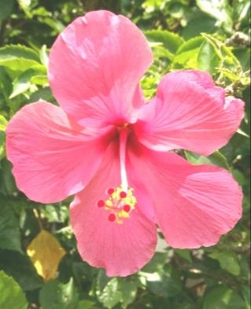
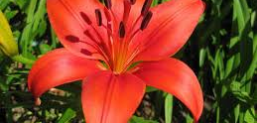
Flower structure
Use the scaffolded notes

Slide 2
Plant phyla

Slide 3
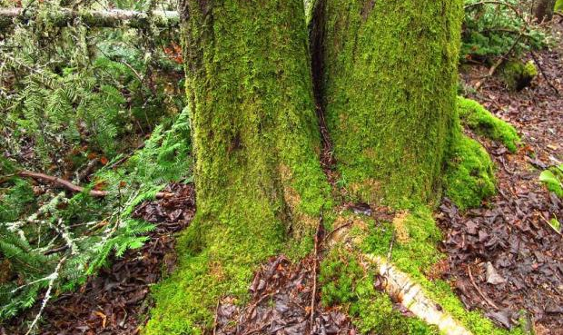
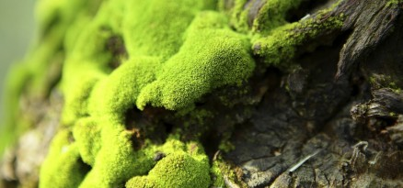
Mosses
Mosses are a phylum of non-vascular plants called Bryophyta. They produce spores to reproduce and do not have true roots.

Slide 4
Ferns
Ferns belong to the phylum Filicinophyta. They are vascular plants and reproduce with spores

Slide 5
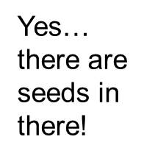
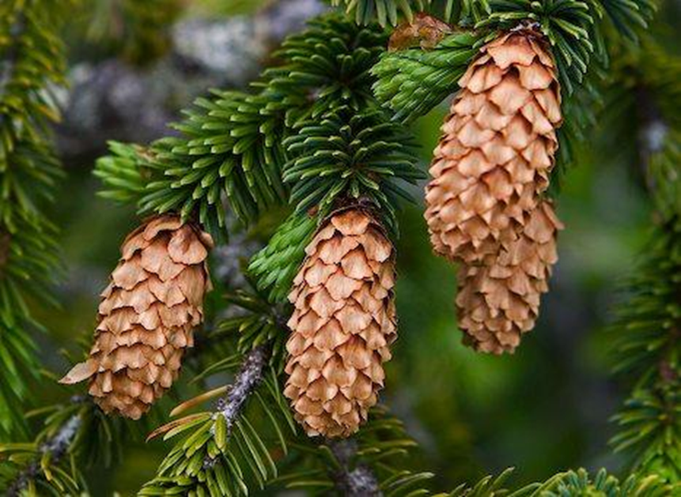
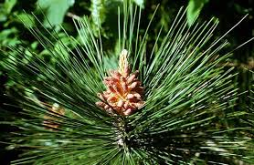
Conifer
Conifers belong to the phylum Coniferophyta and reproduce using cones

Slide 6
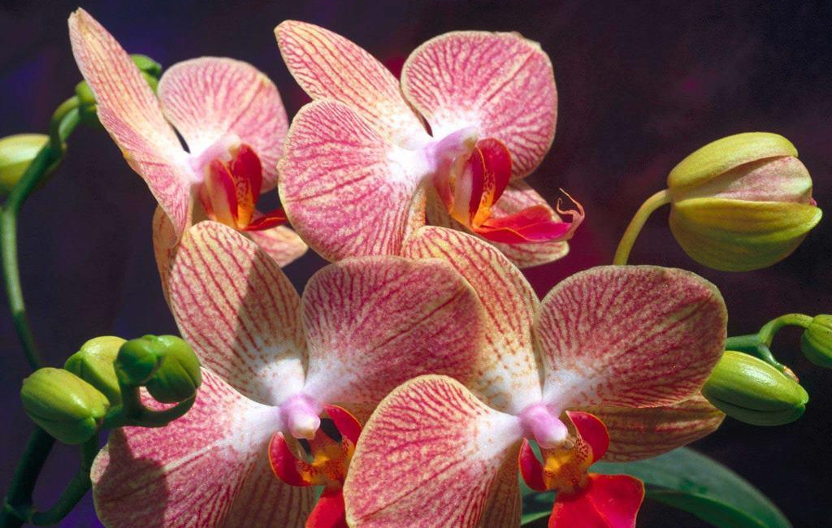
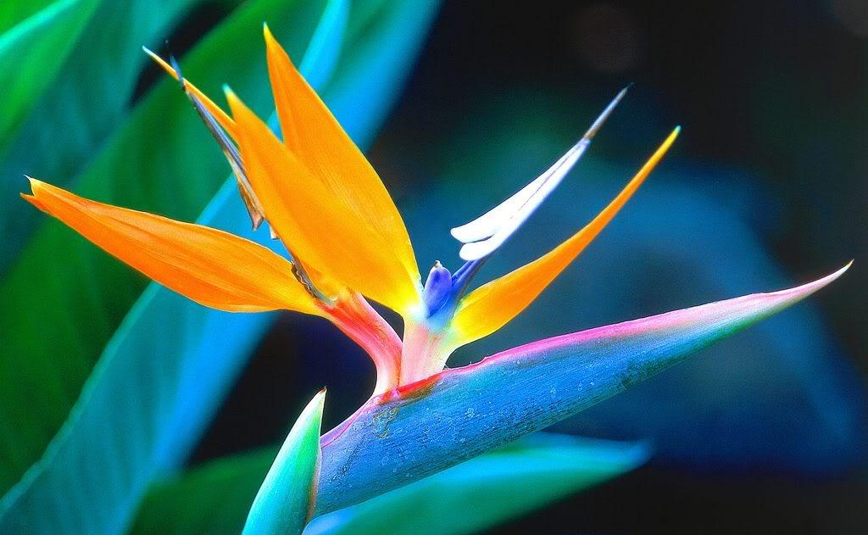
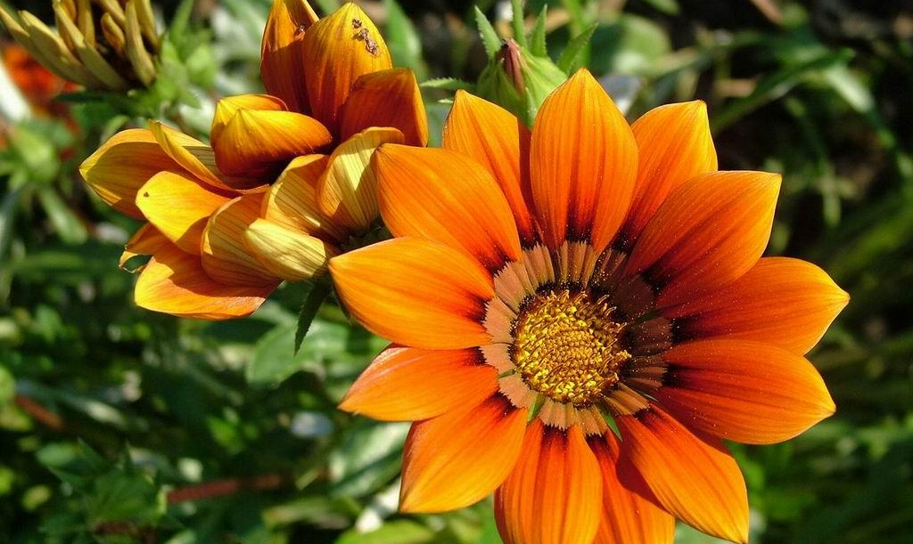
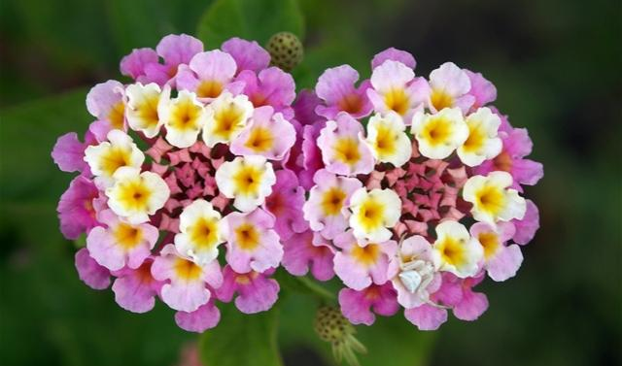
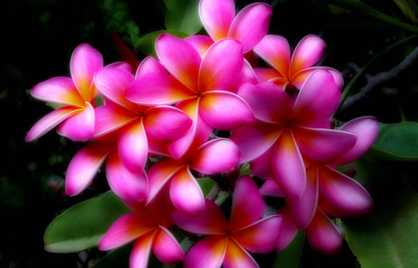
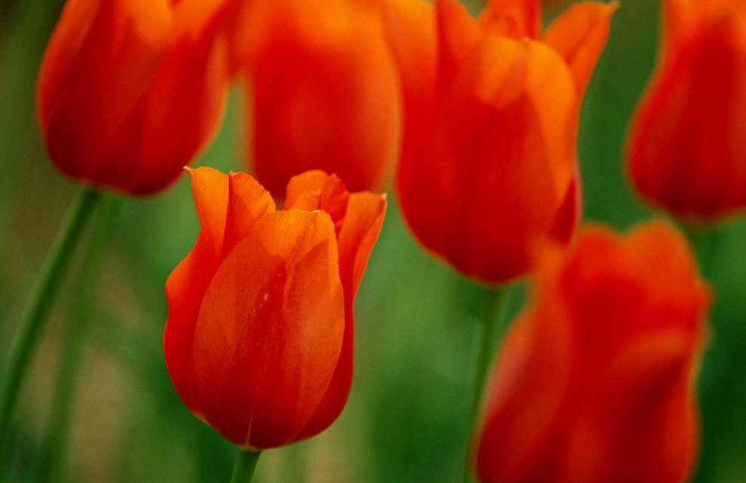
Flowering plants
Some plants reproduce with flowers, These belong to the phylum Angiospermatophyta)

Slide 7
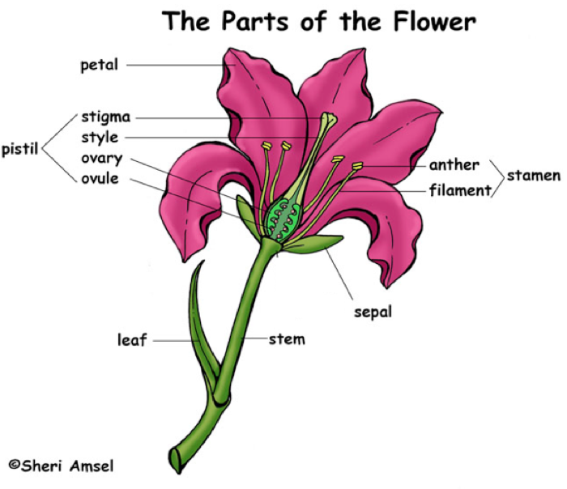
(some flowers)
Nectar gland in base of flower secretes a sugar-rich liquid which attracts pollinating animals

Slide 8
Flower Structure & Function
Male/Female | Structure | Function
- | Petal | Colorful flower structure that attracts pollinators
 | Sepal | Protects the bud (unopened flower)
Pistil (Female parts) | Stigma | Sticky female flower part that collects pollen
 | Style | Connects stigma to ovary
 | Ovary | Produces eggs (eventually develops into the fruit)
 | Ovule | Egg – when pollinated, produces a seed
Stamen (Male Parts) | Anther | Male part of the flower that produces pollen
 | Filament | Supports the anther

Slide 9
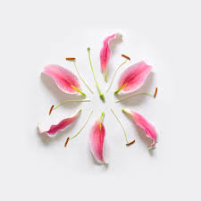
Flower Dissection
Purpose
To study the structure of a typical flower.
To study the male and female reproductive organs needed for sexual reproduction in flowering plants.
Working with a partner, obtain a single flower and observe its parts carefully. Flower parts are arranged in a circular pattern. Each circle is called a whorl. The whorls are attached at the enlarged receptacle located at the base of the flower.
Please read this overview before you begin your flower dissection:
As you examine your flower, you will be carefully removing parts beginning with the outer whorl and working your way in towards the pistil. You will arrange each whorl in a circle on a whiteboard, beginning with the sepals as the largest outermost circle. As you proceed with your dissection, you will place each whorl of flower parts into position on the whiteboard and label them.

Slide 10
Sepals
The sepals form the outermost whorl of the flower. The sepals are leaf-like structures that are usually green in color. Sometimes, the sepals are the same color as the petals, or appear to be another set of petals of a different color.
The function of the sepals is to protect the inner part of the flower
before it blossoms.
Gently remove the sepals, place them into position on the whiteboard, and label them.

Slide 11
2. Petals
The petals are found directly under the sepals. The color and odor of the
petals help to attract birds and insects to the flower for pollination.
Gently remove the petals, place them into position onto the whiteboard, and label them.

Slide 12
3. Stamen
The stalk-like structures inside the petals are the stamens, the male reproductive organs. Depending on the species, the stamens may be attached to the receptacle, to the petals, or to the pistil. The enlarged portion at the top of the stamen is the anther. Inside the anther are pollen sacs, which produce pollen grains. When the pollen grains mature, the pollen sacs split open, releasing the dust like pollen grains. The filament is the thin structure that supports the anther.
Gently remove the stamens, place them into position on the whiteboard, and the component parts.

Slide 13
4. Pistil
The central structure of the flower is the female reproductive organ, the pistil. The top of the pistil is the stigma. When mature the stigma is enlarged, and its surface is moist and sticky. The style is the middle portion of the pistil. It supports the sigma. Some flowers lack a style. The ovary is the enlarged structure at the bottom of the pistil. The ovary contains one or more hollow compartments which contain ovules, which in turn contain the egg nuclei.
Carefully remove the pistil by cutting it from the stem just under the ovary. Place it on the whiteboard and label it.

Slide 14
4. Ovary
Cut the ovary in half and place it under the stigma and style. Label the ovary wall, locules and ovules.

Slide 15
Questions
Please write the answers to the following questions on your whiteboard:
Which does your flower produce in greater numbers: ovules or pollen grains? Explain why this would be important in terms of reproductive success.
What are some adaptations of flower petals to help attract pollinators?
How is the stigma of your flower adapted to capture and hold pollen?
Describe where pollination and fertilization occur.
Explain the differences between pollination and fertilization.
In which part of the male reproductive organ are the pollen grains made?
In which part of the female reproductive organ are the egg cells made?
By which nuclear process are these gametes (pollen and egg) formed?

Slide 16
Control of flowering
Reproductive Structures:
Helps the plant to reproduce, attracts insects etc. Flower produces seeds
Flowers form from…
Apical meristem in the shoot
Vegetative Structures: Help the plant grow and function
Root (water and minerals)
stem (conduction up and down of water and sucrose)
Leaf(photosynthesis to convert light to chemical energy)
Abiotic Factors that Regulate Flowering:
Temperature
Light (our focus)

Slide 17
Photo periods – The period of time, each day a plant receives light; day length
Even a short period of light interrupting the dark can trigger flowering in LDP. This is how farmers can stimulate flowering out of season
Long
day
Long
day
Short day
Short day
Short day
Short day
Require long periods of darkness to flower e.g. Poinsettia S.D.P
Flower when there are short nights (summer)
e.g. Poppies L.D.P

Slide 18
How?
Proteins that absorb a specific wavelength of light
Phytochrome is a pigment within the leaves with two interchangeable forms that each elicit different responses in the plant
Phytochrome Red
Inactive form of phytochrome, formed slowly in the dark
Slowly in the dark
Phytochrome Far Red
Active form of phytochrome formed quickly in the light
Pr Pfr
Rapid in the light

Slide 20
Video Lesson Link
Watch and listen to gain an additional explanation of the control of flowering.
This isn’t necessarily easy stuff… it may take a few times for you to “get it.”
Keep in mind -- FOCUS ON THE BIG IDEA!

Slide 21
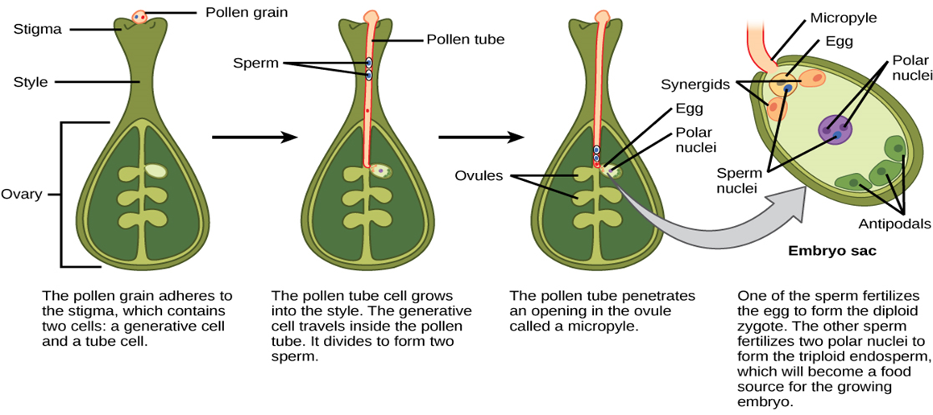
Pollination and fertilization
joining of male (pollen) and female gamete(ovule) to make a zygote
Transfer of pollen to the stigma of flower
Wind
Insects
Bird
Bat

