Slide 1
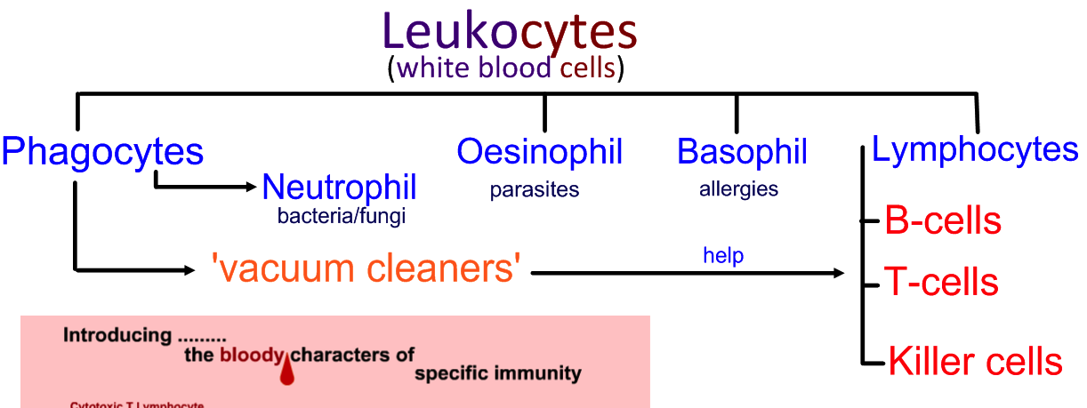
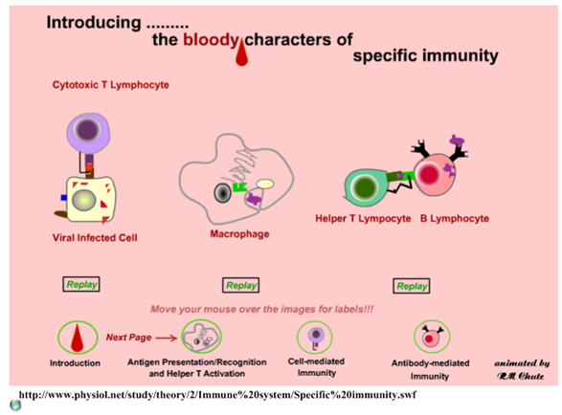
6.3.U5 Ingestion of pathogens by phagocytic white blood cells gives non-specific immunity to diseases.
For this topic you only need to be aware of Phagocytes and Lymphocytes
http://apchute.com/lymphatic/inflam.html

Slide 2
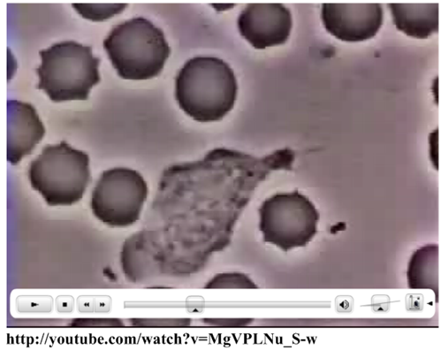
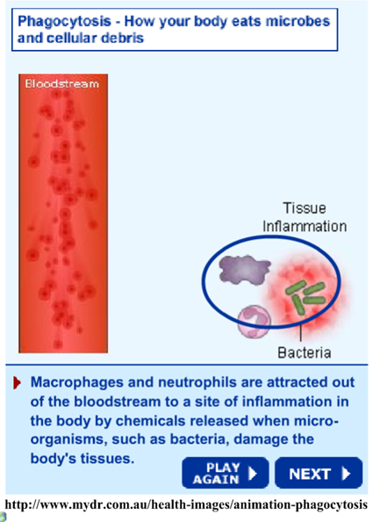
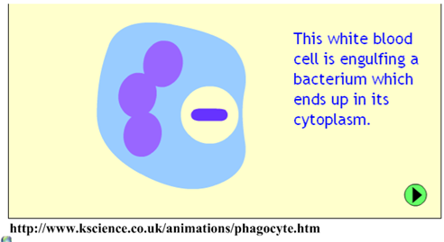
6.3.U5 Ingestion of pathogens by phagocytic white blood cells gives non-specific immunity to diseases.
http://youtube.com/watch?v=MgVPLNu_S-w
http://www.mydr.com.au/health-images/animation-phagocytosis
http://www.kscience.co.uk/animations/phagocyte.htm

Slide 3
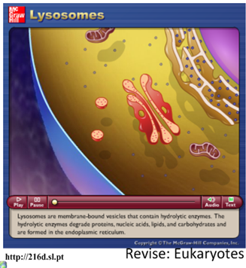
6.3.U5 Ingestion of pathogens by phagocytic white blood cells gives non-specific immunity to diseases.
Phagocytic Leucocytes
“eating cell”
“white blood cells”
Chemotaxis (movement in response to chemicals) attracts the phagocytes to the area of invasion as response to:
proteins produced by the pathogen
phospholipids released by damaged cells
The phagocyte attaches to the pathogen’s cell surface proteins and then engulfs it. The fluid nature of the plasma membrane allows this to happen.
A phagosome forms. This is a vesicle that contains the pathogen. Lysosomes – vesicles of digestive enzymes – deposit the enzymes into the phagosome.
The digestive enzymes break down the pathogen and the waste products are expelled from the cell by exocytosis.
http://216c.sl.pt/
Review opportunity:
Plasma membranes and vesicles
Membrane fluidity and fusion
Endo- and exo-cytosis
http://216d.sl.pt/

Slide 4
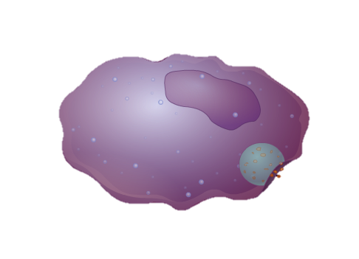
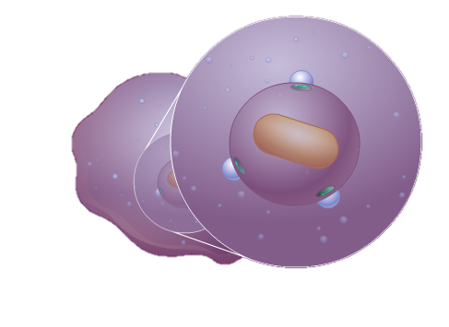
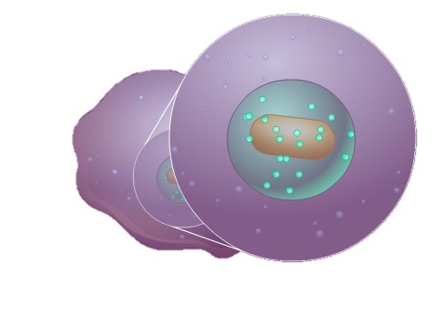
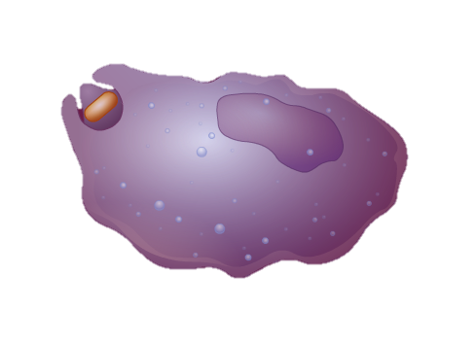
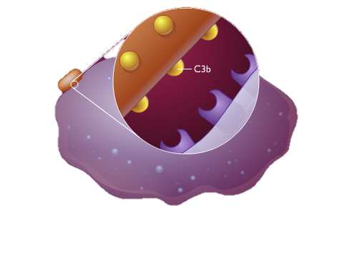
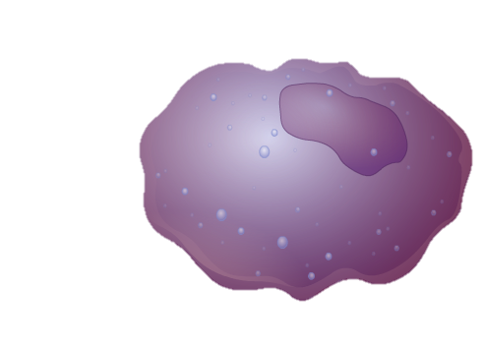
6.3.U5 Ingestion of pathogens by phagocytic white blood cells gives non-specific immunity to diseases.
Phagocytic Leucocytes
card sort game: order the images
& outline the processes
Images from: http://highered.mcgraw-hill.com/sites/0072495855/student_view0/chapter2/animation__phagocytosis.html

Slide 5
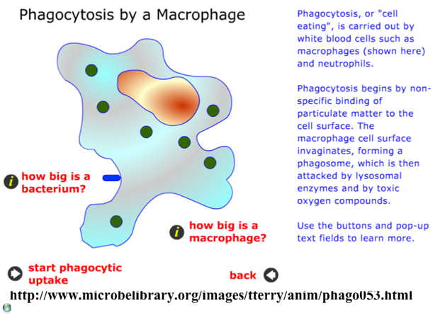
6.3.U5 Ingestion of pathogens by phagocytic white blood cells gives non-specific immunity to diseases.
Phagocytic Leucocytes
Q – can you suggest how phagocytes expelling the digested foreign material benefits humans?
“eating cell”
“white blood cells”
In summary phagocytosis involves a phagocyte:
Detecting and moving towards a foreign material* using chemotaxis
The foreign material is ingested by endocytosis
Lysosomes attach to the ingested vesicle (which encloses the foreign material) and release enzymes into it
The enzymes digest/breakdown the foreign material
The remains of the foreign material are expelled from the phagocyte
*foreign material is commonly a pathogen but can be other things such as dust, dirt, pollen and other allergens
http://www.microbelibrary.org/images/tterry/anim/phago053.html
Edited from: http://www.slideshare.net/gurustip/defense-against-infectious-disease-core-presentation

Slide 6
6.3.U5 Ingestion of pathogens by phagocytic white blood cells gives non-specific immunity to diseases.
Phagocytic Leucocytes
Q – can you suggest how phagocytes expelling the digested foreign material benefits humans?
“eating cell”
“white blood cells”
In summary phagocytosis involves a phagocyte:
Detecting and moving towards a foreign material* using chemotaxis
The foreign material is ingested by endocytosis
Lysosomes attach to the ingested vesicle (which encloses the foreign material) and release enzymes into it
The enzymes digest/breakdown the foreign material
The remains of the foreign material are expelled from the phagocyte
Phagocytes provide the body with a non-specific immune response to any material judged to be foreign. If the response is not enough and infection becomes widespread then lymphocytes, which control the specific immune response, are called into action – this is dealt with next
*foreign material is commonly a pathogen but can be other things such as dust, dirt, pollen and other allergens
http://www.microbelibrary.org/images/tterry/anim/phago053.html
Edited from: http://www.slideshare.net/gurustip/defense-against-infectious-disease-core-presentation

Slide 7
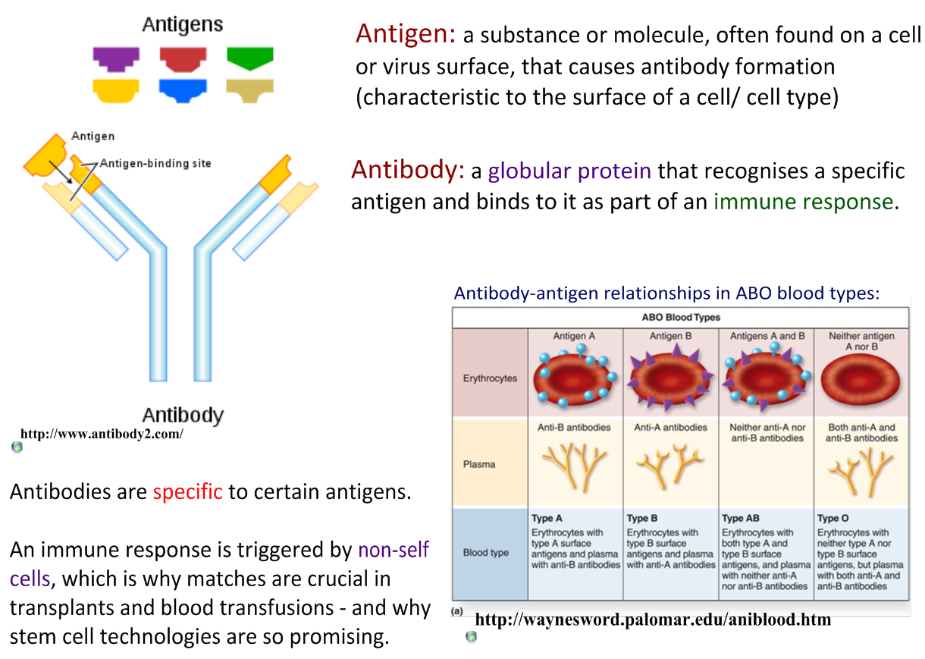
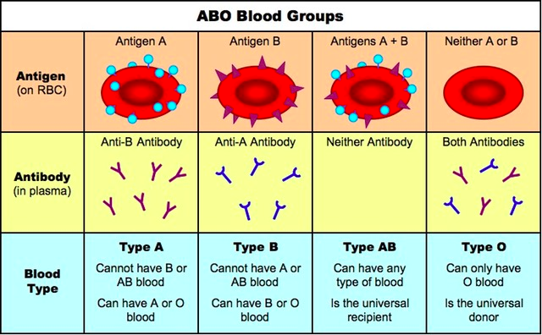
6.3.U6 Production of antibodies by lymphocytes in response to particular pathogens gives specific immunity.
http://www.ib.bioninja.com.au/_Media/abo_blood_groups_med.jpeg
Edited from: http://www.slideshare.net/gurustip/defense-against-infectious-disease-core-presentation

Slide 8
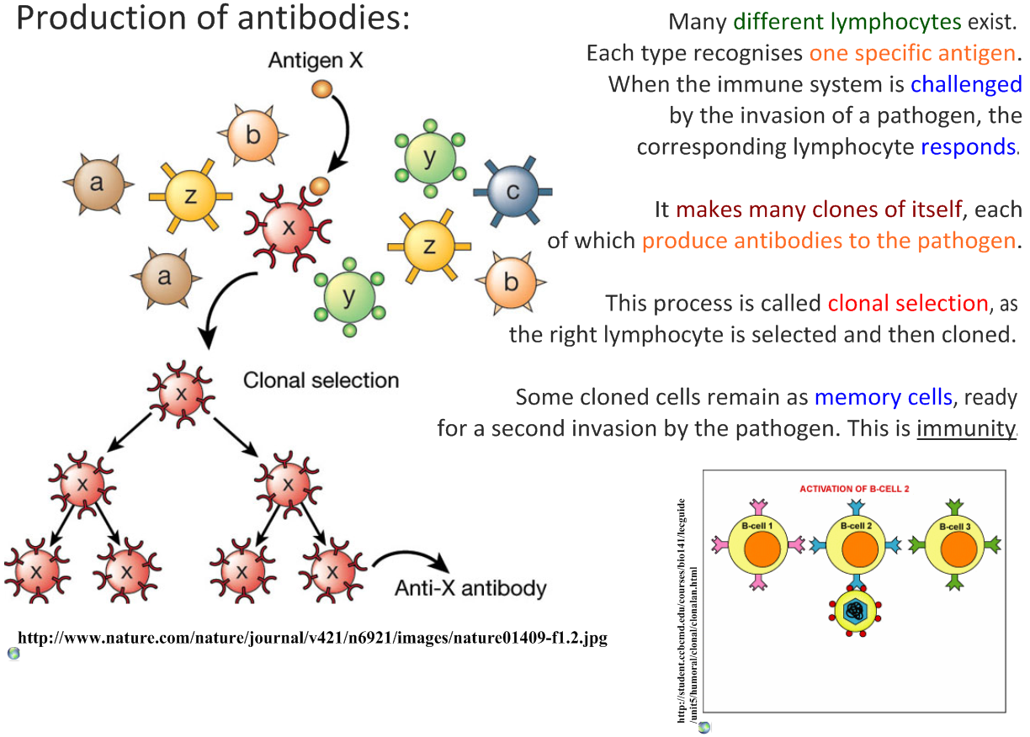
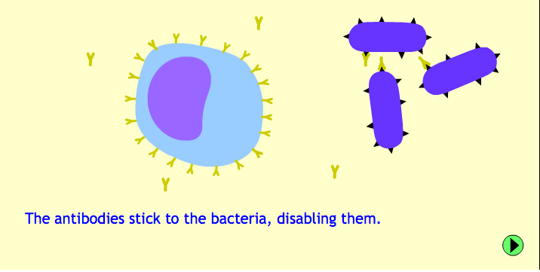
6.3.U6 Production of antibodies by lymphocytes in response to particular pathogens gives specific immunity.
http://www.kscience.co.uk/animations/lymphocyte.htm
Edited from: http://www.slideshare.net/gurustip/defense-against-infectious-disease-core-presentation

Slide 9
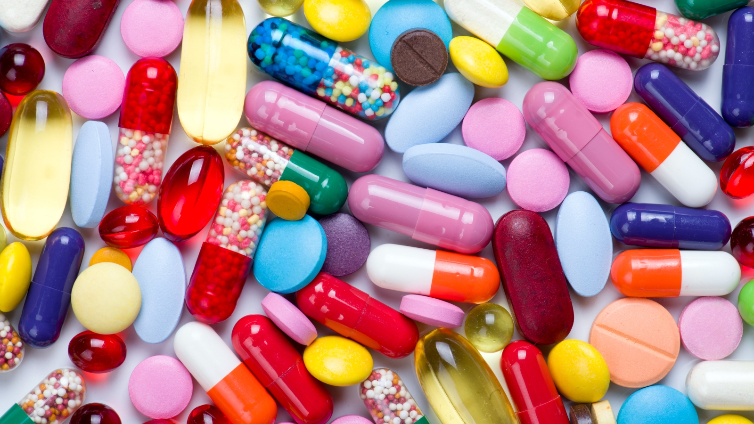
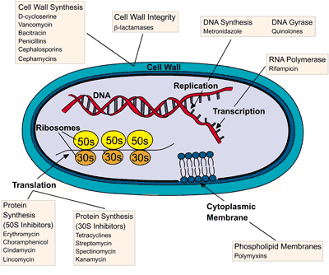
6.5.U7 Antibiotics block processes that occur in prokaryotic cells but not in eukaryotic cells. AND 6.3.U8 Viruses lack a metabolism and cannot therefore be treated with antibiotics.
Antibiotics are drugs used in the treatment and prevention of prokaryotic bacteria
Antibiotics are designed to disrupt structures or metabolic pathways in bacteria and fungi:
cell walls and membranes
Protein synthesis (translation)
DNA/RNA synthesis
Other metabolic processes (e.g. enzyme function)
These do not exist, or are very different, in viruses so antibiotics have no effect upon them.
Eukaryote (e.g. human) cells are also very different in structure and function to prokaryotes. Therefore drugs that inhibit prokaryotes often have little or no effect on eukaryotes
http://edge.alluremedia.com.au/m/l/2015/04/Pills.jpg
http://www.wiley.com/college/pratt/0471393878/instructor/activities/bacterial_drug_resistance/antibiotic_targets_web.gif

Slide 10
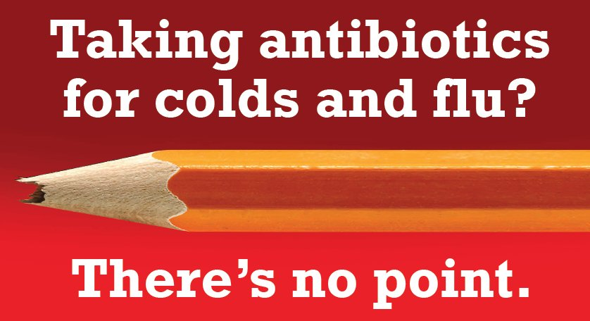
6.3.U8 Viruses lack a metabolism and cannot therefore be treated with antibiotics. Some strains of bacteria have evolved with genes that confer resistance to antibiotics and some strains of bacteria have multiple resistance.
Viruses use the (eukaryotic) host cell metabolism
Viruses are protected by the host cell structure
Viruses have a very different structure to prokaryote, just a protein capsid and genetic material - no cell wall or membrane to attack
http://www.hse.ie/images_upload/portal/eng/services/healthpromotion/AntibioticAwareness/nopoint.jpg

Slide 11
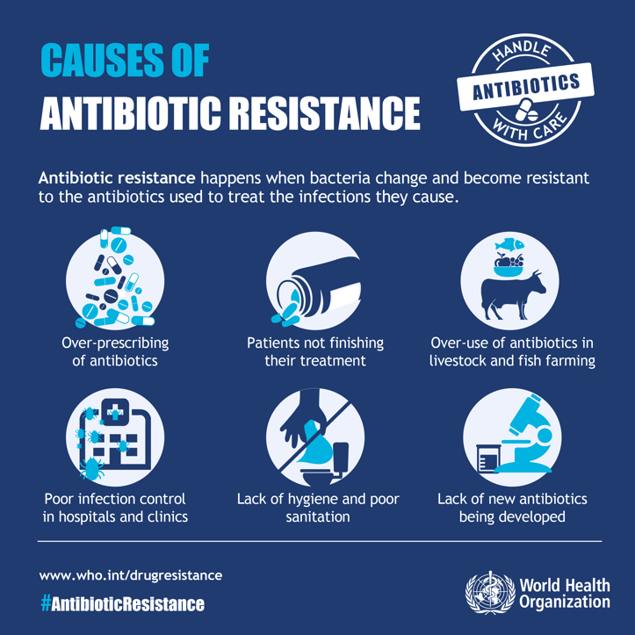
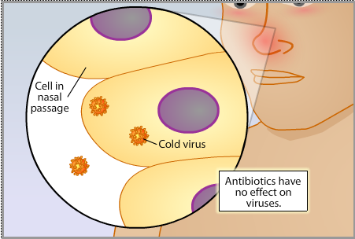
6.3.U8 Viruses lack a metabolism and cannot therefore be treated with antibiotics. Some strains of bacteria have evolved with genes that confer resistance to antibiotics and some strains of bacteria have multiple resistance.
Indiscriminate use of antibiotics is leading to antibiotic resistance in bacteria
An example of evolution by natural selection
Bacteria mutate and resistance to an antibiotic naturally arises
Bacteria divide rapidly therefore a resistant strain of bacteria can quickly proliferate
Over time strains of bacteria can become resistant to multiple strains of bacteria
http://www.sumanasinc.com/scienceinfocus/antibiotics/antibiotics_fla.html
http://outreach.mcb.harvard.edu/animations/resistance7.swf

Slide 12
Review: 5.2.A2 Evolution of antibiotic resistance in bacteria.
http://www.sumanasinc.com/scienceinfocus/antibiotics/antibiotics_fla.html

Slide 13
6.3.U8 Viruses lack a metabolism and cannot therefore be treated with antibiotics. Some strains of bacteria have evolved with genes that confer resistance to antibiotics and some strains of bacteria have multiple resistance.
Do you take antibiotics for granted?
https://iappe.files.wordpress.com/2015/09/1utoyp8uaxogawyqvmjq8_a.jpg
http://www.cdc.gov/drugresistance/images/3-tuberculosis.png

Slide 14
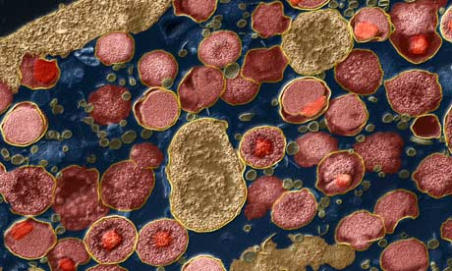
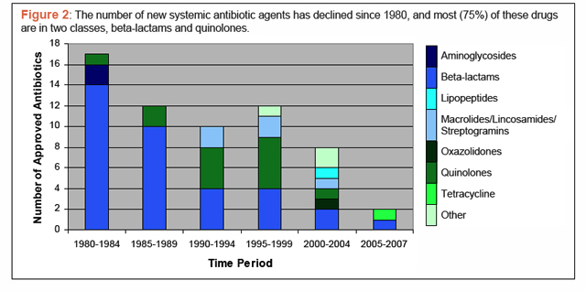
Antibiotics are ineffective against viruses!
Analyse the graph below. Over time, outline what has happened to:
The number of new approved antibiotics
The diversity of new approved antibiotics
Suggest reasons for your answers.
Chlamydia trachomatis bacteria. Are you ready for the end of antibiotics? Guardian: http://gu.com/p/2jxgj
The scariest graph you’ll ever see. Read the article by Maryn McKenna:
http://www.wired.com/wiredscience/2011/02/not-many-antibiotics/

Slide 15
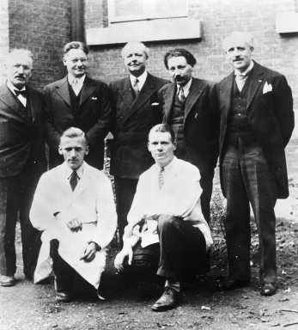
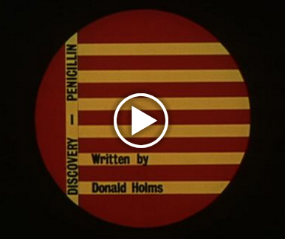
6.3.A2 Florey and Chain’s experiments to test penicillin on bacterial infections in mice. AND Nature of science: Risks associated with scientific research - Florey and Chain’s tests on the safety of penicillin would not be compliant with current protocol on testing. (4.8)
Recap from topic 2:For their work on penicillin Fleming, Florey and Chain were awarded the Nobel prize for medicine in 1945
The discovery of penicillin.
Florey and Chain
http://www.chemheritage.org/
http://www.sciencemuseum.org.uk/hommedia.ashx?id=10271&size=Small
The real story behind penicillin
http://wellcomelibrary.org/player/b16778868#?asi=0&ai=0
http://www.pbs.org/newshour/rundown/the-real-story-behind-the-worlds-first-antibiotic/
An outline of the modern process of drug testing and clinical trials
Years of extensive laboratory research on animals and human cells to determine usefulness, likely dosage and possible side-effects
Assess the safety of the drug and the impact of side-effects on a small group of healthy volunteers – starting with a small dosage which is slowly increased
Test the effectiveness of the drug against a control on a small group of affected volunteers
Randomised and blind testing on a large group of affected volunteers against a placebo and competing drugs
Discuss the ways in which Florey and Chain’s work is in accord with and breaches the modern practices of drug testing.

Slide 16
6.3.A3 Effects of HIV on the immune system and methods of transmission.
What are HIV and AIDS?
Human Immunodeficiency Virus (HIV) gradually attacks the immune system, which is our body’s natural defence against illness. If a person becomes infected with HIV, they will find it harder to fight off infections and diseases.
AIDS is a syndrome caused by HIV. It is when a person’s immune system is too weak to fight off infections, and develops when the HIV is advanced. This is the last stage of HIV where the body can no longer defend itself and may develop various diseases and if left untreated, death.
There is currently no cure for HIV. However, with the right treatment and support, people can live long and healthy lives.
See more at: http://www.avert.org/

Slide 17
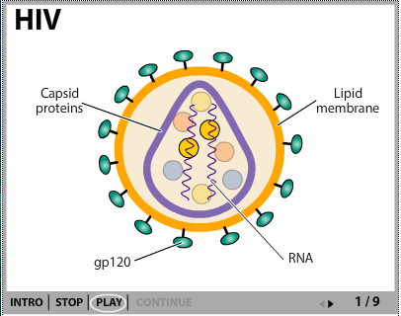
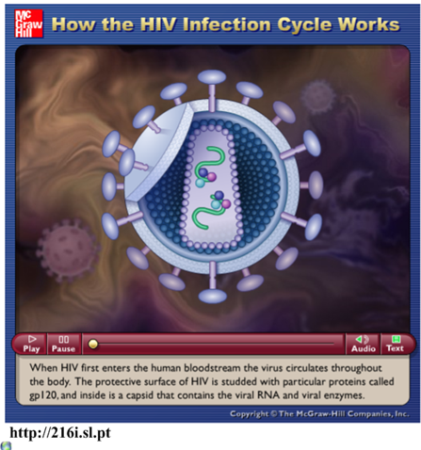
6.3.A3 Effects of HIV on the immune system and methods of transmission.
http://www.sumanasinc.com/webcontent/animations/content/lifecyclehiv.html
http://highered.mheducation.com/sites/0072495855/student_view0/chapter24/animation__how_the_hiv_infection_cycle_works.html

Slide 18
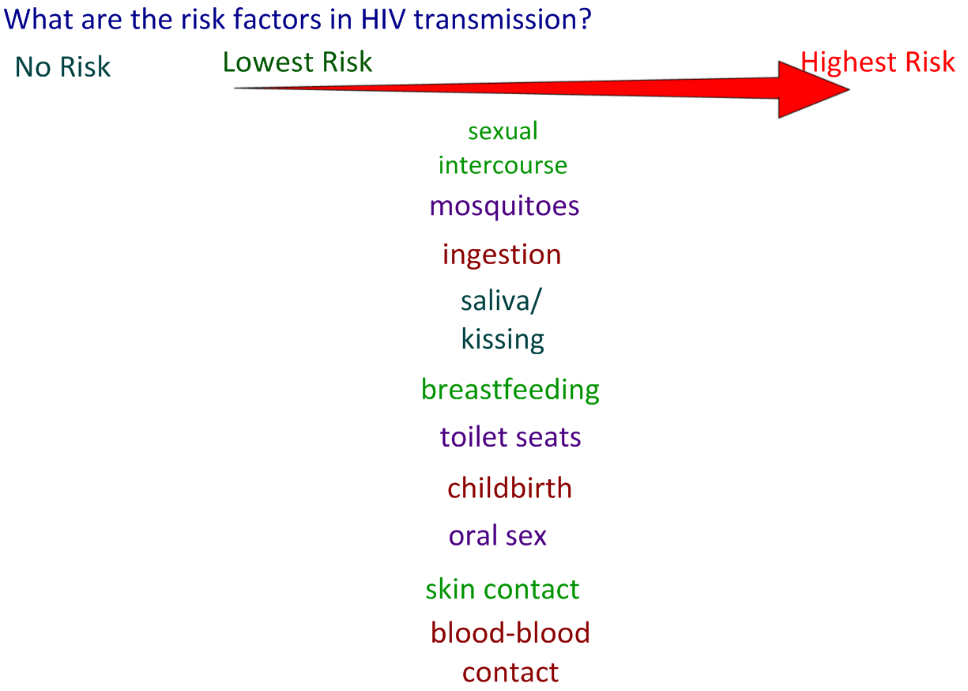
6.3.A3 Effects of HIV on the immune system and methods of transmission.

Slide 19
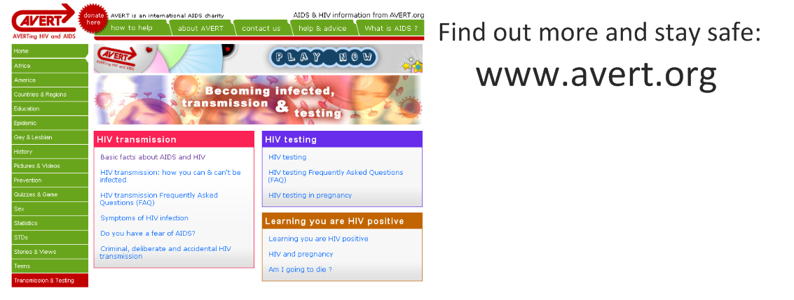
6.3.A3 Effects of HIV on the immune system and methods of transmission.
http://www.avert.org/

Slide 20
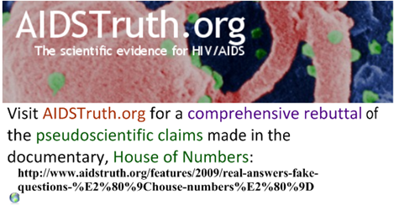
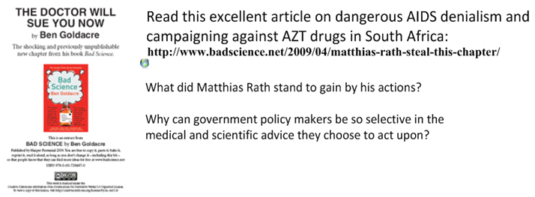
House of numbers: bad science and the popular media
https://www.aidstruth.org/2009/11/26/constantine-and-weiss-pinpoint-misrepresentations/
https://youtu.be/X_N4zgjF0K0
http://www.badscience.net/2009/10/aids-denialism-at-the-spectator/
http://www.badscience.net/2009/04/matthias-rath-steal-this-chapter/

