Slide 1
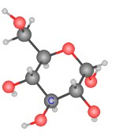
HL Respiration Introduction
Oxidation, reduction, phosphorylation & decarboxylation

Slide 2
Four reactions to know:
. Reaction | Description | Example
Oxidation | Oxygen is added Hydrogen is removed Loss of electrons | Dehydrogenation of alcohol
Reduction | Oxygen is removed Hydrogen is added Gain of electrons | Reduction of NAD⁺ to NADH
Phosphorylation | Phosphate is added | ADP + P_{i} → ATP
Decarbooxylation | Carbon is removed

Slide 3
Oxidation and Reduction
O.I.L
Oxidation is loss of electrons
Oxidation is also adding oxygen
Oxidation is taking away hydrogen
R.I.G.
Reduction is gain of electrons
Reduction is taking away oxygen
Reduction is adding hydrogen

Slide 4
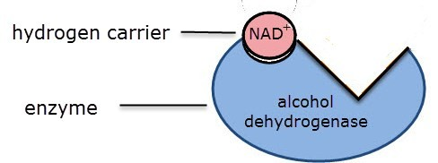
An electron carrier – NAD⁺
NAD⁺ is a “co-enzyme” hydrogen carrier.
It is often involved in enzyme catalysed reactions
e.g. alcohol dehydrogenase

Slide 5
Reduction of NAD +
Explained simply:
NAD⁺ picks up a hydrogen ion and becomes reduced NAD (or NADH)
More fully explained:
NAD+ removes two hydrogen atoms from the molecule being oxidized.
It picks up a H⁻ ion and becomes reduced NAD while another H atom becomes a H⁺ ion which is released into the solution. ( NADH + H⁺)

Slide 6
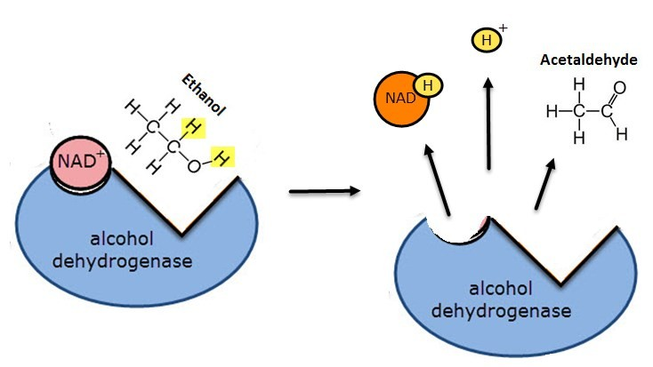
An example of an oxidation-reduction reaction
NAD+ is reduced – it gains Hydrogen. Ethanol is oxidised – it loses hydrogen.

Slide 7
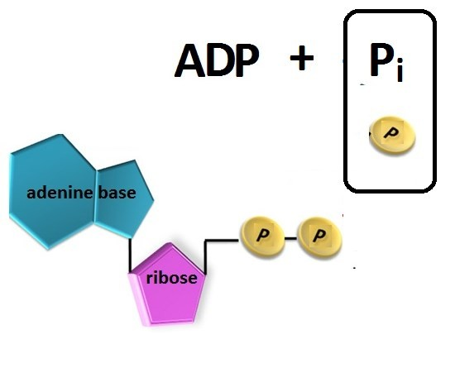
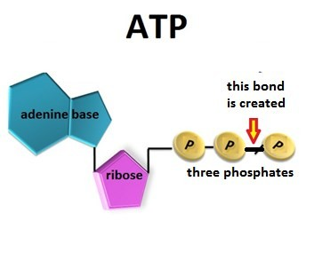
What is Phosphorylation
Phosphorylation is adding phosphate to a molecule.
ADP is phosphorylated to make ATP
Energy from the breakdown of glucose is used to form ATP

Slide 8
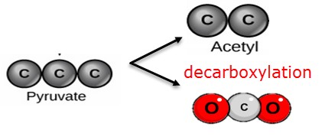
Decarboxylation in Respiration
Decarboxylation is the removal of carbon dioxide from a molecule.
Many steps in the break down of glucose involve decarboxylation. eg. The conversion or pyruvate to acetyl in the link reaction
Glucose → Pyruvate → Acetyl → Carbon Dioxide 6C 3C 2C 1C
Strictly speaking: decarboxylation removes a ‘carboxyl’ group (COOH)
which is replaced by a hydrogen - releasing carbon dioxide (CO₂)

Slide 9
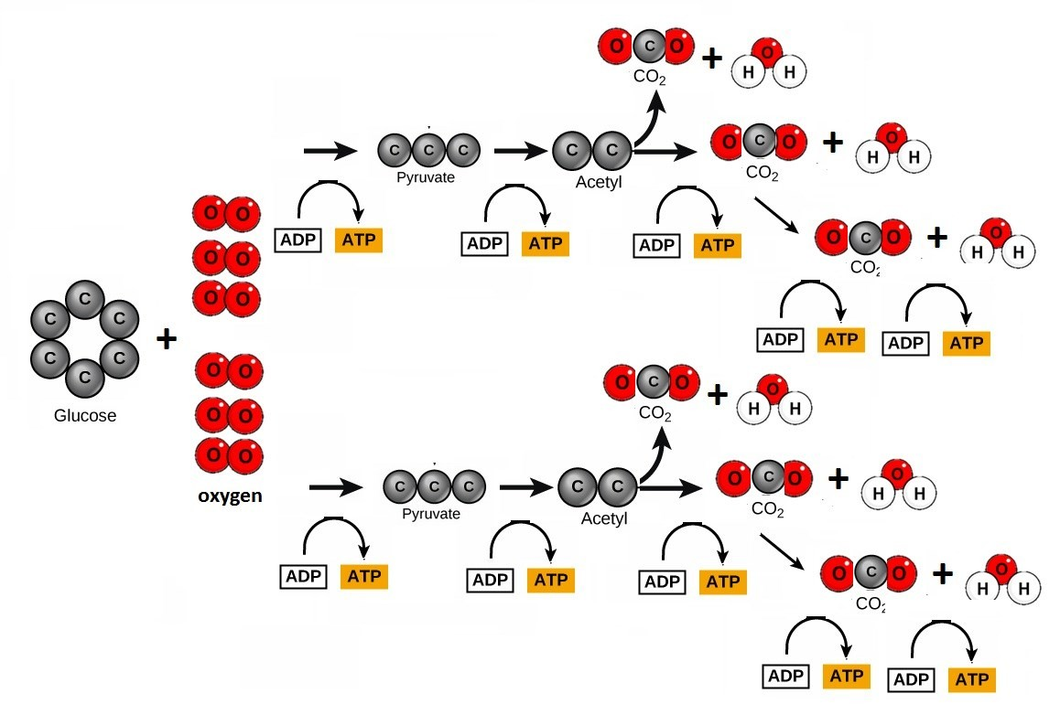
Phosphorylation and decarboxylation in respiration
Oxidation, reduction, phosphorylation and decarboxylation are important types of reaction in respiration

