Slide 1
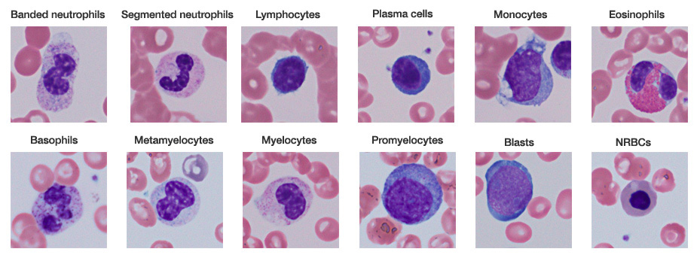
6.3 Defense against infectious disease
Essential idea: The human body has structures and processes that resist the continuous threat of invasion by pathogens.
Leukocytes are very varied in their structure and function. Beyond leukocytes the body has other mechanisms such mucous membranes and barriers, e.g. the skin which help resist the invasion of pathogens.
http://www.tissuegnostics.com/images/hemoquest_software/bloodcellsclases.jpg

Slide 3
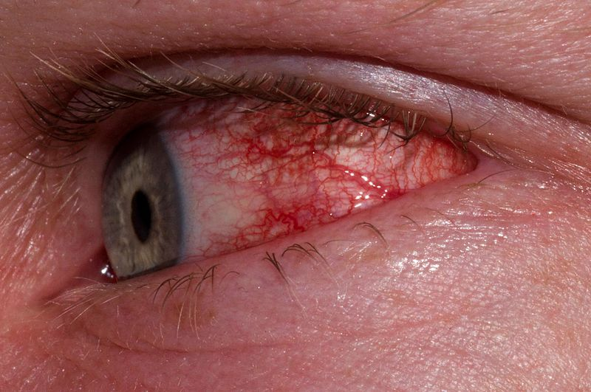
Bacteria
Prokaryotes (no real nucleus)
Divide by binary fission
Can cause:
Food poisoning (e.g. Salmonella)
Ear and eye infections
Cholera, diarrhea
http://en.wikipedia.org/wiki/File:Ericson_Type_II_Conjunctivitis.JPG

Slide 4
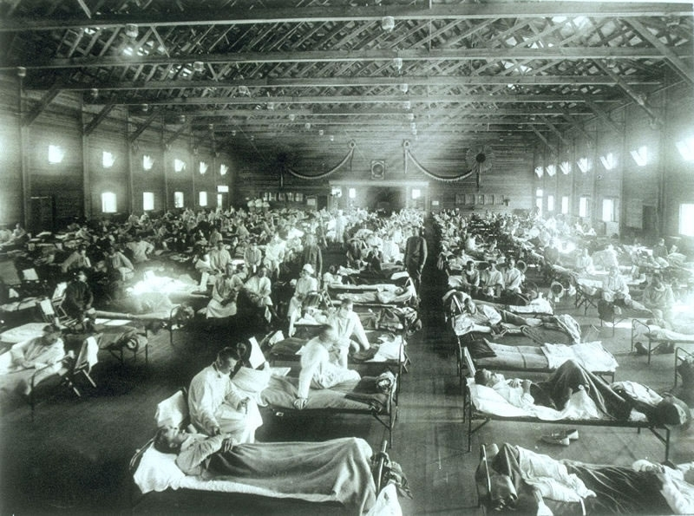
Viruses
Acellular (non-living?)
Need a ‘host’ cell to carry out functions of life, including reproduction
Can have DNA or RNA
Mutate, evolve and recombine quickly
Cause:
Flu, HIV/AIDS, smallpox, measles, common cold, herpes, Ebola
The 1918 flu epidemic killed between 50 and 130 million people. http://en.wikipedia.org/wiki/1918_flu_pandemic

Slide 5
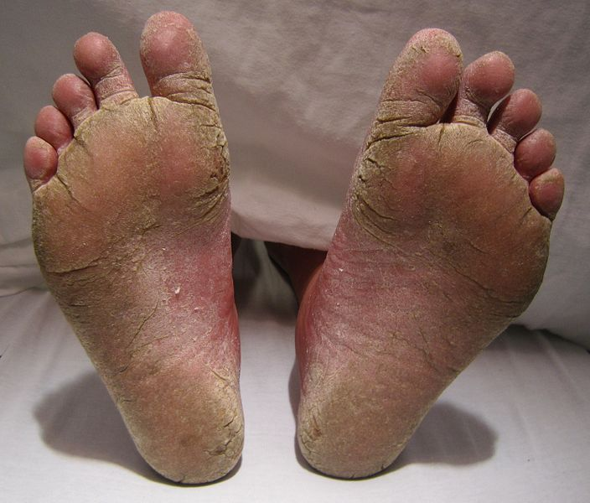
Fungi
Eukaryotes, reproduce with spores
Cause:
Athlete’s foot, mould, ringworm
Allergic reactions and respiratory problems
Image from: http://en.wikipedia.org/wiki/Athlete's_foot

Slide 6
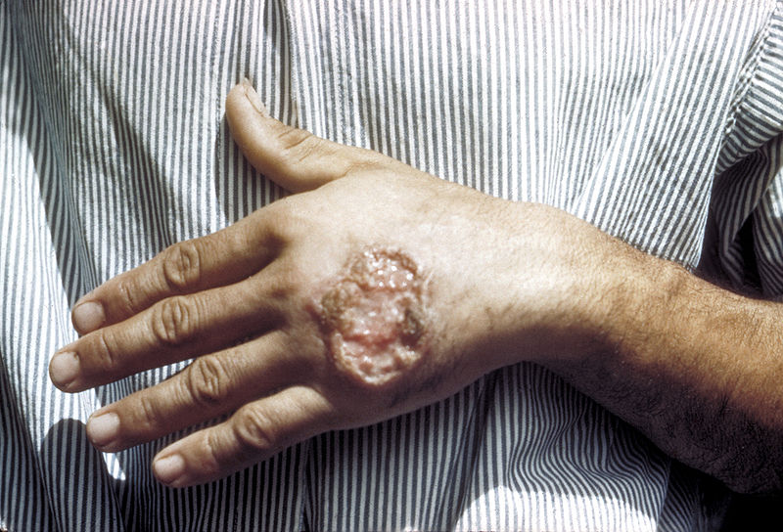
Protozoa
Simple parasites
Cause:
Malaria
Leishmaniasis
Toxoplasmosis
Leishmaniasis image from:
http://en.wikipedia.org/wiki/Leishmaniasis

Slide 8
6.3.U1 The skin and mucous membranes form a primary defence against pathogens that cause infectious disease.

Slide 9
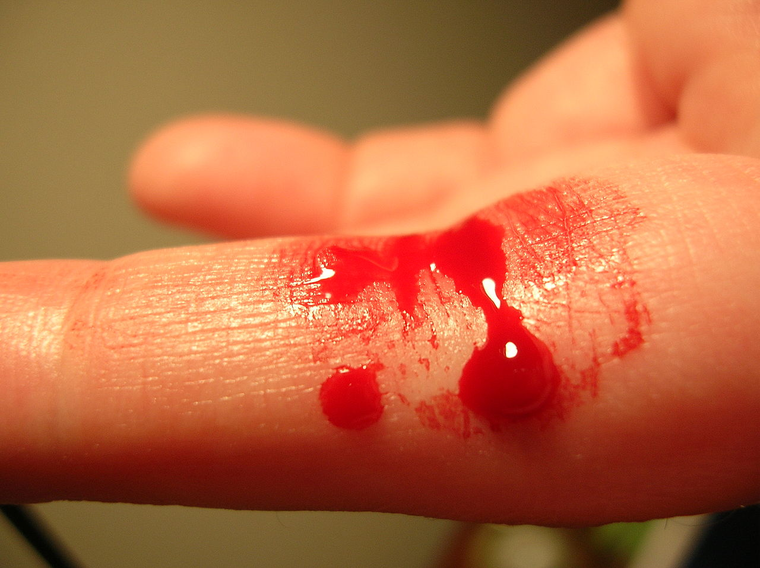
6.3.U2 Cuts in the skin are sealed by blood clotting. AND 6.3.U3 Clotting factors are released from platelets.
Wounds such as cuts to the skin causes opening through which pathogens can potentially enter the body
Blood clots at the site of a wound to prevent blood loss and the entry of pathogens.
Platelets (small cell fragments) along with damaged tissue release clotting factors in response to a wound.
Clotting factors cause a series of reactions which end with fibrin (a protein) fibres forming a mesh across the wound site.
The fibrin fibres capture blood cells and platelets forming a clot. In the presence of air the clot dries to form a scab with shields the healing tissues underneath
https://commons.wikimedia.org/wiki/File:Bleeding_finger.jpg

Slide 10
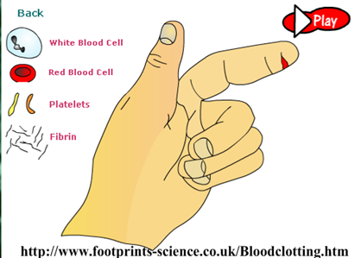
6.3.U4 The cascade results in the rapid conversion of fibrinogen to fibrin by thrombin.
http://www.footprints-science.com/flash/Blood%20clotting.swf

Slide 11
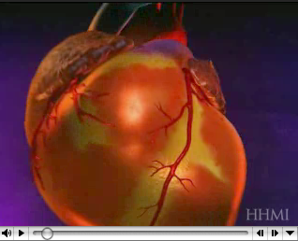
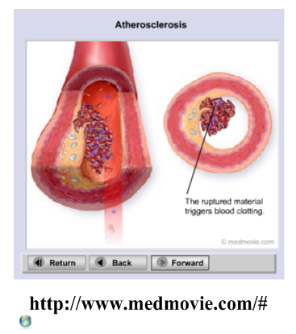
6.3.A1 Causes and consequences of blood clot formation in coronary arteries AND Review: 6.2.A3 Causes and consequences of occlusion of the coronary arteries.
http://www.hhmi.org/biointeractive/obesity/heart_attack.html

Slide 12
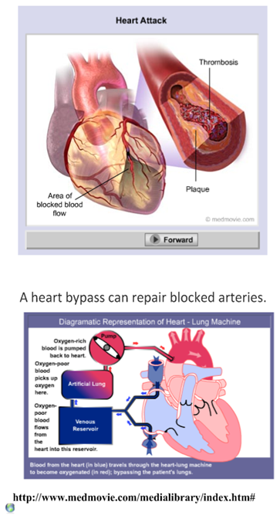
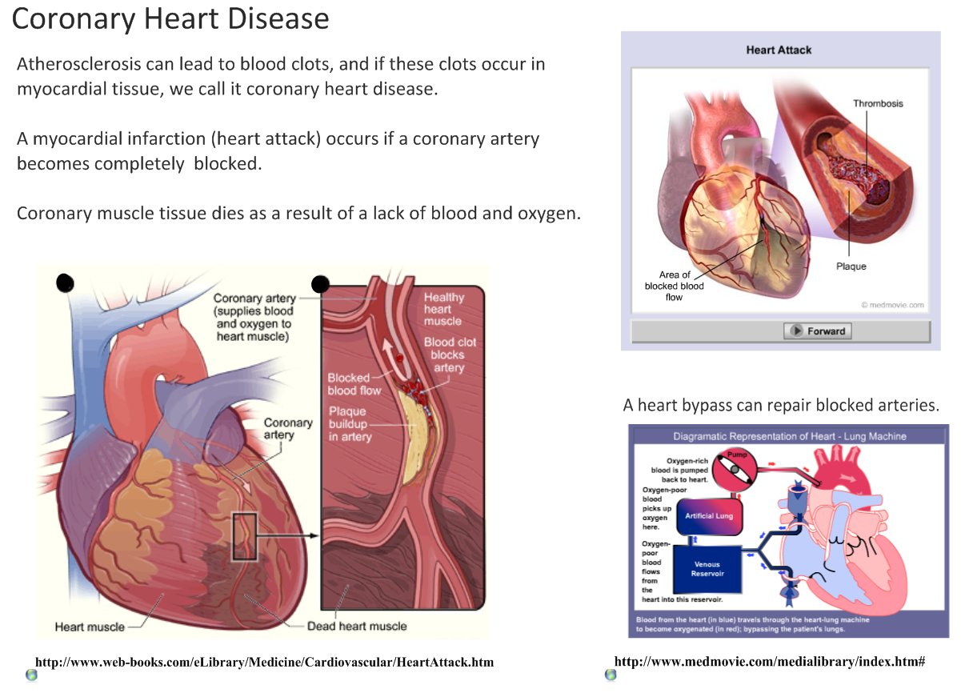
6.3.A1 Causes and consequences of blood clot formation in coronary arteries AND Review: 6.2.A3 Causes and consequences of occlusion of the coronary arteries.

Slide 13
6.3.A1 Causes and consequences of blood clot formation in coronary arteries AND Review: 6.2.A3 Causes and consequences of occlusion of the coronary arteries.

