Slide 1


When the soil is dry or salty and the air has
a high temperature and a low humidity.

Slide 2




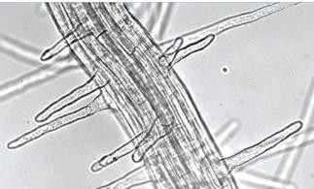
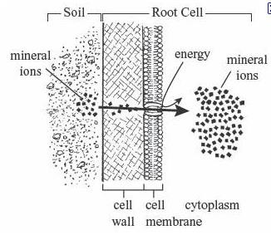
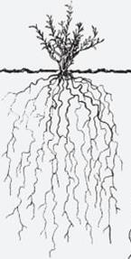
Root hair cells absorb water from the soil by osmosis
They use active transport to increase the concentration of mineral ions in their cells
A large network of roots takes water from the soil

Slide 3


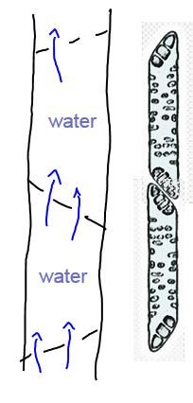
To help the flow of water xylem cells have:
  - no cytoplasm
  - holes in their cell walls
Water movement in xylem is caused by transpiration pull - the evaporation of water in the leaves causes tension in the cells of the leaf and tension in the xylem tubes
Cohesion sticks water together and creates tension in xylem.
Adhesion to the xylem cell walls tends to pull water up the xylem vessel.
Water uptake through osmosis in the roots
pushes water into xylem

Slide 4


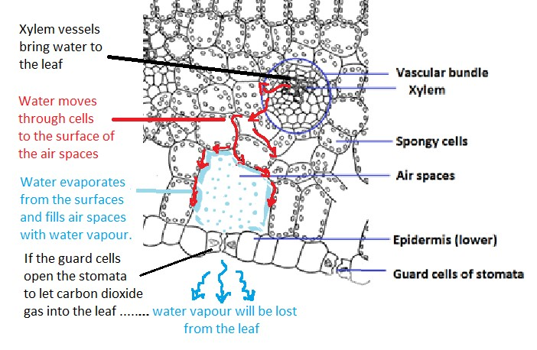

Slide 5





Air Humidity, Temperature, Air movement, Water supply, Light level
Lots of air movement
High temperature
Low air humidity

Slide 6





High air humidity
Humidity,
Temperature,
Air movement,
Water supply, Light level
Low
temperatures
Low wind speeds

Slide 7



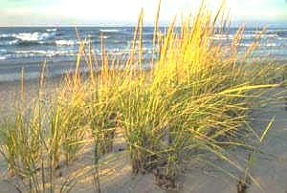
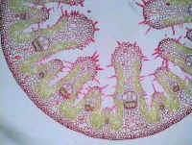
These adaptations all reduce water loss from the plant
Smaller leaves (often needle shaped)
Hairs on leaf (decrease air currents by stomata)
Thick waxy cuticle (makes leaf impermeable)
Fewer stomata (decreases transpiration)
Stomata sunken in pits (reduces exposure to air currents)
Rolled up leaf (creates high humidity inside the rolled leaf and decreases water vapour evaporation.)
Fleshy leaves or stems with water storage cells
Deep root system (to get below water table)
Extensive surface root system (to absorb night time humidity)
Marram grass leaves growing on sand dunes

Slide 8
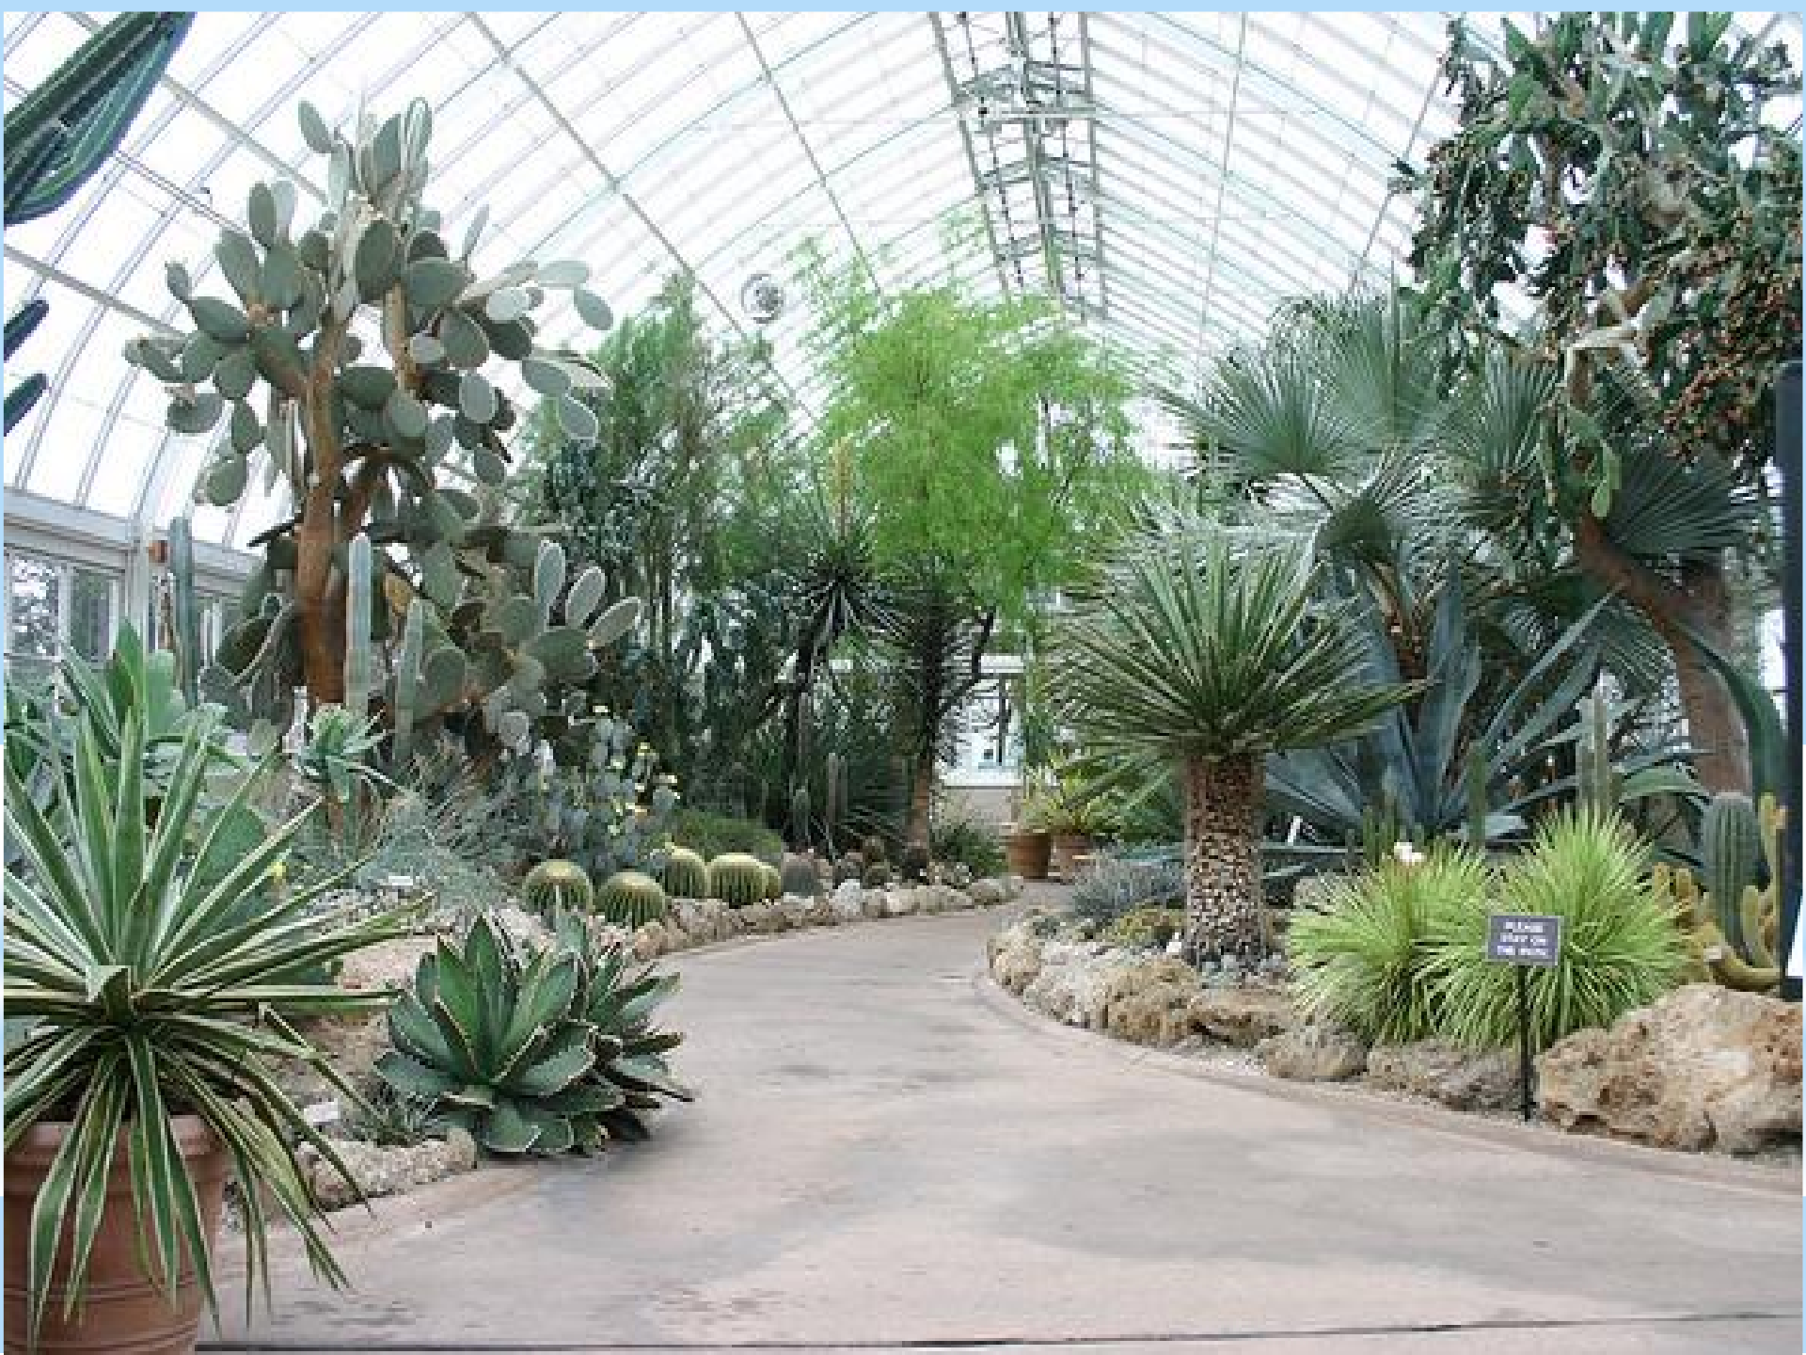



Smaller leaves
Hairs on leaf
Thick waxy cuticle Fewer stomata
Stomata sunken in pits Rolling up the leaf Fleshy leaves or stems Deep root system
Extensive surface root system

Slide 9

Describe the harsh environment found in deserts or on beaches with reference to light, temperature, wind and humidity.
Explain how the abiotic factors in deserts or on beaches affect the rate of transpiration in a typical terrestrial plant.
Name two adaptations of xerophytes and explain
how they reduce transpiration rates?

