Slide 1
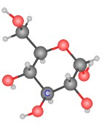
Glycolysis and the Link Reaction
Diagrams and simple explanations

Slide 2
Five stages of respiration to remember
Glycolysis → Link reaction → Krebs cycle →
Electron transport chain → Oxidative phosphorylation

Slide 3
Four glycolysis reactions to know
Reaction | Description | Glycolysis example
Oxidation | Hydrogen is removed | Oxydation of triose phosphate
Reduction | Hydrogen is added | Reduction of NAD⁺ to make NADH
Phosphorylation | Phosphate is added (Phosphate comes from the reaction ATP → ADP + P_{i}) | Phosphorylation of Glucose to make glucose-1,6-bisphosphate
Dephosphorylation | Phosphate is removed | Dephosphorylation of Triose phosphate

Slide 4
Summary of Glycolysis
Two ATP molecules provide the phosphate
Triose
phosphate
Pyruvate
Glucose
Glucose-1,6- bisphosphate
Four ATP molecules are formed during glycolysis.
A net gain of two ATP.

Slide 5
Glycolysis in words
Glycolysis takes place in the cytoplasm.
Glucose is broken down into pyruvate.
Glucose is phosphorylated making it unstable.
Glucose-1,6-bishosphate is broken into two triose phosphate molecules.
Oxidation of triose phosphate removes H⁺
NADH (reduced NAD⁺) is produced.
Triose phosphate is dephosphorylated.
There is a small net yield of ATP (2 molecules) without use of oxygen.

Slide 6
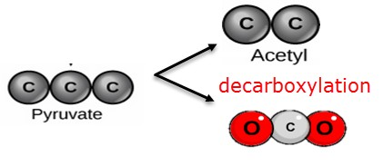
Decarboxylation in the link reaction
Decarboxylation is the removal of carbon dioxide from a molecule.
Many steps in the break down of glucose involve decarboxylation. eg. The conversion or pyruvate to acetyl in the link reaction
Glucose → Pyruvate → Acetyl + Carbon Dioxide 6C 3C 2C 1C
Strictly speaking: decarboxylation removes a ‘carboxyl’ group (COOH)
which is replaced by a hydrogen - releasing carbon dioxide (CO₂)

Slide 7
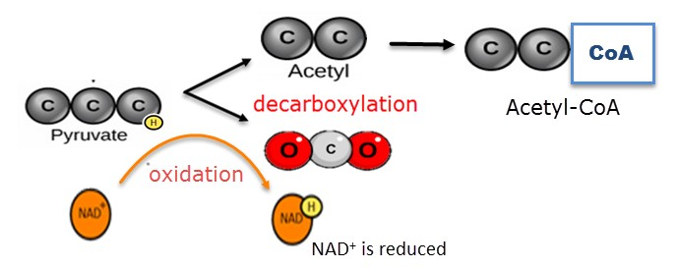
Summary of the Link Reaction
Pyruvate is oxidised, decarboxylated and attached to co-enzyme A

Slide 8
and in words….
In aerobic respiration the link reaction follows glycolysis. Pyruvate is converted into acetyl-CoA in the link reaction. Acetyl-CoA enters the Krebs cycle in the mitochondria.
Pyruvate is decarboxylated and oxidized. NAD+ is reduced forming NADH
One molecule of CO₂ is produced
The acetyl compound is attached to coenzyme A to form acetyl coenzyme A (acetyl-CoA)

Slide 9
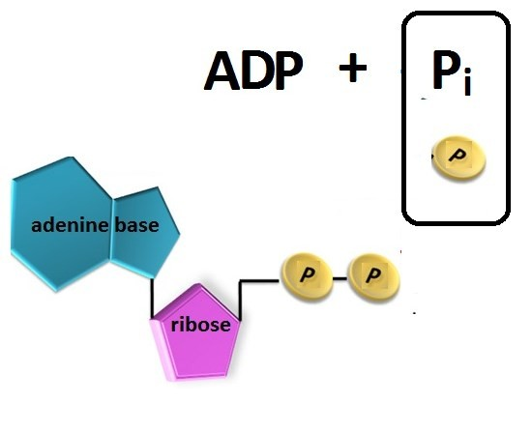
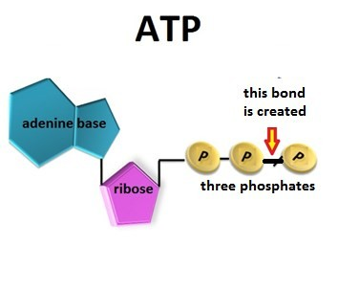
What is Phosphorylation
Phosphorylation is adding phosphate to a molecule.
ADP is phosphorylated to make ATP
Energy from the breakdown of glucose is used to form ATP

Slide 10
Reduction of NAD+
Explained simply:
NAD+ picks up a hydrogen ion and becomes reduced NAD (or NADH)
More fully explained:
NAD+ removes two hydrogen atoms from the molecule being oxidized.
It picks up a H⁻ ion and becomes reduced NAD while another H atom becomes a H⁺ ion which is released into the solution. ( NADH + H⁺)

