Slide 1
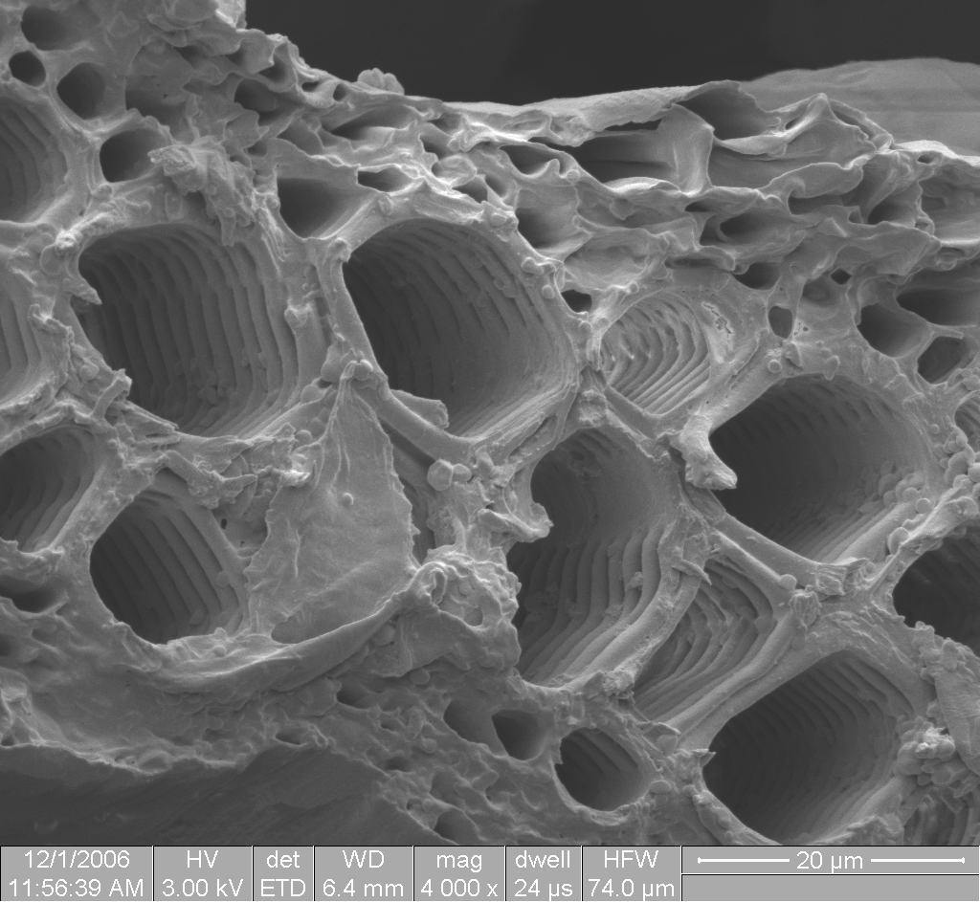
9.1 Transport in the xylem of plants AHL
Essential idea: structure and function are correlated in the xylem of plants.
One of the key structural features of xylem is the rings of lignin (seen in the lower power scanning EM image). The lignified walls of xylem help them to withstand the very low pressure inside the xylem which drives the transpiration pull.
http://www.nsf.gov/news/mmg/media/images/Sel-lower1_70363.jpg

Slide 2
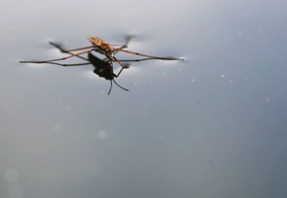
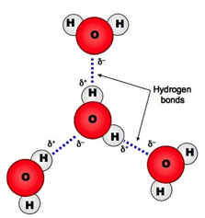
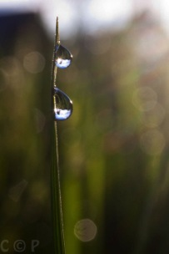
Review 2.2.U2 Hydrogen bonding and dipolarity explain the cohesive, adhesive, thermal and solvent properties of water.
Nature of science:
Use theories to explain natural phenomena—the theory that hydrogen bonds form between water molecules explains the properties of water. (2.2)
Cohesion:
This property occurs as a result of the polarity of a water molecule and its ability to form hydrogen bonds
Although hydrogen bonds are weak the large number of bonds present (each water molecule bonds to four others in a tetrahedral arrangement) gives cohesive forces great strength
Water molecules are strongly cohesive (they tend to stick to one another)
Surface tension is caused by the cohesive hydrogen bonding resisting an object trying to penetrate the surface.
Water droplets form because the cohesive forces are trying to pull the water into the smallest possible volume, a sphere.
n.b. capillary action involves cohesion and adhesion and so dealt with under adhesion.
http://ib.bioninja.com.au/standard-level/topic-3-chemicals-of-life/31-chemical-elements-and.html

Slide 3
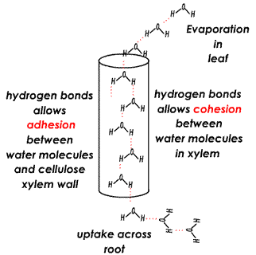
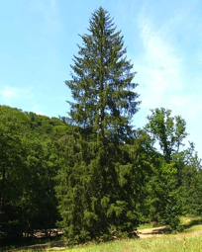
Review 2.2.U2 Hydrogen bonding and dipolarity explain the cohesive, adhesive, thermal and solvent properties of water.
Adhesion:
This property occurs as a result of the polarity of a water molecule and its ability to form hydrogen bonds
Water molecules tend to stick to other molecules that are charged or polar for similar reasons that they stick to each other
Again similarly individual hydrogen bonds are weak, but large number of bonds gives adhesive forces great strength
Water droplets stick to surface and seem to defy gravity because of form because the adhesive forces that bond them to the surface of the grass blade.
Capillary action is caused by the combination of adhesive forces causing water to bond to a surface, e.g. the sides of a xylem vessel and the cohesive forces bonding water molecules together. Capillary action is helpful in the movement of water during transpiration and also when you drink using a straw.
http://click4biology.info/c4b/9/plant9.2.htm
http://commons.wikimedia.org/wiki/File:GemeineFichte.jpg

Slide 4
9.1.U2 Plants transport water from the roots to the leaves to replace losses from transpiration. AND 9.1.U3 The cohesive property of water and the structure of the xylem vessels allow transport under tension.

Slide 5
9.1.U2 Plants transport water from the roots to the leaves to replace losses from transpiration. AND 9.1.U3 The cohesive property of water and the structure of the xylem vessels allow transport under tension.
http://www.biology.ualberta.ca/facilities/multimedia/uploads/alberta/transport.swf
This attraction allows water ‘stick’ to the xylem vessel and hence move upwards.

Slide 6
9.1.U4 The adhesive property of water and evaporation generate tension forces in leaf cell walls.
In Summary:
The loss of water from the top of xylem vessels due to evaporation lowers the pressure inside the vessel and pulls more water into the vessel due to cohesion
Adhesion attracts water molecules to the walls of xylem and vice versa.
Therefore as the water moving upwards (similarly to cohesion) it pulls inward on the walls of the xylem vessels generating tension - try sucking on a straw when the bottom end is closed.
Edited from: http://www.slideshare.net/gurustip/transport-in-angiospermophytes

Slide 7
9.1.U1 Transpiration is the inevitable consequence of gas exchange in the leaf.
http://passel.unl.edu/pages/animation.php?a=transpiration.swf&b=1094667161

Slide 8
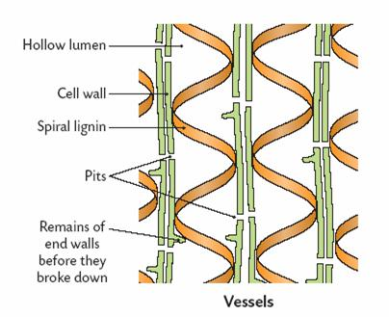
9.1.U3 The cohesive property of water and the structure of the xylem vessels allow transport under tension.
Xylem cells contain no cytoplasm this provides a larger lumen making water transport more efficient. However because the cells are are non-living water transport must be a passive process.
Cell walls are thickened to make them stronger
Wall are impregnated with lignin*. Lignin may be deposited in different ways, such as spirals or rings.
Strengthened xylem walls can withstand very low internal pressures without collapsing.
Xylem cells are arranged end to end to form continuous vessels. The reduction of the walls between cells in a vessel makes it easier for water to move between cells
Can you suggest a function of the pits in the cell walls?
*Lignin is a complex fibrous organic polymer which is strong and rigid. It makes plant stems woody.
http://www.nsf.gov/news/mmg/media/images/Sel-lower1_70363.jpg

Slide 9
9.1.S1 Drawing the structure of primary xylem vessels in sections of stems based on microscope images.
In a cross section (transverse section, TS) of a stem each vascular bundle consists of large xylem vessels toward the inside and smaller phloem cells toward the outside. Xylem vessels can be identified by their large empty lumens and the thickened cell walls.
n.b. Some plant stems, such as monocotyledons, do not possess a cambium and so it is not easy to distinguish between the cortex and pith (both are usually labeled together). In these stems the vascular bundles are not arranged in a ring.
Edited from: http://www.slideshare.net/gurustip/transport-in-angiospermophytes

Slide 10
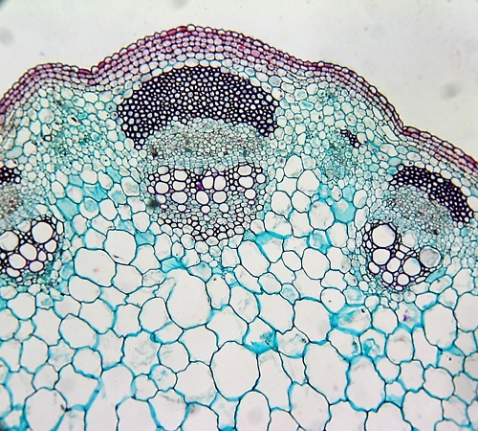
9.1.S1 Drawing the structure of primary xylem vessels in sections of stems based on microscope images.
Task: draw tissue diagrams of the light micrograph and label the different tissues you can identify.
Species unknown
http://plantphys.info/plant_physiology/images/stemvb.jpg

Slide 11
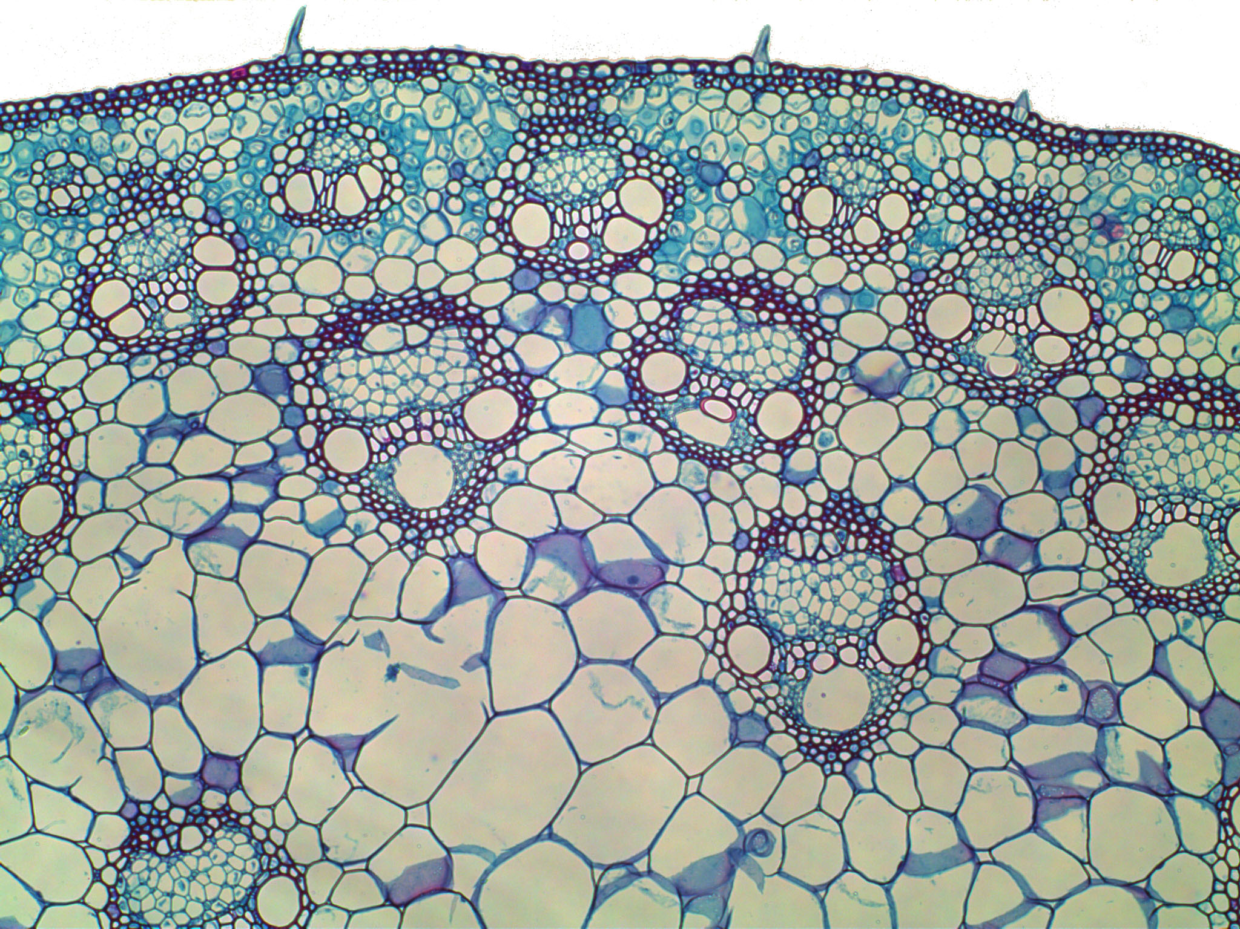
9.1.S1 Drawing the structure of primary xylem vessels in sections of stems based on microscope images.
Task: draw tissue diagrams of the light micrograph and label the different tissues you can identify.
Zea mays (Corn) stem
http://emp.byui.edu/wellerg/Roots%20and%20Shoots%20Lab/Images/Zea%20Mays%20Stem%20P.jpg

Slide 12
9.1.A1 Adaptations of plants in deserts and in saline soils for water conservation.

Slide 13
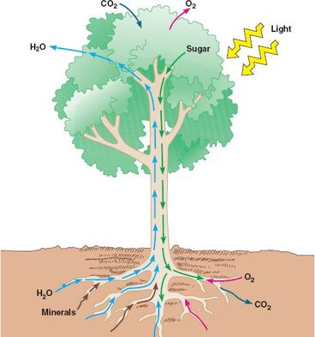
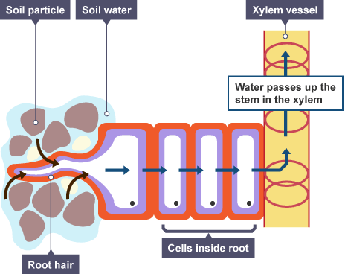
9.1.U5 Active uptake of mineral ions in the roots causes absorption of water by osmosis.
Water enters the root hair cells by osmosis
For osmosis to occur there must be a higher concentration of solutes, e.g. mineral ions inside the cell than in the soil water surrounding the roots.
A high concentration of solutes means a there is a low concentration of water in the root hair cells compared to the soil water.
Therefore water moves down the concentration gradient and enters the root hair cells.
Higher water concentration
Lower water concentration
Plants take up water and essential minerals via their roots and thus need a large surface area in order to optimise this uptake.
The root epidermis may have extensions called root hairs which increase surface area for mineral and water absorption
http://www.bbc.co.uk/staticarchive/441a940349a662c2e000ee46215e29024262e92c.gif
http://rajkumarbiology.weebly.com/uploads/9/6/4/2/9642700/431153986.jpg?368

Slide 14
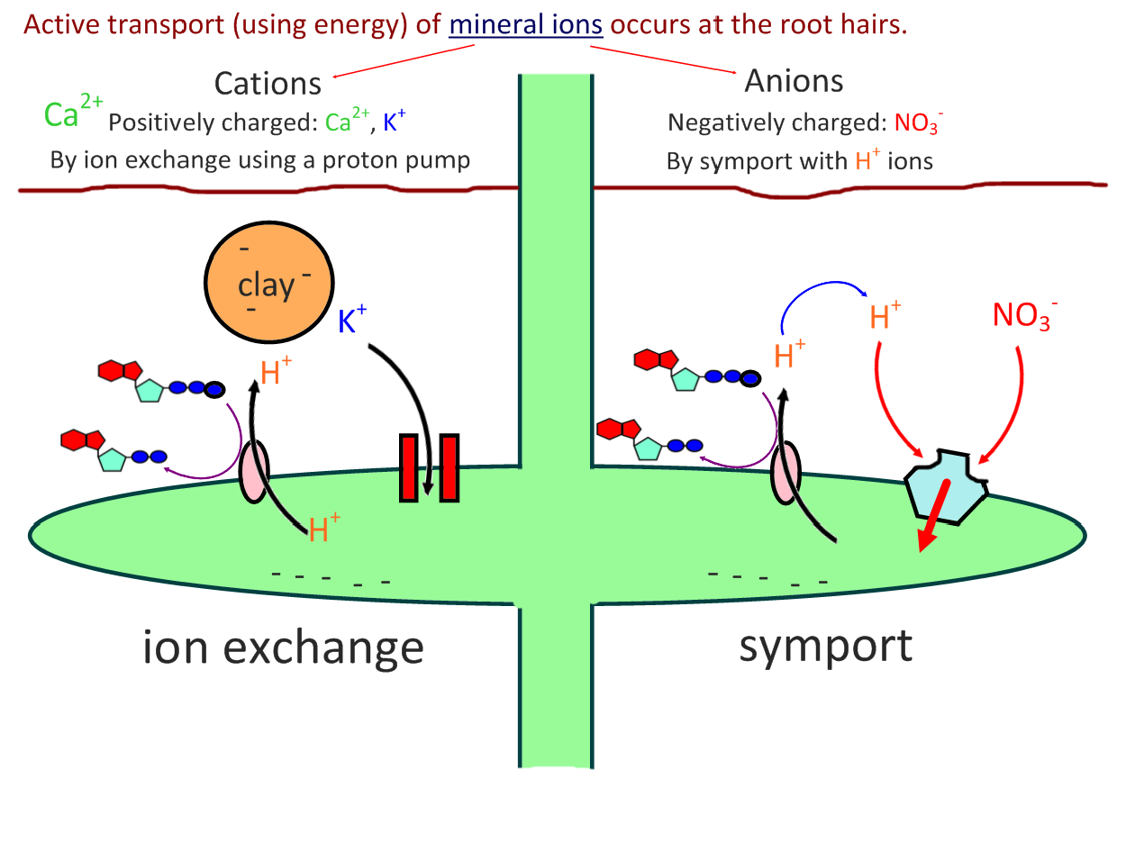
9.1.U5 Active uptake of mineral ions in the roots causes absorption of water by osmosis.
The use of ATP means that cell must respire (aerobically) to carry out active transport.
Active uptake of mineral ions results in a higher concentration of minerals in plants than in the surrounding soil

Slide 15
9.1.U5 Active uptake of mineral ions in the roots causes absorption of water by osmosis.
The use of ATP means that cell must respire (aerobically) to carry out active transport.
You should not need to know the detailed process by which plant cells acquire mineral ions.
Active uptake of mineral ions results in a higher concentration of minerals in plants than in the surrounding soil

Slide 16
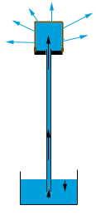
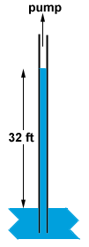
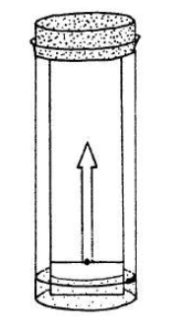
9.1.A2 Models of water transport in xylem using simple apparatus including blotting or filter paper, porous pots and capillary tubing.
Modelling water transport
Setup each model to see it working. For each model discuss both how it models water transport in plants and what its limitations as a model are; when does it cease to be a good representation?
Water evaporates from the surface of the porous pot
Nature of Science: Use models as representations of the real world- mechanisms involved in water transport in the xylem can be investigated using apparatus and materials that show similarities in structure to plant tissues. (1.10)
Water is lost from the trough as water moves up the tube to replace water lost from the pot
Place a capillary tube in water and the water moves up the tube - the thinner the tube the higher the water rises.
Place the end of a strip of filter paper in water and the water will gradually move up the paper. What material is paper made from?
10m
For the porous pot to work there must be an airtight seal between the porous pot and the tube. Additionally allow an air bubble to enter the tube to see water movement more clearly.

Slide 17
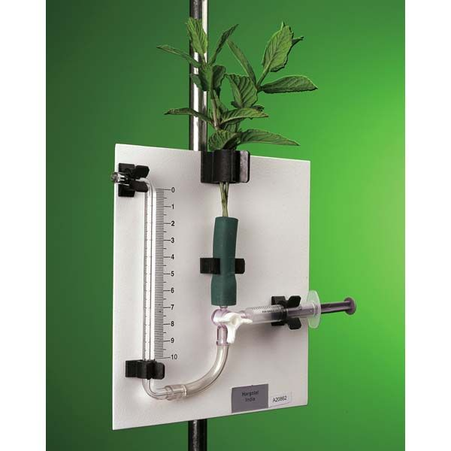
9.1.S2 Measurement of transpiration rates using potometers. (Practical 7) AND 9.1.S3 Design of an experiment to test hypotheses about the effect of temperature or humidity on transpiration rates.
Design of an experiment to test hypotheses about the effect of temperature or humidity on transpiration rates.
Potometers vary in design, but all measure transpiration indirectly by looking at the water uptake.
Independent variable: will it be temperature or humidity? How will this be varied and what range of values will you use?
As transpiration occurs a bubble of air moves into the tube and towards the plant (to replace the volume of water transpired).
control variables: What factors could affects the investigation and hence need to be kept constant?
Dependent variable: detail how you will measure transpiration in order that you can calculate a rate.
Reliability: how many repetitions do you need? Before answering the question consider how you intend to analyse the data.
http://www.findel-international.com/netalogue/zoom/H24920.jpg

