Slide 1
Enzymes
Biological catalysts

Slide 2
Catalysts
A catalyst is a substance that speeds up the rate of a chemical reaction but is not itself changed by the reaction.

Slide 3
Hydrogen peroxide breaks down to water and oxygen
hydrogen peroxide
manganese dioxide
water + oxygen
2H₂O₂
2H₂O
+
O₂
The escaping oxygen causes the foaming

Slide 4
Enzymes act as biological catalysts
They occur inside cells or are secreted by the cells.
Catalase is the enzyme that catalyses the break down of hydrogen peroxide.
Catalase

Slide 5
Enzymes are proteins
Proteins are long molecules that are folded into a specific shape.
catalase
amylase
pepsin
trypsin

Slide 6
The part of an enzyme where the reaction occurs is known as the active site
Active site:
Enzyme

Slide 7
The molecule the enzyme acts on is known as the substrate molecule
Substrate molecules
Active site:
The site on the enzyme where the reaction occurs
Enzyme

Slide 8
The molecule the enzyme produces is known as the product molecule
Product molecules
Active site:
The site on the enzyme where the reaction occurs
Enzyme

Slide 9
The enzyme can be re-used

Slide 10
Each enzyme is specific to one substrate molecule or type of molecule
The lock and key hypothesis states that the active site specifically matches the shape of the substrate molecule
enzyme
active site

Slide 11
The rate of an enzyme controlled reaction is
affected by temperature
At low temperatures enzyme controlled reactions go slowly because the molecules have low kinetic energy.

Slide 12
When temperature increases the reaction also increases as the molecules have more kinetic energy
But this only occurs up to the optimum temperature (usually about 40ºC)
The temperature at which the rate of reaction is
fastest is known as the optimum temperature

Slide 13
After the optimum temperature the heat causes the enzyme to denature
The enzyme changes shape and the active site no longer matches the shape of the substrate molecule

Slide 14
Rates of enzyme reactions can be measured by recording the time for a substrate to disappear or a product appears
Controlled variables:
Volume and concentration of substrate (milk)
Volume and concentration of enzyme (trypsin)
pH (controlled by buffers)
Temperature
trypsin
protein
polypeptides
white
clear

Slide 15
Rate of reaction of an enzyme reaction changes at different temperatures
Optimum temperature
Molecules gain kinetic energy
Enzyme
is denaturing
Rate
Of
Reaction
0 10 20 30 40 50 60 70
Temperature/ºC

Slide 16
The activity and shape of enzymes is also
affected by pH
Enzymes prefer to work at an optimum pH. Outside of its pH range the enzyme is denatured.
Optimum pH
pepsin
amylase
Rate
Of
Reaction
1 2 3 4 5 6 7 8 9 10 11 12
pH

Slide 17
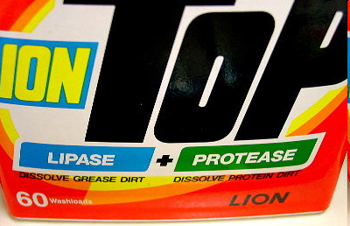
Enzymes are used in biological washing powders
Proteases break down the coloured, insoluble proteins that cause stains to smaller, colourless soluble polypeptides.
Can wash at lower temperatures

Slide 18
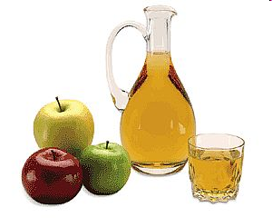
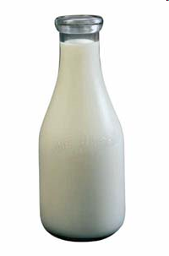
Enzymes are used in the food industry
Pectinase break down substances in apple cell walls and enable greater juice extraction.
Lactase breaks down lactose in milk into glucose and galactose. This makes milk drinkable for lactose intolerant people.

Slide 19
Enzymes are used in seed germination
starch
amylase
secreted
embryo plant
absorbed
maltose

Slide 20
Summary
Keywords:
catalyst
catalyse
protein
catalase
amylase
lactase
pectinase
trypsin
pepsin
substrate
active site
product
temperature
optimum
denature
pH
protease
enzyme

