Slide 1
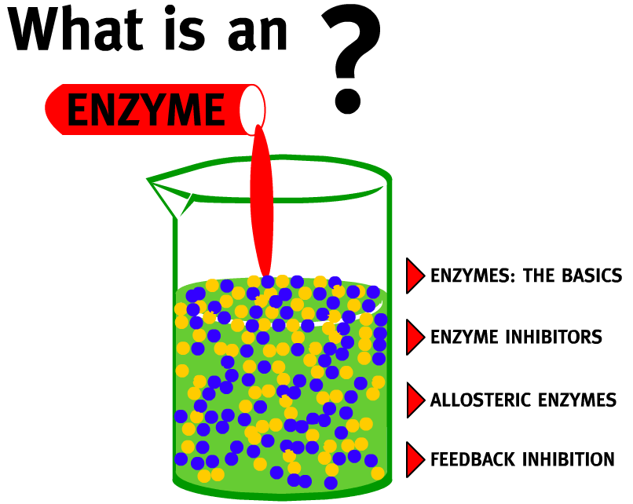
2.5.U1 Enzymes have an active site to which specific substrates bind. 2.5.U2 Enzyme catalysis involves molecular motion and the collision of substrates with the active site.
Enzyme: A globular protein that increases the rate of a biochemical reaction by lowering the activation energy threshold (i.e. a biological catalyst)
Use the animation to find out more about enzymes and how they work.
A good alternative is How Enzymes Work from McGraw and Hill
http://highered.mheducation.com/sites/0072495855/student_view0/chapter2/animation__how_enzymes_work.html
http://www.northland.cc.mn.us/biology/biology1111/animations/enzyme.swf

Slide 2
2.5.U1 Enzymes have an active site to which specific substrates bind.

Slide 3
2.5.U1 Enzymes have an active site to which specific substrates bind.

Slide 4
2.5.U1 Enzymes have an active site to which specific substrates bind.

Slide 5
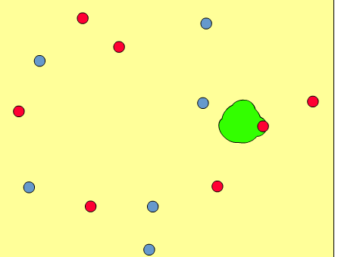
2.5.U2 Enzyme catalysis involves molecular motion and the collision of substrates with the active site.
The coming together of a substrate molecule and an active site is known as a collision
Most enzyme reactions occur when the substrates are dissolved in water
All molecules dissolved in water are in random motion, with each molecule moving separately
If not immobilized the enzyme can move too, however enzymes tend be larger than the substrate(s) and therefore move more slowly
Collisions are the result of the random movements of both substrate and enzyme
The substrate may be at any angle to the active site when the collision occurs
Successful collisions are ones in which the substrate and active site happen to be correctly aligned to allow binding to take place
The simulation from KScience allows you to both see enzyme kinetics happening and secondly how it is affected by different factors
http://www.kscience.co.uk/animations/model.swf

Slide 6
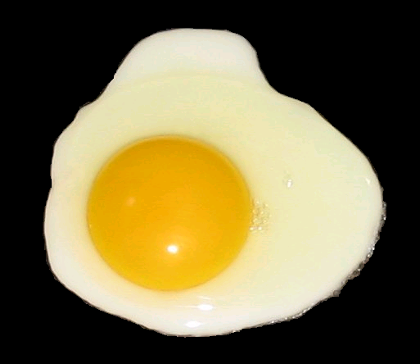
2.4.A2 Denaturation of proteins by heat or by deviation of pH from the optimum.
The three-dimensional conformation of proteins is stabilized by bonds or interactions between R groups of amino acids within the molecule. Most of these bonds and interactions are relatively weak and they can be disrupted or broken. This results in a change to the conformation of the protein, which is called denaturation.
A denatured protein does not normally return to its former structure – the denaturation is permanent. Soluble proteins often become insoluble and form a precipitate.
Heat can cause denaturation: vibrations within the molecule breaks intermolecular bonds or interactions.
Remember this slide? Enzymes are proteins and denaturation is a key to how enzyme activity is affected by temperature and pH
Extremes of pH can cause denaturation: charges on R groups are changed, breaking ionic bonds within the protein or causing new ionic bonds to form.
http://upload.wikimedia.org/wikipedia/commons/2/22/Fried_egg%2C_sunny_side_up_%28black_background%29.PNG

Slide 7
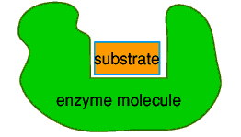
2.5.U4 Enzymes can be denatured.
For enzymes a change in structure means a change in the active site. If the active site changes shape the substrate is no longer able to bind to it.
Enzyme before denaturation
substrate can bind to the active site
Enzyme after denaturation
substrate can no longer bind to the active site
http://www.biotopics.co.uk/other/enzyme.html

Slide 8
2.5.U3 Temperature, pH and substrate concentration affect the rate of activity of enzymes.
Temperature, pH and substrate concentration can all affect the rate of activity of enzymes.
Above are sketch graphs graphs showing how each factor affects enzyme activity.
Your aim is to be able not just to recreate the graphs, but to annotate and explain their shape in terms of what is happening at a molecular level.

Slide 9
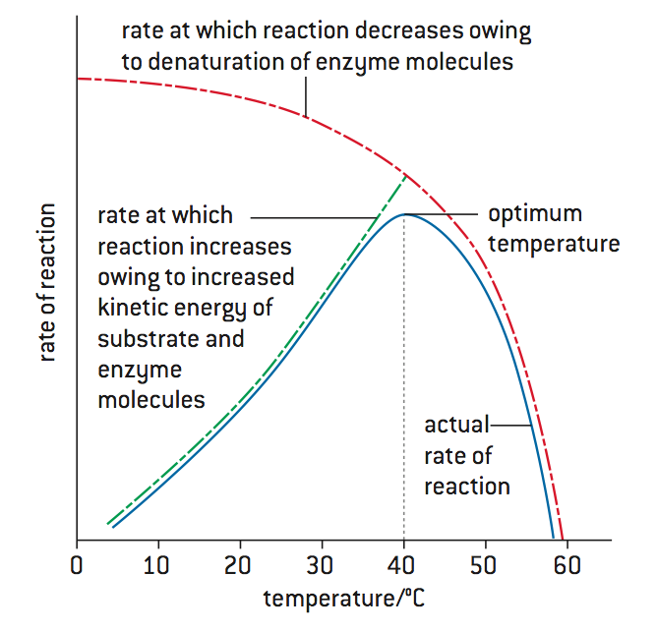
2.5.U3 Temperature, pH and substrate concentration affect the rate of activity of enzymes.
Low temperatures result in insufficient thermal energy for the activation of a given enzyme-catalysed reaction to be achieved
Increasing the temperature will increase the speed and motion of both enzyme and substrate, resulting in higher enzyme activity
This is because a higher kinetic energy will result in more frequent collisions between enzyme and substrate
At an optimal temperature (may differ for different enzymes), the rate of enzyme activity will be at its peak
Higher temperatures will cause enzyme stability to decrease, as the thermal energy disrupts the hydrogen bonds holding the enzyme together
This causes the enzyme (particularly the active site) to lose its shape, resulting in a loss of enzyme activity (denaturation)

Slide 10
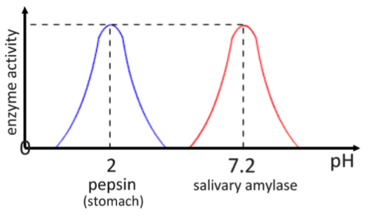
2.5.U3 Temperature, pH and substrate concentration affect the rate of activity of enzymes.
Changing the pH will alter the charge of the enzyme, which in turn will protein solubility and may change the shape of the molecule
Changing the shape or charge of the active site will diminish its ability to bind to the substrate, halting enzyme function
Enzymes have an optimum pH and moving outside of this range will always result in a diminished rate of reaction
Different enzymes may have a different optimum pH ranges

Slide 11
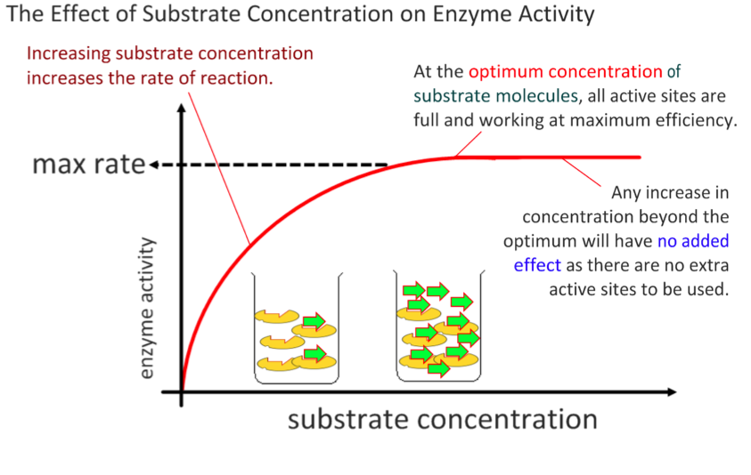
2.5.U3 Temperature, pH and substrate concentration affect the rate of activity of enzymes.

Slide 12
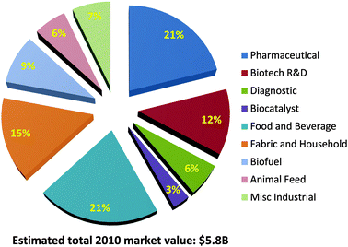
2.5.U5 Immobilized enzymes are widely used in industry.
Common uses of enzymes in industry include:
Detergents contain proteases and lipases to help breakdown protein and fat stains
Enzymes are widely used in the food industry, e.g.
fruit juice, pectin to increase the juice yield from fruit
Fructose is used as a sweetener, it is converted from glucose by isomerase
Rennin is used to help in cheese production
Enzymes are used to breakdown the starch in grains into biofuels that can be combusted
Paper production uses enzymes to helping in the pulping of wood
In the textiles industry enzymes help in the processing of fibres, e.g. polishing cloth to make it appear more shiny
In the brewing industry enzymes help a number of processes including the clarification of the beer
In Medicine & Biotechnology enzymes are widely used in everything from diagnostic tests tests to contact lens cleaners to cutting DNA in genetic engineering.
http://pubs.rsc.org/services/images/RSCpubs.ePlatform.Service.FreeContent.ImageService.svc/ImageService/Articleimage/2013/CS/c3cs35506c/c3cs35506c-f1.gif

Slide 13
2.5.U5 Immobilized enzymes are widely used in industry.
Advantages of enzyme immobilization:
Concentration of substrate can be increased as the enzyme is not dissolved – this increases the rate of reaction
Recycled enzymes can be used many times, immobilized enzymes are easy to separate from the reaction mixture, resulting in a cost saving.
o
Separation of the products is straight forward (this also means that the the reaction can stopped at the correct time).
Stability of the enzyme to changes in temperature and pH is increased reducing the rate of degradation, again resulting in a cost saving.
Enzymes used in industry are usually immobilized. They are attached to a material so that their movement is restricted. Common ways of doing this are:
Aggregations of enzymes bonded together
Attached to surfaces, e.g. glass
Entrapped in gels, e.g. alginate gel beads
http://pubs.rsc.org/services/images/RSCpubs.ePlatform.Service.FreeContent.ImageService.svc/ImageService/Articleimage/2013/CS/c3cs35506c/c3cs35506c-f1.gif

Slide 14
2.5.A1 Methods of production of lactose-free milk and its advantages.

Slide 15
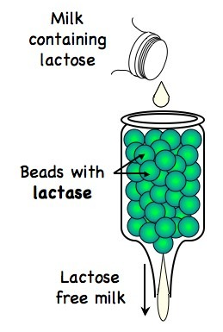
2.5.A1 Methods of production of lactose-free milk and its advantages.
Production of Lactose-free milk
Lactase obtained from commonly from yeast (bacteria is an alternative)
Lactase is bound to the surface of alginate beads
Milk is passed (repeatedly) over the beads
The lactose is broken down into glucose and galactose
The immobilized enzyme remains to be used again and does not affect the quality of the lactose free milk
Other uses of lactose free milk:
As a means to increase the sweetness of milk (glucose and galactose are sweeter in flavour), thus negating the need for artificial sweeteners
As a way of reducing the crystallisation of ice-creams (glucose and galactose are more soluble than lactose)
As a means of shortening the production time for yogurts or cheese (bacteria ferment glucose and galactose more readily than lactose)

Slide 16
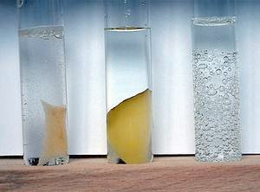
2.5.S1 Design of experiments to test the effect of temperature, pH and substrate concentration on the activity of enzymes. 2.5.S2 Experimental investigation of a factor affecting enzyme activity. (Practical 3)
Catalase is one of the most widespread enzymes. It catalyses the conversion of hydrogen peroxide, a toxic by-product of metabolism, into water and oxygen.
Catalase
H₂O₂
H₂O + O₂
Possible research questions, what are you going to investigate (independent variable)?
What is the effect of substrate concentration?
What is the effect of temperature?
What is the effect of pH?
Which type of yeast has a higher concentration of catalase?
Important things to consider:
How are you going to vary the mass/volume/concentration of your variable?
What units will you be measuring your variable in?
Have you chosen an effect range or values to answer your question?
Are the concentrations/chemicals you are using safe to handle?
http://www.scienceexperimentsforkids.us/wp-content/uploads/2011/08/hydrogen-experiments-for-kids-3-img.jpg

Slide 17
2.5.S1 Design of experiments to test the effect of temperature, pH and substrate concentration on the activity of enzymes. 2.5.S2 Experimental investigation of a factor affecting enzyme activity. (Practical 3)
How are you going to measure your results (dependent variable)?
Are you measuring the increase of a product or the dissapearance of a substrate?
Are you measuring directly (e.g. testing for the concentration of the product) or indirectly (change in pH)?
What equipment will you be using to measure your results?
What are the units and uncertainty given both the equipment and how you choose to use it?
What time period do you need to run the experiment for? How fast is the enzyme action likely to be?
How many repeats will you need to make sure your results are reliable?
http://www.scienceexperimentsforkids.us/wp-content/uploads/2011/08/hydrogen-experiments-for-kids-3-img.jpg

Slide 18
2.5.S1 Design of experiments to test the effect of temperature, pH and substrate concentration on the activity of enzymes. 2.5.S2 Experimental investigation of a factor affecting enzyme activity. (Practical 3)
How are you going to make sure it is a fair test (control variables)?
What variables other than your independent variable could affect the results?
Why would these variables affect the results?
How will you ensure each is kept constant and monitored?
What level should they be kept constant at? If a control variable is too far from it’s optimum then it could limit the enzyme action and no change would be seen in the results.
If a variable cannot be controlled it should still be discussed and considered as an uncontrolled variable.
Safety and ethics:
Are you using any equipment that may cause you or others harm? What steps have you taken to minimize this risk?
If you intend to use animals have you first considered alternative subjects?
If you still intend to use animals are subjects have you ensured both:
no harm comes to them as a result of the experiment
The experiment does not induce stress or conditions beyond that normally found in their natural environment
http://www.scienceexperimentsforkids.us/wp-content/uploads/2011/08/hydrogen-experiments-for-kids-3-img.jpg

