Slide 1
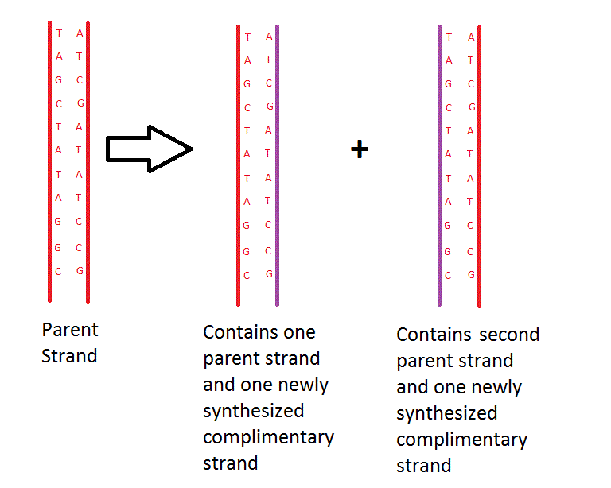
Semiconservative Replication
Color code or highlight your notes!
DNA replication that produces two copies, each containing one of the original strands and one new strand.

Slide 2
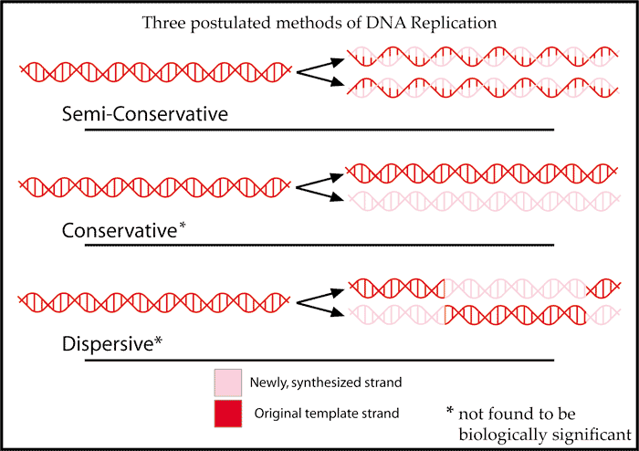
Alternative to Semi-Conservative
Conservative replication leaves the two original template DNA strands together in a double helix and produces a copy composed of two new strands containing all of the new DNA base pairs.
Dispersive replication produces copies of the DNA containing distinct regions of DNA composed of either both original strands or both new strands.

Slide 3
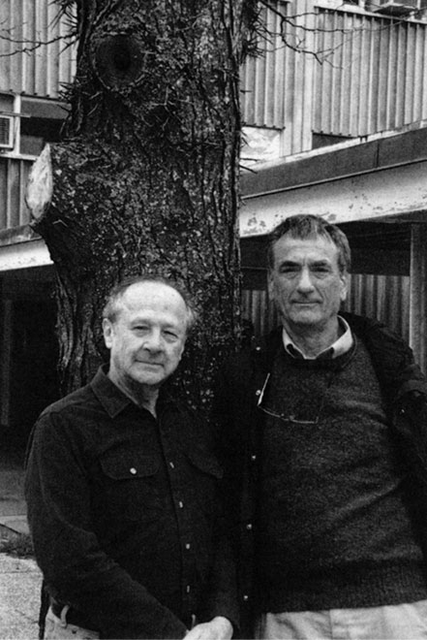
How do we know DNA replication is semiconservative?
Meselson and Stahl experiment (1958)

Slide 4
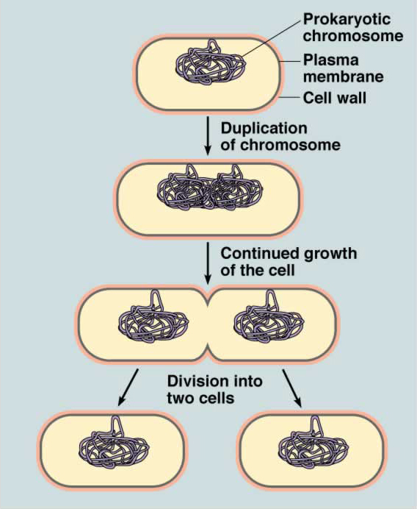
Binary Fission
Why are bacteria useful when studying DNA replication?

Slide 5
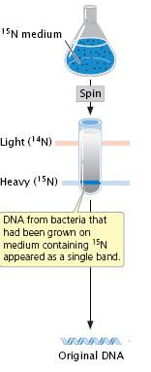
Start:
Allow many generations of E.coli bacteria to divide only in the presence of “heavy” nitrogen (¹⁵N).
All of their DNA will now contain this “heavy” nitrogen in the bases.
When spun in a centrifuge, all the DNA sunk to the bottom of the tube because it was all “heavy.”

Slide 6
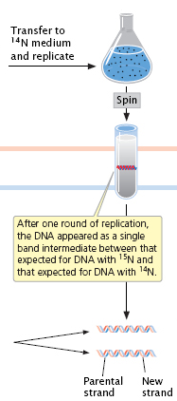
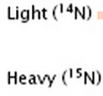
Cycle 1:
The bacteria were transferred to a solution with light nitrogen (¹⁴N) and allowed to divide.
When spun in a centrifuge, all the DNA was in a single band above where the ¹⁵N band had been.

Slide 7
In your notes,
draw what would
have been seen after
Cycle 1 if DNA replication
was conservative or
dispersive.

Slide 8
If conservative...
If dispersive...
Light ¹⁴N
Heavy ¹⁵N

Slide 9
If conservative...
If dispersive...
?
Light ¹⁴N
Heavy ¹⁵N

Slide 10
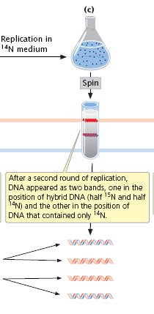
Cycle 2:
The bacteria continued to grow with light nitrogen (¹⁴N) and allowed to divide.
When spun in a centrifuge, half the DNA was in a band above where the ¹⁵N band had been and half the DNA was above that.

Slide 11
In your notes,
draw what would
have been seen after
Cycle 2 if DNA replication
was dispersive.

Slide 12
If dispersive...
Light ¹⁴N
Heavy ¹⁵N

Slide 13
If dispersive...
Light ¹⁴N
Heavy ¹⁵N

Slide 14
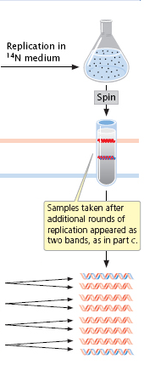
Cycle 3:
The bacteria continued to grow with light nitrogen (¹⁴N) and allowed to divide.
When spun in a centrifuge, some DNA was in a band above where the ¹⁵N band had been and more of the DNA was above that.

Slide 15
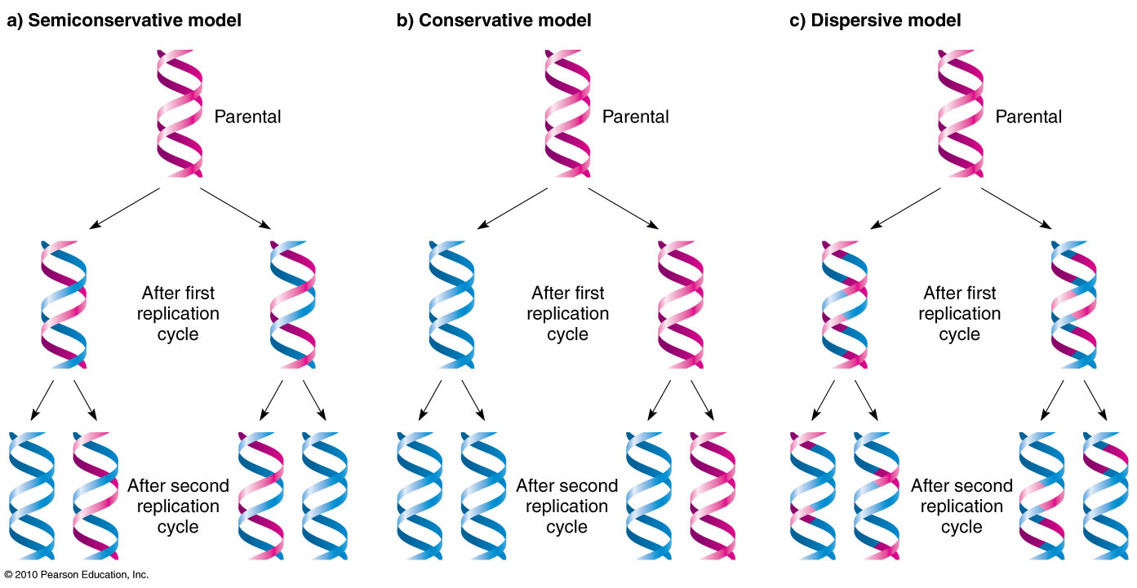

Slide 16
Statements
2.7.U1: define semi-conservative and complementary base pairing
2.7.NOS: describe the experiments
2.7.S2: explain how the results of the experiment support DNA replication as semiconservative

