Slide 1
Protein Synthesis

Slide 2
The DNA Code
The order of bases along the DNA strand codes for the order in which amino acids are chemically joined together to form a polypeptide

Slide 3
Protein synthesis involves two types of nucleic acids:
DNA (deoxyribonucleic acid)
RNA (ribonucleic acid)

Slide 4
RNA
RNA, like DNA, is a polymer formed by a sequence of nucleotides
Three Types of RNA:
messenger RNA (mRNA)
transfer RNA (tRNA)
ribosomal RNA (rRNA)

Slide 5
Differences Between DNA and RNA
DNA RNA
double-stranded single-stranded
sugar = deoxyribose sugar = ribose
bases = A,T,C,G bases = A,U,C,G
(uracil takes the place of thymine)

Slide 6
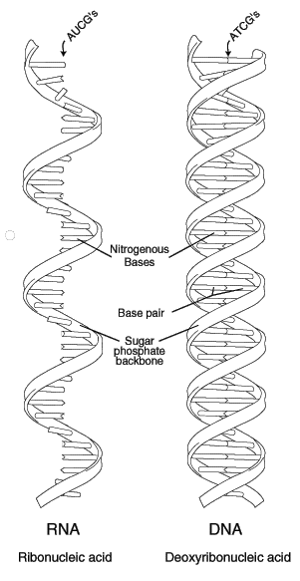

Slide 7
Protein Synthesis
involves two processes:
Transcription: the copying of the genetic message (DNA) into a molecule of mRNA
Translation: mRNA is used to assemble an amino acid sequence into a polypeptide

Slide 8
Transcription
occurs in the nucleus of the cell
1) DNA strand separates and serves as a template (pattern) for mRNA assembly

Slide 9
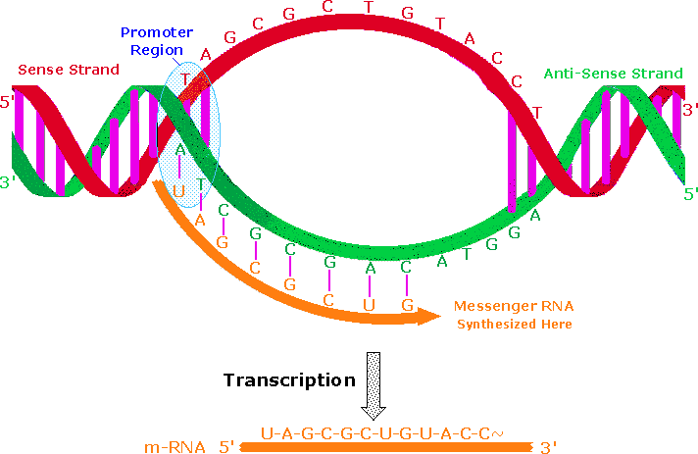
2) free mRNA nucleotides match up to the exposed nucleotides on the DNA strand

Slide 10
http://www.johnkyrk.com/DNAtranscription.html
mRNA strand leaves the DNA strand when a “stop codon” is reached
the mRNA strand carries the code for the production of one polypeptide

Slide 11
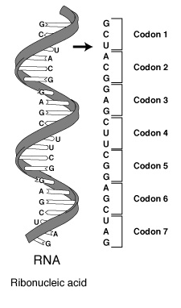
A sequence of 3 bases called a codon codes for one amino acid

Slide 12
Translation
Occurs in the cytoplasm of the cell, at the ribosome
1) mRNA moves out of the nucleus and into the cytoplasm to a ribosome

Slide 13
2) mRNA is “read” by the ribosome and is converted to a chain of amino acids with the help of tRNA

Slide 14
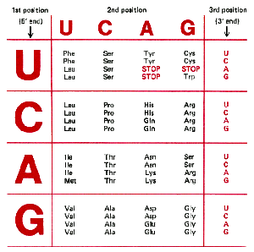

Slide 15
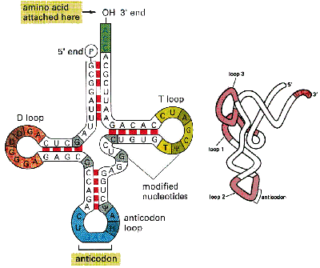
http://www.johnkyrk.com/DNAtranslation.html

Slide 16
As the mRNA moves across the ribosome, tRNAs temporarily attach. The amino acids are joined by a chemical bond by enzymes until a stop codon is reached
a polypeptide is produced

Slide 17
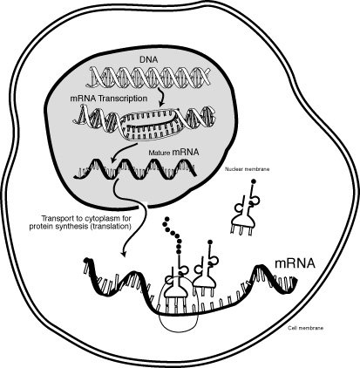

Slide 18
Animations
http://www.lewport.wnyric.org/JWANAMAKER/animations/Protein%20Synthesis%20-%20long.html
http://www.ncc.gmu.edu/dna/ANIMPROT.htm

