Slide 1
7.2 Transcription and Gene expression
Essential idea: Information stored as a code in DNA is copied onto mRNA.
"The genetic code is frequently referred to as a blueprint because it contains the instructions a cell requires in order to sustain itself. We now know that there is more to these instructions than simply the sequence of letters in the nucleotide code, however. For example, vast amounts of evidence demonstrate that this code is the basis for the production of various molecules, including RNA and protein ... In transcription, a portion of the double-stranded DNA template gives rise to a single-stranded RNA molecule."
.
The image shows how DNA is used as a template to create portable molecules of genetic code, i.e. mRNA, that can leave the nucleus for translation in other regions of the cell
https://commons.wikimedia.org/wiki/File:Simple_transcription_elongation1.svg

Slide 2
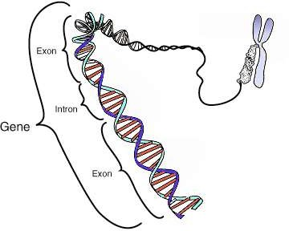
Between genes exist non-coding regions of DNA (introns). Although such DNA does not code for polypeptides it can affect transcription of mRNA.
Review: 7.1.U6 Some regions of DNA do not code for proteins but have other important functions.
Promoters sequences are attachment points for RNA polymerase adjacent to the gene
Some other regions act as binding sites for particular proteins, which in turn affect transcription of the nearby gene:
Enhancers are sequences that increase the rate of transcription (when a protein is bound to it)
Silencers inhibit transcription (when a
protein is bound to it)
http://commons.wikimedia.org/wiki/File:Gene.png

Slide 3
Non-coding regions have important functions, for example promoters:
7.2.A1 The promoter as an example of non-coding DNA with a function.
The promoter is a DNA sequence is located near a gene. It acts as the binding site for RNA polymerase.
Operator is a region of DNA that can regulate transcription, typically inhibiting transcription (silencers are a type of operator)
RNA polymerase transcribes the gene into RNA, typically mRNA
The adjacent gene is transcribed, but the promoter region is not.
Edited from: http://commons.wikimedia.org/wiki/File:Lac_Operon.svg

Slide 4
One well known example of the regulation of gene expression by proteins is the metabolism of lactose in E. coli bacterium. The diagram below illustrates this example:
7.2.U5 Gene expression is regulated by proteins that bind to specific base sequences in DNA.
RNA Polymerase
The repressor protein is bound to the operator preventing RNA Polymerase from transcribing the genes.
DNA Strand
Operator is a region of DNA that can regulate transcription, typically inhibiting transcription, such as this silencer sequence.
Genes involved in the metabolism (breakdown) of lactose
The promoter is a DNA sequence is located near a gene. It acts as the binding site for RNA polymerase.
The consequence of the inhibition of the lactose metabolism is that the concentration of undigested lactose now increases in E. coli …
Edited from: http://commons.wikimedia.org/wiki/File:Lac_Operon.svg

Slide 5
One well known example of the regulation of gene expression by proteins is the metabolism of lactose in E. coli bacterium. The diagram below illustrates this example:
7.2.U5 Gene expression is regulated by proteins that bind to specific base sequences in DNA.
Lactose binds to the repressor protein inhibiting it: the repressor can no longer bind to the operator.
Lactose molecules build up I inside the E. coli
With the synthesis of lactase the lactose is broken down, as it’s concentration decreases the inhibition of the repressor molecules will decrease ‘silencing’ the gene again.
RNA polymerase binds with the promoter, and express the genes (by transcribing them), which in turn synthesizes lactase

Slide 6
Summary of common types of regulating proteins and associated sequences found in eukaryotes.
7.2.U5 Gene expression is regulated by proteins that bind to specific base sequences in DNA.
DNA
Sequence
Binding protein
Function
Enhancers
Activator
Activator proteins bind to enhancer sequences of DNA to greatly increase the rate of transcription of a gene.
Silencers
Repressor
Repressor proteins bind to non-coding regions
of DNA to either block or reduce the transcription of a gene.
Promoter
RNA
A region of DNA located close to a specific gene. Once bound to the sequence RNA polymerase transcribes the gene.
Polymerase

Slide 7
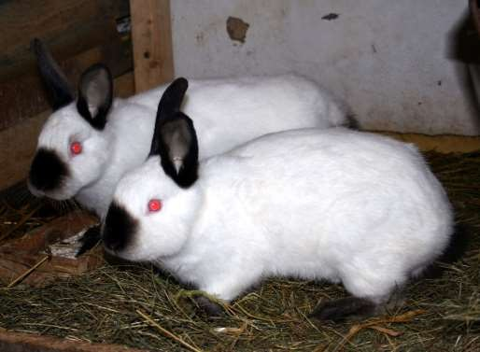
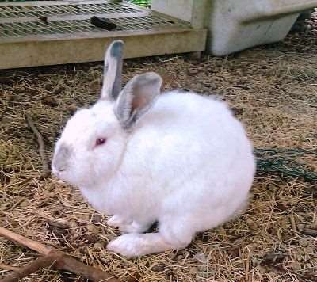
7.2.U6 The environment of a cell and of an organism has an impact on gene expression.
The environment of an organism impacts gene expression. For example human hair and skin colour are impacted by the exposure to sunlight and high temperatures
Similarly pigments in the fur of Himalayan rabbits (Oryctolagus cuniculus) are regulated by temperature.
Gene C controls fur pigmentation in Himalayan rabbits. The gene is active when environmental temperatures are between 15 and 25°C. At higher temperatures the gene is inactive.
In low temperatures, Gene C becomes active in the rabbit's colder extremities (ears, nose, and feet) and produces a black pigment.
In the warm weather no pigment is produced and the fur is white
http://upload.wikimedia.org/wikipedia/commons/0/06/Kr%C3%B3liki_kalifornijskie_666.jpg http://www.alpinecommunitynetwork.com/wp-content/uploads/himalayan-bunny-5-19-11-1_opt4.jpg

Slide 8
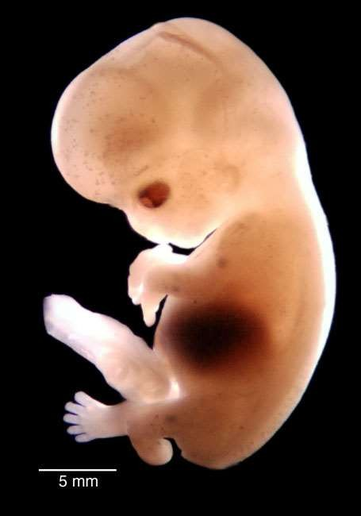
7.2.U6 The environment of a cell and of an organism has an impact on gene expression.
The environment of a cell can also impact gene expression. This is a complex area of genetics, but can be outlined as follows:
Only a small number of genes are involved in determining body patterns during embryonic development.
The expression of these genes is regulated by a group of molecules referred to as morphogens.
Morphogens diffuse across the surfaces of cells from a concentrated source. Therefore different embryonic cells get different concentrations of morphogens.
Morphogens regulate the production of a transcription factors in a cell.
This results in the activation and inhibition of different genes in different cells. This in turn controls how long your fingers should be, where your nose is on your face, and other specifics about body structure.
http://embryo.soad.umich.edu/carnStages/stage22/Opticals/10303_lftLat_slide.jpg

Slide 9
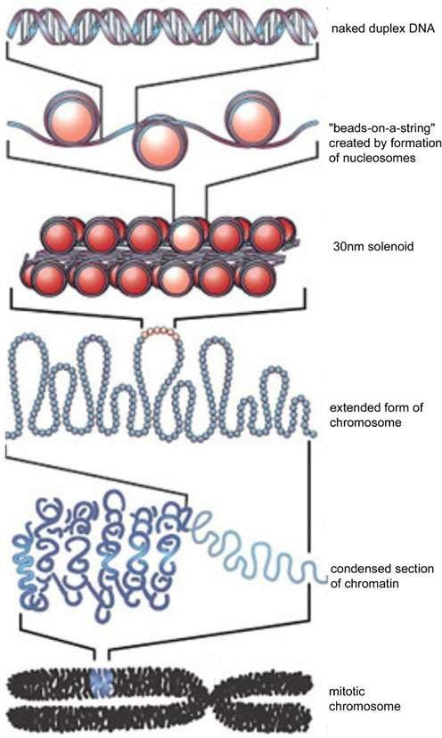
Eukaryotic DNA supercoiling is organised by nucleosomes
Review: 7.1.U1 Nucleosomes help to supercoil the DNA.
Nucleosomes both protect DNA and allow it to be packaged, this in turn allows DNA to be supercoiled.
Nucleosomes are formed by wrapping DNA around histone proteins
n.b. Prokaryotic DNA is, like eukaryotic DNA, supercoiled, but differently: Prokaryotic DNA maybe associated with proteins, but it is not organised by histones and is therefore sometimes referred as being ‘naked’.
http://en.wikipedia.org/wiki/File:DNA_to_Chromatin_Formation.jpg

Slide 10
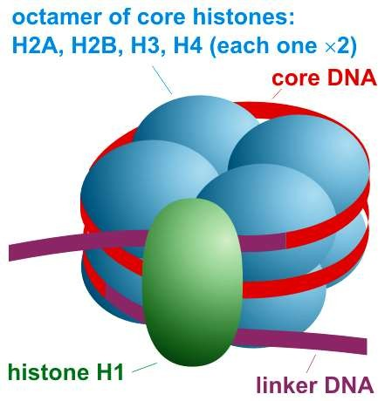
Review: 7.1.U1 Nucleosomes help to supercoil the DNA.
Structure of a simplified nucleosome
octamer (contains two copies of four
different types of histone protein)
The H1 histone binds DNA in such a way to form a structure called the 30 nm fibre (solenoid) that facilitates further packing
http://commons.wikimedia.org/wiki/File:Nucleosome_organization.png
http://en.wikipedia.org/wiki/File:DNA_to_Chromatin_Formation.jpg

Slide 11
7.2.U2 Nucleosomes help to regulate transcription in eukaryotes.
Methylation is the addition of methyl groups to DNA
Acetylation is the addition of Acetyl groups to histones
Edited from: http://www.nature.com/neuro/journal/v13/n4/images/nn0410-405-F1.jpg

Slide 12
7.2.U2 Nucleosomes help to regulate transcription in eukaryotes.
Methylation is the addition of methyl groups to DNA
Methylation of DNA inhibits transcription
Processes that inhibit transcription bind the DNA more tightly to the histone making it less accessible to transcription factors (forming heterochromatin).
*Chromatin is a complex of DNA, protein and RNA. Tightly packed chromatin which cannot be transcribed is referred to as heterochromatin.
Edited from: http://www.nature.com/neuro/journal/v13/n4/images/nn0410-405-F1.jpg

Slide 13
Acetylation is the addition of Acetyl groups to histones
7.2.U2 Nucleosomes help to regulate transcription in eukaryotes.
Processes that promote transcription bind the DNA more loosely to the histone making it more accessible to transcription factors (forming euchromatin*).
Acetylation promotes transcription
n.b. Methylation of histones can also occur, this process can both promote and inhibit transcription.
*Chromatin is a complex of DNA, protein and RNA. Loosely packed chromatin which can be transcribed is referred to as euchromatin.
Edited from: http://www.nature.com/neuro/journal/v13/n4/images/nn0410-405-F1.jpg

Slide 14
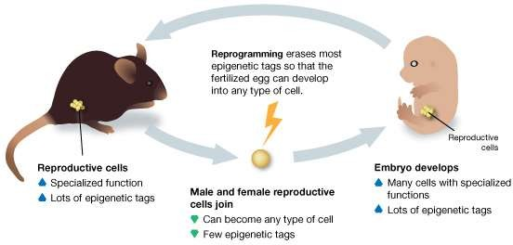
7.2.U2 Nucleosomes help to regulate transcription in eukaryotes.
Changes in the environment affect the cell metabolism, this in turn can directly or indirectly affect processes such as Acetylation & Methylation.
Methylation and acetylation mark the DNA to affect transcription. These markers are known as epigenetic tags*.
For a new organism to grow it needs unmarked DNA that can develop into lots of different specialised cell types.
Reprogramming scours the genome and erases the epigenetic tags to return the cells to a genetic "blank slate”.
For a small number of genes, epigenetic tags make it through this process unchanged hence get passed from parent to offspring.
*The branch of genetics concerned with hertible changes not caused by DNA is called Epigenetics.
http://learn.genetics.utah.edu/content/epigenetics/inheritance/images/Reprogramming.jpg

Slide 15
Nature of Science: Looking for patterns, trends and discrepancies - there is mounting evidence that the environment can trigger heritable changes in epigenetic factors. (3.1)
Use the excellent Learn.Genetics resources to learn more about Epigenetics and it’s importance.
http://learn.genetics.utah.edu/content/epigenetics/rats/
What evidence can you find that supports the idea that the environment can trigger heritable changes?

Slide 16
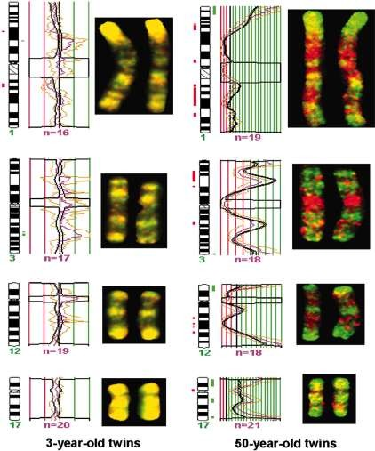
The images show a mapping of chromosomal regions with differential DNA methylation in monozygotic (identical) twins
7.2.S1 Analysis of changes in the DNA methylation patterns.
The sample is of metaphase chromosomes
Hypermethylation (high levels of methylation) in one twin compared to the other.
chromosome number (humans have 23 pairs)
Similar levels of methylation in both twins.
The diagrams maps changes between the twins’ levels of methylation of DNA across the chromosomes.
Hypomethylation (low levels of methylation) in one twin compared to the other.
Your task: compare the diagrams (not the graphs) then analyse the evidence and deduce conclusions.
http://www.pnas.org/content/102/30/10604/F3.expansion.html

Slide 17
7.2.S1 Analysis of changes in the DNA methylation patterns.
Comparison (evidence):
The variation in the levels of methylation between the twins increases with age.
Hypomethylation occurs more away from the end of the chromosomes.
The levels of both hypermethylation & hypomethylation increase with age.
Chromosome 3 shows the greatest variation in methylation at both ages.
Chromosome 17 changes the least with age.
http://www.pnas.org/content/102/30/10604/F3.expansion.html

Slide 18
7.2.S1 Analysis of changes in the DNA methylation patterns.
Analysis and deductions:
The variation in the levels of methylation between the twins increases with age.
The twins will have different experiences/enviro nment stimuli which will in turn causes different levels of methylation on different chromosomes.
http://www.pnas.org/content/102/30/10604/F3.expansion.html

Slide 19
7.2.S1 Analysis of changes in the DNA methylation patterns.
Analysis and deductions:
The levels of both hypermethylation & hypomethylation increase with age.
Methylation inhibits transcription: as the organism ages cells becomes more greatly specialised due to more inhibited and promoted DNA.
http://www.pnas.org/content/102/30/10604/F3.expansion.html

Slide 20
7.2.S1 Analysis of changes in the DNA methylation patterns.
Analysis and deductions:
Chromosome 17 shows the greatest variation in methylation at both ages.
Chromosome 20 changes the least with age.
Numbers, sizes and roles of genes varies between chromosomes.
Therefore it is expected that some chromosomes vary more than others in their degree of methylation and how they are affected by time/environment.
http://www.pnas.org/content/102/30/10604/F3.expansion.html

Slide 21
7.2.S1 Analysis of changes in the DNA methylation patterns.
Analysis and deductions:
Chromosome 17 shows the greatest variation in methylation at both ages.
Chromosome 20 changes the least with age.
Numbers, sizes and roles of genes varies between chromosomes.
Therefore it is expected that some chromosomes vary more than others in their degree of methylation and how they are affected by time/environment.
http://www.pnas.org/content/102/30/10604/F3.expansion.html

Slide 22
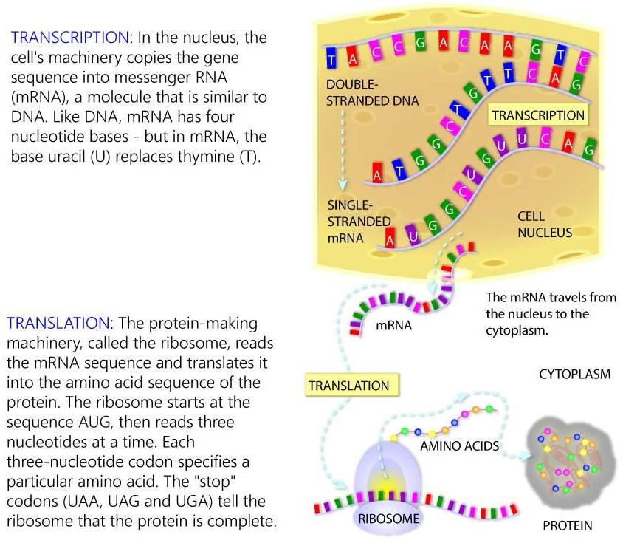
Review: 2.7.U4 Transcription is the synthesis of mRNA copied from the DNA base sequences by RNA polymerase.
http://learn.genetics.utah.edu/content/molecules/transcribe/

Slide 23
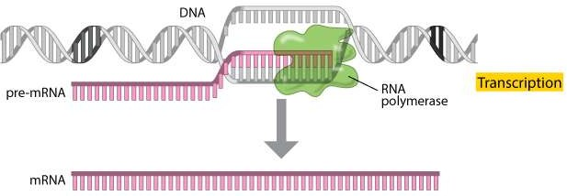
Review: 2.7.U4 Transcription is the synthesis of mRNA copied from the DNA base sequences by
RNA polymerase.
Transcription is the process by which an RNA sequence is produced from a DNA template:
Three main types of RNA are predominantly synthesised:
Messenger RNA (mRNA): A transcript copy of a gene used to encode a polypeptide
Transfer RNA (tRNA): A clover leaf shaped sequence that carries an amino acid
Ribosomal RNA (rRNA): A primary component of ribosomes
http://www.nature.com/scitable/topicpage/Translation-DNA-to-mRNA-to-Protein-393

Slide 24
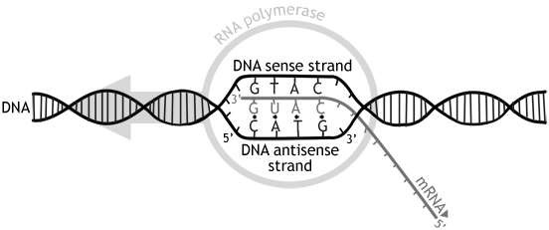
Review: 2.7.U4 Transcription is the synthesis of mRNA copied from the DNA base sequences by
RNA polymerase. AHL: 7.2.U1 Transcription occurs in a 5’ to 3’ direction.
The enzyme RNA polymerase binds to a site on the DNA at the start of a gene (The sequence of DNA that is transcribed into RNA is called a gene).
RNA polymerase separates the DNA strands and synthesises a complementary RNA copy from the antisense DNA strand.
Transcription occurs in a 5’ to 3’ direction: RNA polymerase adds the 5´ end of the free RNA nucleotide to the 3´ end of the growing mRNA molecule (RNA polymerase moves along the anti- sense strand in a 3’ to 5’ direction).
It does this by covalently bonding ribonucleoside triphosphates that align opposite their exposed complementary partner (using the energy from the cleavage of the additional phosphate groups to join them together)
Once the RNA sequence has been synthesised:
RNA polymerase will detach from the DNA molecule
RNA detaches from the DNA
the double helix reforms
Transcription occurs in the nucleus (where the DNA is) and, once made, the mRNA moves to the cytoplasm (where translation can occur)

Slide 25
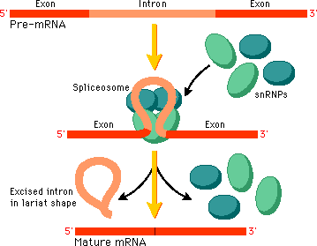
Eukaryotic genes (unlike prokaryote) contain base sequences that are not translated
into polypeptides
7.2.U3 Eukaryotic cells modify mRNA after transcription.
Introns are non-coding sections of the gene
Exons are
coding sections
of the gene.
Introns are removed then broken down back into nucleotides ready for use
The Spliceosome* forms and causes the introns to form loops which allows the exons to be joined
Mature mRNA contains only exons leaves the
nucleus to be translated into polypeptides.
*The spliceosome is a complex assembled from small nuclear RNA (snRNA) and proteins.
http://www.phschool.com

Slide 26
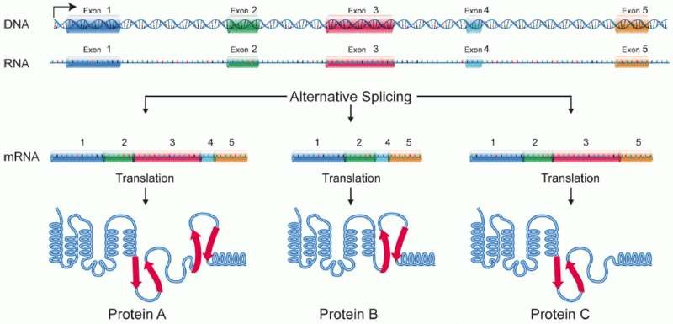
The splicing process above can happen in different ways to the same gene. particular exons (of a gene) may be included within or excluded from mature mRNA
7.2.U4 Splicing of mRNA increases the number of different proteins an organism can produce.
Multiple proteins produced by a single gene. Each proteins produced will vary in it’s biological function. An example of this is the IgM gene which produces different immunoglobulins (antibodies) to fight different pathogens.
https://commons.wikimedia.org/wiki/File:DNA_alternative_splicing.gif

