Slide 1
2.5 Enzymes
Essential idea: Enzymes control the metabolism of the cell.
Above is just a small part of the IUBMB-Sigma-Nicholson Metabolic Pathways Chart aims to show all the metabolic pathways found in eukaryote cells. The chart in it's entirety shows how complex the chemicals reactions needed to support life in a single cell unit. This was mentioned earlier in 2.1, but in addition to the complexity now add to that idead the fact that every arrow on the chart shows an enzyme controlling the conversion of compounds.

Slide 2
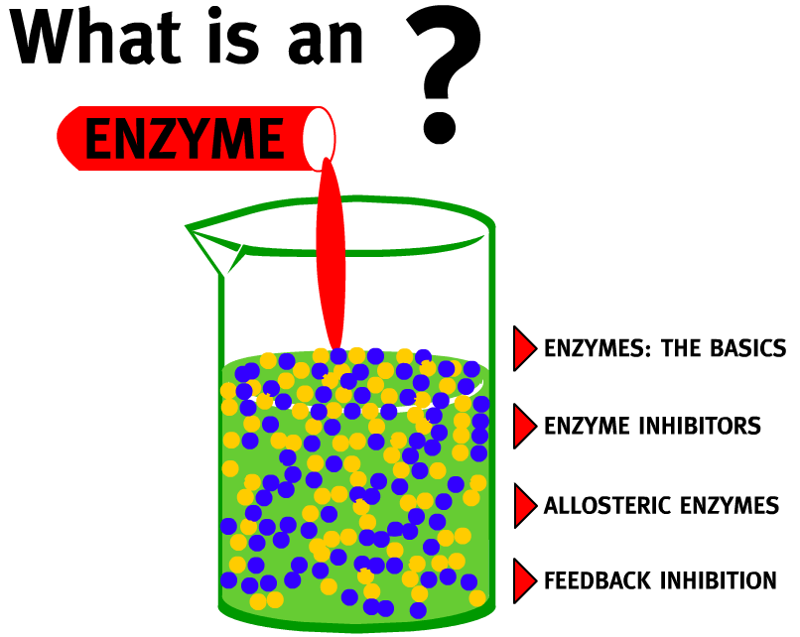
2.5.U1 Enzymes have an active site to which specific substrates bind. 2.5.U2 Enzyme catalysis involves molecular motion and the collision of substrates with the active site.
Enzyme: A globular protein that increases the rate of a biochemical reaction by lowering the activation energy threshold (i.e. a biological catalyst)
Use the animation to find out more about enzymes and how they work.
A good alternative is How Enzymes Work from McGraw and Hill
http://highered.mheducation.com/sites/0072495855/student_view0/chapter2/animation__how_enzymes_work.html
http://www.northland.cc.mn.us/biology/biology1111/animations/enzyme.swf

Slide 3
2.5.U1 Enzymes have an active site to which specific substrates bind.

Slide 4
2.5.U1 Enzymes have an active site to which specific substrates bind.

Slide 5
2.5.U1 Enzymes have an active site to which specific substrates bind.

Slide 6
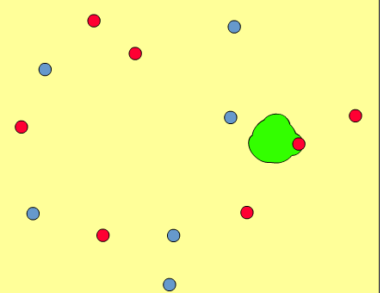
2.5.U2 Enzyme catalysis involves molecular motion and the collision of substrates with the active site.
The coming together of a substrate molecule and an active site is known as a collision
Most enzyme reactions occur when the substrates are dissolved in water
All molecules dissolved in water are in random motion, with each molecule moving separately
If not immobilized the enzyme can move too, however enzymes tend be larger than the substrate(s) and therefore move more slowly
Collisions are the result of the random movements of both substrate and enzyme
The substrate may be at any angle to the active site when the collision occurs
Successful collisions are ones in which the substrate and active site happen to be correctly aligned to allow binding to take place
The simulation from KScience allows you to both see enzyme kinetics happening and secondly how it is affected by different factors
http://www.kscience.co.uk/animations/model.swf

Slide 7
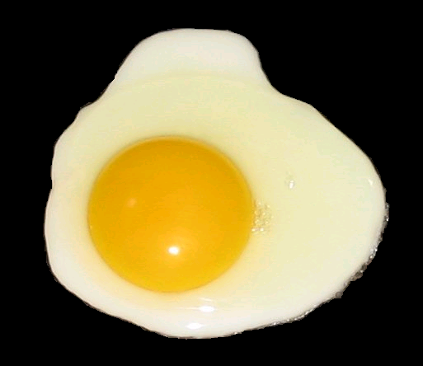
2.4.A2 Denaturation of proteins by heat or by deviation of pH from the optimum.
The three-dimensional conformation of proteins is stabilized by bonds or interactions between R groups of amino acids within the molecule. Most of these bonds and interactions are relatively weak and they can be disrupted or broken. This results in a change to the conformation of the protein, which is called denaturation.
A denatured protein does not normally return to its former structure – the denaturation is permanent. Soluble proteins often become insoluble and form a precipitate.
Heat can cause denaturation: vibrations within the molecule breaks intermolecular bonds or interactions.
Remember this slide? Enzymes are proteins and denaturation is a key to how enzyme activity is affected by temperature and pH
Extremes of pH can cause denaturation: charges on R groups are changed, breaking ionic bonds within the protein or causing new ionic bonds to form.
http://upload.wikimedia.org/wikipedia/commons/2/22/Fried_egg%2C_sunny_side_up_%28black_background%29.PNG

Slide 8
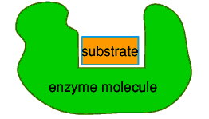
2.5.U4 Enzymes can be denatured.
For enzymes a change in structure means a change in the active site. If the active site changes shape the substrate is no longer able to bind to it.
Enzyme before denaturation
substrate can bind to the active site
Enzyme after denaturation
substrate can no longer bind to the active site
http://www.biotopics.co.uk/other/enzyme.html

Slide 9
2.5.U3 Temperature, pH and substrate concentration affect the rate of activity of enzymes.
Temperature, pH and substrate concentration can all affect the rate of activity of enzymes.
Above are sketch graphs graphs showing how each factor affects enzyme activity.
Your aim is to be able not just to recreate the graphs, but to annotate and explain their shape in terms of what is happening at a molecular level.

Slide 10
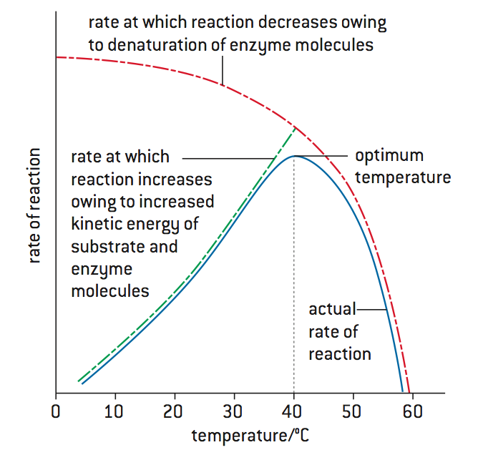
2.5.U3 Temperature, pH and substrate concentration affect the rate of activity of enzymes.
Low temperatures result in insufficient thermal energy for the activation of a given enzyme-catalysed reaction to be achieved
Increasing the temperature will increase the speed and motion of both enzyme and substrate, resulting in higher enzyme activity
This is because a higher kinetic energy will result in more frequent collisions between enzyme and substrate
At an optimal temperature (may differ for different enzymes), the rate of enzyme activity will be at its peak
Higher temperatures will cause enzyme stability to decrease, as the thermal energy disrupts the hydrogen bonds holding the enzyme together
This causes the enzyme (particularly the active site) to lose its shape, resulting in a loss of enzyme activity (denaturation)

Slide 11
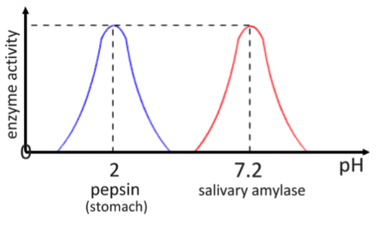
2.5.U3 Temperature, pH and substrate concentration affect the rate of activity of enzymes.
Changing the pH will alter the charge of the enzyme, which in turn will protein solubility and may change the shape of the molecule
Changing the shape or charge of the active site will diminish its ability to bind to the substrate, halting enzyme function
Enzymes have an optimum pH and moving outside of this range will always result in a diminished rate of reaction
Different enzymes may have a different optimum pH ranges

Slide 12
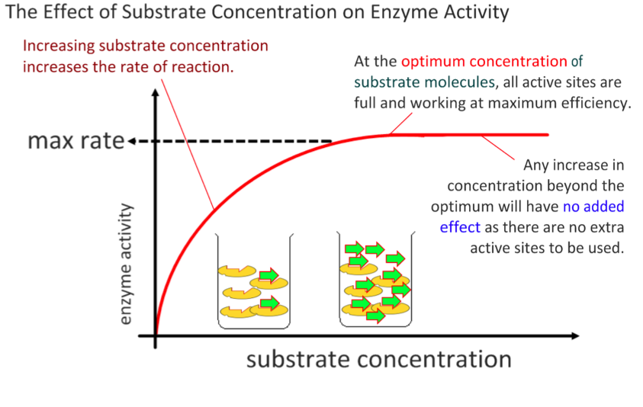
2.5.U3 Temperature, pH and substrate concentration affect the rate of activity of enzymes.

