Slide 1
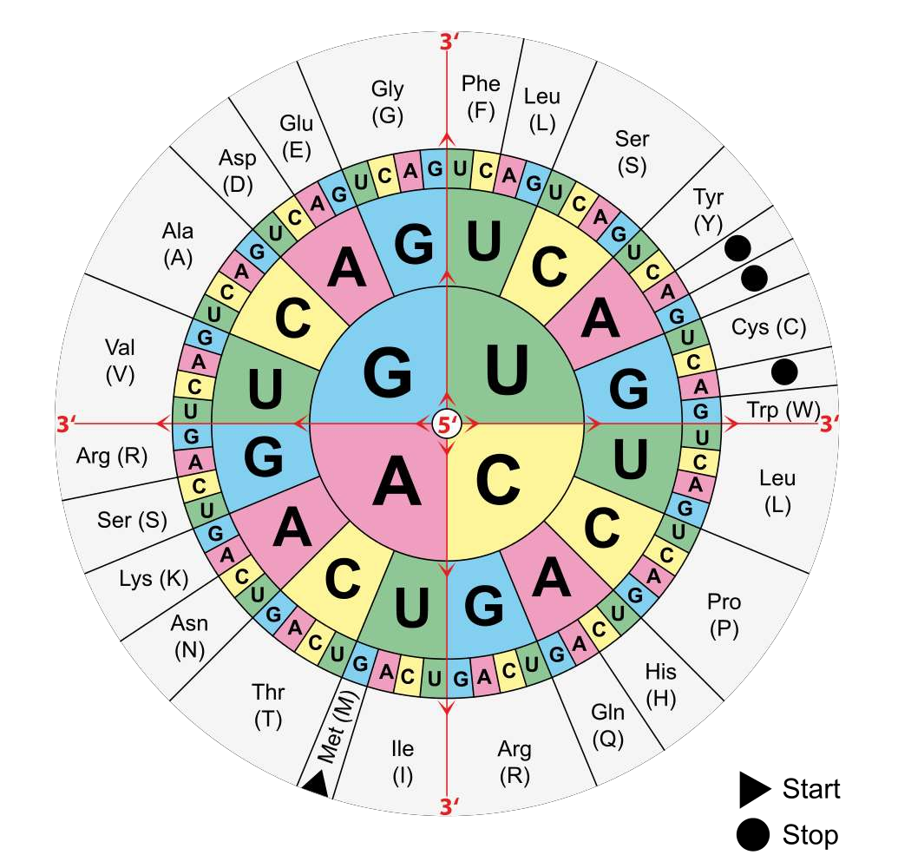
7.3 Translation
Essential idea: Information transferred from DNA to
mRNA is translated into an amino acid sequence.
The image shows a table used to translate mRNA codons (which have been transcribed from DNA) into amino acids.
"The genes in DNA encode protein molecules, which are the "workhorses" of the cell, carrying out all the functions necessary for life ... In the simplest sense, expressing a gene means manufacturing its corresponding protein"
https://commons.wikimedia.org/wiki/File:Aminoacids_table.svg

Slide 2
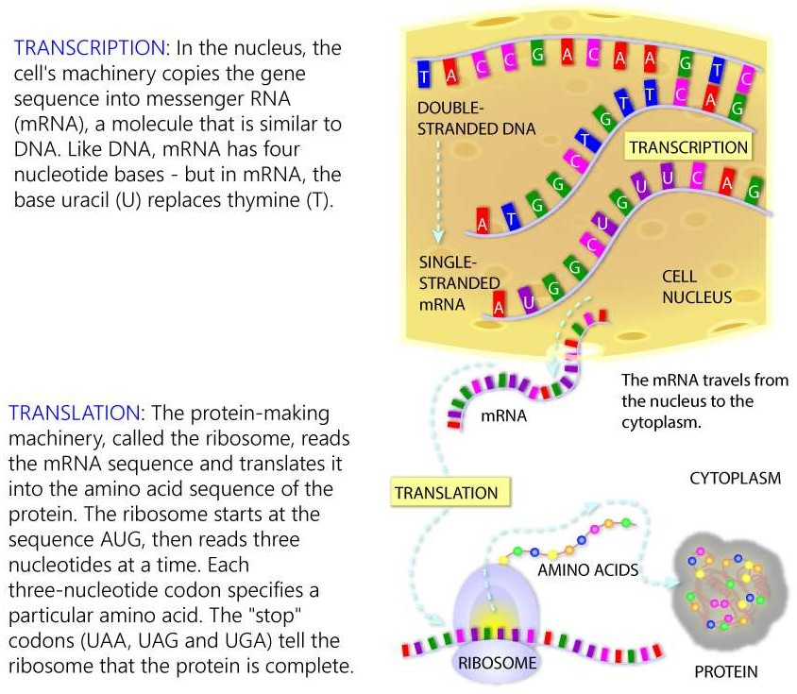
Review: 2.7.U4 Transcription is the synthesis of mRNA copied from the DNA base sequences by RNA polymerase. AND 2.7.U5 Translation is the synthesis of polypeptides on ribosomes.
http://learn.genetics.utah.edu/content/molecules/transcribe/

Slide 3
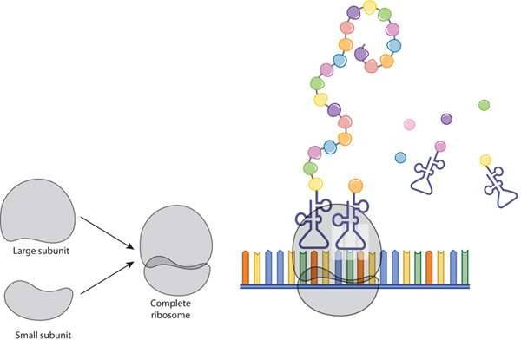
Translation is the process of protein synthesis in which the genetic information encoded in mRNA is translated into a sequence of amino acids in a polypeptide chain
Review: 2.7.U5 Translation is the synthesis of polypeptides on ribosomes.
A ribosome is composed of two halves, a large and a small subunit. During translation, ribosomal subunits assemble together like a sandwich on the strand of mRNA:
Each subunit is composed of RNA molecules and proteins
The small subunit binds to the mRNA
The large subunit has binding sites for tRNAs and also catalyzes peptide bonds between amino acids
http://www.nature.com/scitable/topicpage/ribosomes-transcription-and-translation-14120660

Slide 4
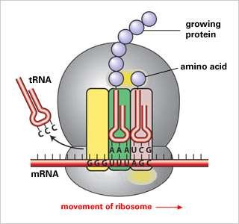
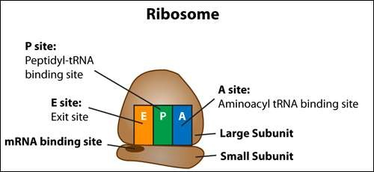
To understand how ribosomes work learn how to draw, label and annotate their structure.
Review: 2.7.U5 Translation is the synthesis of polypeptides on ribosomes. (plus AHLdetail)
Use this slide and the previous one to
construct your own diagram.
tRNA carrying amino acids bind first in this site.
tRNA currently holding the growing peptide is located at this site
tRNAs leave the ribosome at
this site
http://old-www.hartnell.edu/tutorials/biology/images/ribosome_sm.jpg http://www.proteinsynthesis.org/wp-content/uploads/2013/02/protein-synthesis-ribosome.jpg

Slide 5
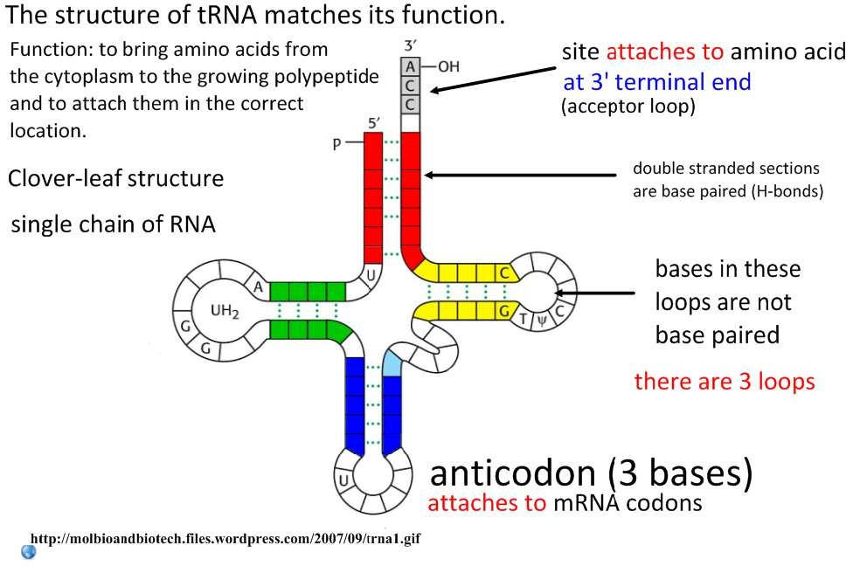
7.3.S2 The use of molecular visualization software to analyse the structure of eukaryotic ribosomes and a tRNA molecule.

Slide 6
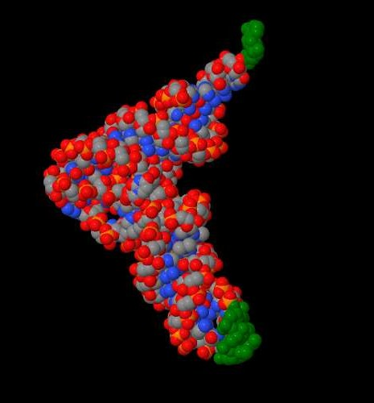
7.3.S2 The use of molecular visualization software to analyse the structure of eukaryotic ribosomes and a
tRNA molecule.
Use the RCSB Protein Bank to explore the
following Jmol images:
The large ribosomal subunit
The Path of Messenger RNA Through the Ribosome
A tRNA molecule
For each image:
Identify the structures you know of from your diagrams
Compare and constrast the usefulness of
the jmol image and your diagrams
http://www.rcsb.org/pdb/education_discussion/educational_resources/tRNA_jmol.jsp

Slide 7
Without computers analysis of the molecular structure such as ribosomal and tRNA structure would not be possible. The calculations that now take seconds to complete and would take weeks and months to do manually.
Nature of Science: Developments in scientific research follow improvements in computing—the use of computers has enabled scientists to make advances in bioinformatics applications such as locating genes within genomes and identifying conserved sequences. (3.7)
Bioinformatics also relies on computers to large extent as it involves analysing large amounts of data stored in vast databases. Bioinformatics is an interdisciplinary field of science, bioinformatics combines computer science, statistics, mathematics, and engineering to study and process biological data, in particular genetics and genomics.
http://www.rcsb.org/pdb/education_discussion/educational_resources/tRNA_jmol.jsp

Slide 8
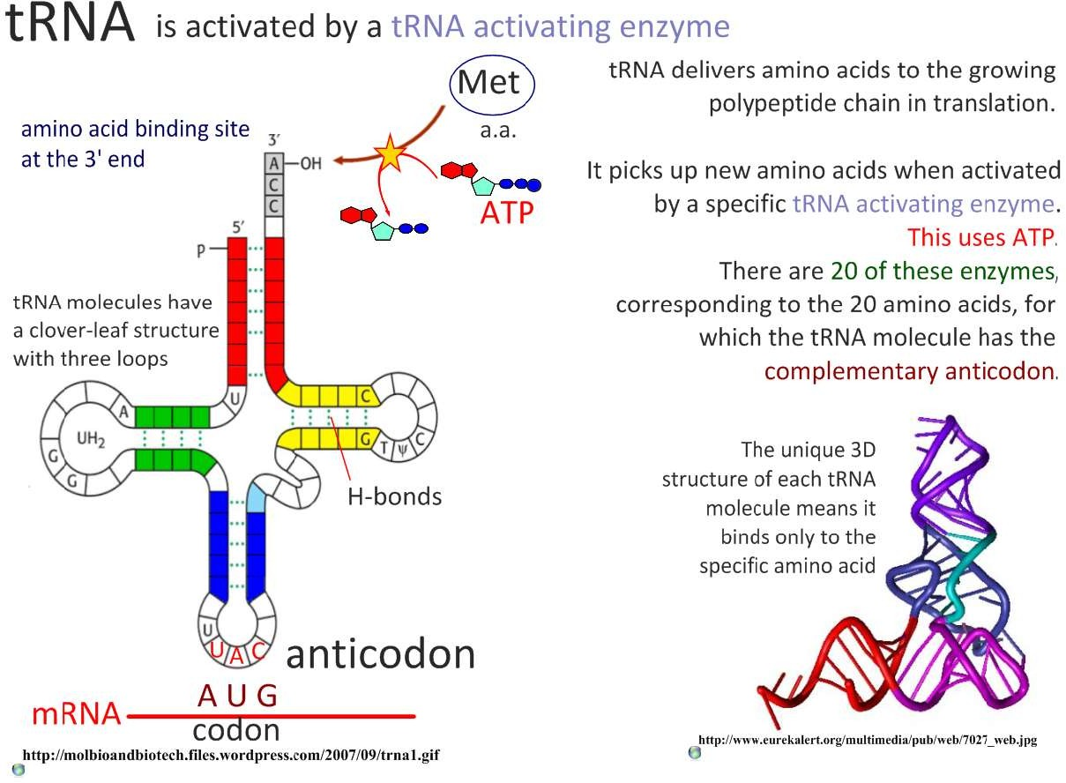
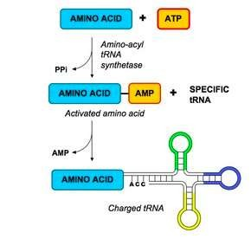
7.3.A1 tRNA-activating enzymes illustrate enzyme–substrate specificity and the role of phosphorylation.
The energy in the bond linking the tRNA molecule to the amino acid will be used in translation to form a peptide bond between adjacent amino acids
http://www.ib.bioninja.com.au/_Media/trna_activation_med.jpeg

Slide 9
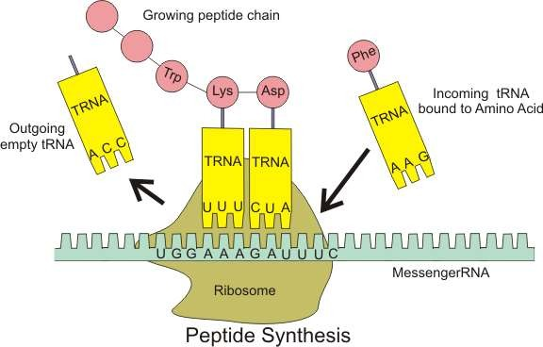
Review: 2.7.U8 Translation depends on complementary base pairing between codons on mRNA
and anticodons on tRNA.
Key components of translation that enable genetic code to synthesize polypeptides
tRNA molecules have an anticodon of three bases that binds to a complementary codon on mRNA
tRNA molecules carry the amino acid corresponding to their codon
2
3
mRNA has a sequence of codons that specifies the amino acid sequence of the polypeptide
4
Ribosomes:
act as the binding site for
mRNA and tRNA
catalyse the peptide bonds of the polypeptide
1
https://upload.wikimedia.org/wikipedia/commons/0/0f/Peptide_syn.png

Slide 10
The process of translation can be summarised by the following steps:
7.3.U1 Initiation of translation involves assembly of the components that carry out the process. AND 7.3.U2 Synthesis of the polypeptide involves a repeated cycle of events. AND 7.3.U3 Disassembly of the components follows termination of translation.
INITIATION | mRNA binds to the small subunit of the ribosome. The small subunit of the ribosome moves along the mRNA molecule in a 5' - 3' direction until it reaches a start codon (AUG) A molecule of tRNA (with it’s amino acid, Methionine attached) complementary to the start codon (UAC) binds to the P site of the ribosome The large subunit of the ribosome binds to the tRNA and small subunit
ELONGTION | A second tRNA (with amino acid attached) complementary to the second codon on the mRNA then binds to the A site of the ribosome The amino acid carried by the tRNA in the P site is transferred to the amino acid in the A site as a consequence of the ribosome catalyzing a new peptide bond (condensation reaction). The growing polypeptide increases in length. The ribosome moves one codon along the mRNA (in a 5’ – 3’ direction): The tRNA in the P site is moved to the E site and then released The tRNA in the A site is moved into P site Another tRNA binds, complementary to the next codon on the mRNA, binds to the A site. Steps 6, 7, and 8 are repeated until a stop codon is reached.
TERMINATION | 10. When a stop codon is reached translation is stopped. a release factor attaches to the A site the polypeptide chain is released the ribosome complex dissembles ready for reuse translating another mRNA molecule
initiation
elongation
termination

Slide 11

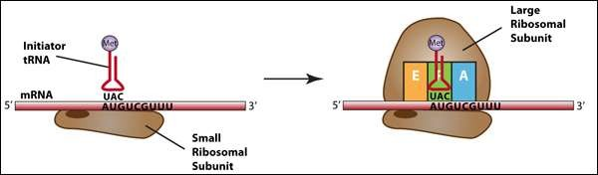
Initiation:
7.3.U1 Initiation of translation involves assembly of the components that carry out the process.
mRNA binds to the small subunit of the ribosome.
The small subunit of the ribosome moves along the mRNA molecule in a 5' - 3' direction until it reaches a start codon (AUG)
A molecule of tRNA (with it’s amino acid, Methionine attached) complementary to the start codon (UAC) binds to the P site of the ribosome
Note: a maximum of two tRNAs can be bound at the same time.
n.b. the A, P, E notation, though not necessary makes the process of translation easier to explain
4. The large subunit of the ribosome binds to the tRNA and small subunit
http://www.hartnell.edu/tutorials/biology/translation.html

Slide 12
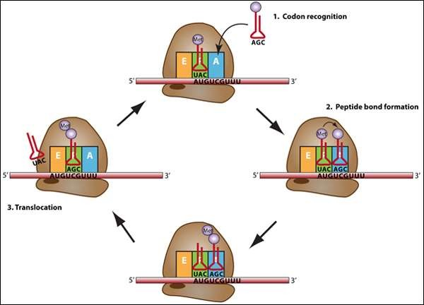
Elongation:
7.3.U2 Synthesis of the polypeptide involves a repeated cycle of events.
A second tRNA (with amino acid attached) complementary to the second codon on the mRNA then binds to the A site of the ribosome
The amino acid carried by the tRNA in the P site is transferred to the amino acid in the A site as a consequence of the ribosome catalyzing a new peptide bond (condensation reaction). The growing polypeptide increases in length.
The ribosome moves one codon along the mRNA (in a 5’ – 3’ direction):
  The tRNA in the P site is moved to the E site and then released
  The tRNA in the A site is moved into P site
Another tRNA binds, complementary to the next codon on the mRNA, binds to the A site.
Steps 6, 7, and 8 are repeated until a stop codon is reached.
http://www.hartnell.edu/tutorials/biology/translation.html

Slide 13
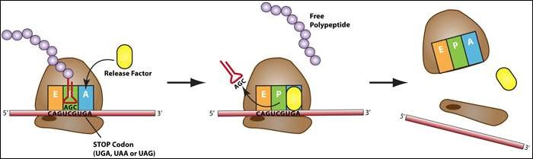
Termination:
7.3.U3 Disassembly of the components follows termination of translation.
When a stop codon is reached translation is stopped:
  a release factor attaches to the A site
  the polypeptide chain is released
  the ribosome complex dissembles ready for reuse translating another mRNA molecule
http://www.hartnell.edu/tutorials/biology/translation.html

Slide 14
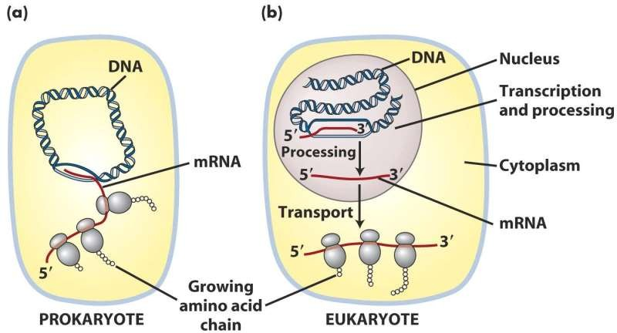
Translation can occur immediately after transcription in prokaryotes.
7.3.U6 Translation can occur immediately after transcription in prokaryotes due to the absence of a nuclear membrane.
Growing polypeptide chain
In prokaryotes ribosomes can be adjacent to the chromosomes whereas in eukaryotes the mRNA needs to be relocated from the nucleus to the cytoplasm (through the nuclear membrane)
In eukaryotes the mRNA is modified, e.g. spliced, (here labelled processing) after transcription before translation, this does not occur in prokaryotes
http://barleyworld.org/sites/default/files/figure-08-01_0.jpg

Slide 15
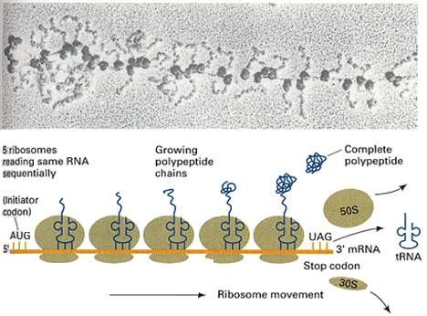
A polysome is a structure that consists of multiple ribosomes attached to a single mRNA
7.3.S1 Identification of polysomes in electron micrographs of prokaryotes and eukaryotes.
Multiple ribosomes translating mRNA simultaneously enables the cell to quickly create many copies of the required polypeptide.
Electron micrograph showing a polysome
Diagram of a generalised polysome
http://urei.bio.uci.edu/~hudel/bs99a/lecture21/polysome.gif

Slide 16
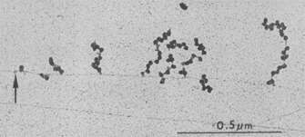
In prokaryotes the chromosome may have numerous polysomes attached directly to it.
7.3.S1 Identification of polysomes in electron micrographs of prokaryotes and eukaryotes.
Features to take note of:
The arrow indicates the chromosome
Polysomes show as the side chains. The dark ball-like ribosomes on each polysome side chain are clearly visible
Electron micrograph showing growing polysomes on a chromosome from E. coli.
n.b. polysomes in eukaryotes occur separately in the cytoplasm or on the ER. This is because Ribosomes attach to the mRNA as it is being translated.
http://www.nature.com/scitable/content/27459/williams_polysome_mid_1.jpg

Slide 17
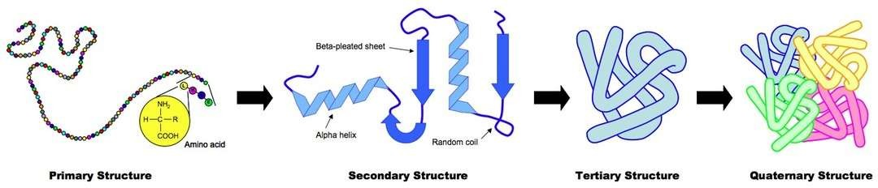
There are four levels of protein structure. Which level a protein conforms to is
determined by it’s amino acid sequence.
7.3.U7 The sequence and number of amino acids in the polypeptide is the primary structure. AND 7.3.U8 The secondary structure is the formation of alpha helices and beta pleated sheets stabilized by hydrogen bonding. AND 7.3.U9 The tertiary structure is the further folding of the polypeptide stabilized by interactions between R groups. AND 7.3.U10 The quaternary structure exists in proteins with more than one polypeptide chain.
(Polypeptide)
The order / sequence of the amino acids of which the protein is composed
Formed by covalent peptide bonds between adjacent amino acids
Controls all subsequent levels of structure
The chains of amino acids fold or turn upon themselves
Held together by hydrogen bonds between (non-adjacent) amine (N-H) and carboxylic (C-O) groups
H-bonds provide a level of structural stability
Fibrous proteins
The polypeptide folds and coils to form a complex 3D shape
Caused by interactions between R groups (H- bonds, disulphide bridges, ionic bonds and hydrophilic / hydrophobic interactions)
Tertiary structure may be important for the function (e.g. specificity of active site in enzymes)
Globular proteins
The interaction between multiple polypeptides or prosthetic groups
A prosthetic group is an inorganic compound involved in a protein (e.g. the heme group in haemoglobin)
Fibrous and Globular proteins

