Slide 1
Self Quiz

Slide 2
Do atoms always have an equal number of protons,
neutrons and electrons?
Yes.
No.

Slide 3
Do atoms always have an equal number of protons,
neutrons and electrons?
Yes.
No.

Slide 4
A chemical bond is formed through:
The gaining, losing, or sharing of protons.
The gaining, losing, or sharing of neutrons.
The gaining, losing, or sharing of electrons.
The gaining, losing, or sharing of isotopes.
The gaining, losing, or sharing of ions.

Slide 5
A chemical bond is formed through:
The gaining, losing, or sharing of protons.
The gaining, losing, or sharing of neutrons.
The gaining, losing, or sharing of electrons.
The gaining, losing, or sharing of isotopes.
The gaining, losing, or sharing of ions.

Slide 6
After sodium loses an electron, it is:
A positive ion.
A negative ion.
A neutral ion.
An isotope.
A compound.

Slide 7
After sodium loses an electron, it is:
A positive ion.
A negative ion.
A neutral ion.
An isotope.
A compound.

Slide 8
After chlorine gains an electron, it is:
A positive ion.
A negative ion.
A neutral ion.
An isotope.
A compound.

Slide 9
After chlorine gains an electron, it is:
A positive ion.
A negative ion.
A neutral ion.
An isotope.
A compound.

Slide 10
How many electrons does sodium lose to chlorine to form an ionic bond?
1. 1
2. 2
3. 3
4. 4
5. 5
6. 6
7. 7
8. 8

Slide 11
How many electrons does sodium lose to chlorine to form an ionic bond?
1. 1
2. 2
3. 3
4. 4
5. 5
6. 6
7. 7
8. 8

Slide 12
What is the difference between a nonpolar covalent bond and a polar covalent bond?
A polar covalent bond results when there is unequal sharing of electrons in a molecule, whereas electrons are shared equally in a nonpolar covalent bond.
A polar covalent bond has two equal sides and a nonpolar
covalent bond has two different sides.
A nonpolar covalent bond is positively charged and a polar covalent bond is negatively charged.
A polar covalent bond is positively charged and a nonpolar covalent bond is negatively charged.

Slide 13
What is the difference between a nonpolar covalent bond and a polar covalent bond?
A polar covalent bond results when there is unequal sharing of electrons in a molecule, whereas electrons are shared equally in a nonpolar covalent bond.
A polar covalent bond has two equal sides and a nonpolar
covalent bond has two different sides.
A nonpolar covalent bond is positively charged and a polar covalent bond is negatively charged.
A polar covalent bond is positively charged and a nonpolar covalent bond is negatively charged.

Slide 14
A covalent chemical bond is one in which
electrons are removed from one atom and transferred to another atom so that the two atoms become oppositely charged.
protons or neutrons are shared by two atoms
electrons of one atom are transferred to another atom.
electrons are shared by two atoms

Slide 15
A covalent chemical bond is one in which
electrons are removed from one atom and transferred to another atom so that the two atoms become oppositely charged.
protons or neutrons are shared by two atoms
electrons of one atom are transferred to another atom.
electrons are shared by two atoms

Slide 16
A covalent bond is likely to be polar when
the electron being shared between two atoms is much more attracted to one of the atoms than the other atom.
the two atoms sharing electrons are different elements.
the two atoms sharing electrons are of the same element.
the two atoms are sharing electrons equally

Slide 17
A covalent bond is likely to be polar when
the electron being shared between two atoms is much more attracted to one of the atoms than the other atom.
the two atoms sharing electrons are different elements.
the two atoms sharing electrons are of the same element.
the two atoms are sharing electrons equally

Slide 18
The ionic bond of sodium chloride is formed
when
sodium and chlorine both lose electrons.
chlorine gains a proton from sodium.
sodium gains an electron from chlorine.
sodium and chlorine share an electron pair.
chlorine gains an electron from sodium.

Slide 19
The ionic bond of sodium chloride is formed
when
sodium and chlorine both lose electrons.
chlorine gains a proton from sodium.
sodium gains an electron from chlorine.
sodium and chlorine share an electron pair.
chlorine gains an electron from sodium.

Slide 20
Draw an atom and show the location of the proton, neutron and electron

Slide 21
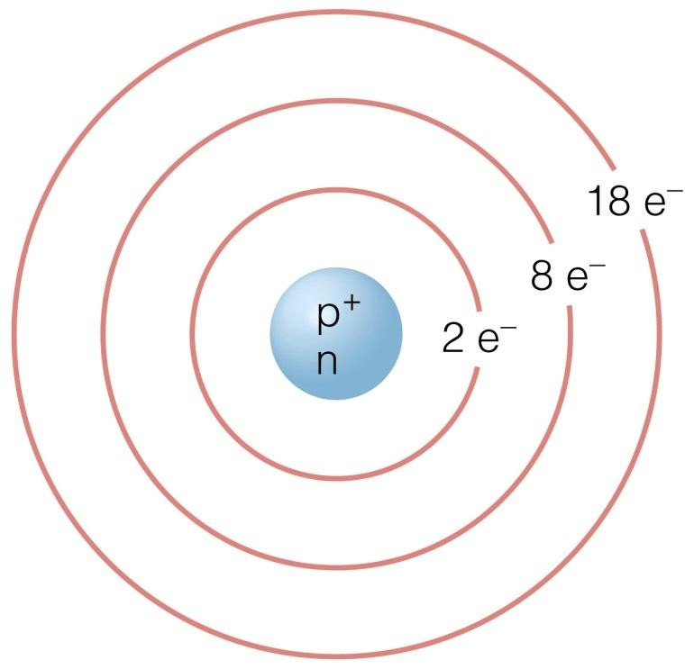
Draw an atom and show the location of the proton, neutron and electron
NOTE: Details of electron orbitals not expected

Slide 22
What type of bond results from attraction of opposite charges?

Slide 23
What type of bond results from attraction of opposite charges?
IONIC

