Slide 1
Industrial Uses of Enzymes

Slide 2
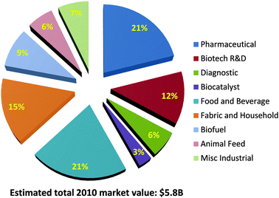
2.5.U5 Immobilized enzymes are widely used in industry.
Common uses of enzymes in industry include:
Detergents contain proteases and lipases to help breakdown protein and fat stains
Enzymes are widely used in the food industry, e.g.
fruit juice, pectin to increase the juice yield from fruit
Fructose is used as a sweetener, it is converted from glucose by isomerase
Rennin is used to help in cheese production
Enzymes are used to breakdown the starch in grains into biofuels that can be combusted
Paper production uses enzymes to helping in the pulping of wood
In the textiles industry enzymes help in the processing of fibres, e.g. polishing cloth to make it appear more shiny
In the brewing industry enzymes help a number of processes including the clarification of the beer
In Medicine & Biotechnology enzymes are widely used in everything from diagnostic tests tests to contact lens cleaners to cutting DNA in genetic engineering.
http://pubs.rsc.org/services/images/RSCpubs.ePlatform.Service.FreeContent.ImageService.svc/ImageService/Articleimage/2013/CS/c3cs35506c/c3cs35506c-f1.gif

Slide 3
2.5.U5 Immobilized enzymes are widely used in industry.
Advantages of enzyme immobilization:
Concentration of substrate can be increased as the enzyme is not dissolved – this increases the rate of reaction
Recycled enzymes can be used many times, immobilized enzymes are easy to separate from the reaction mixture, resulting in a cost saving.
o
Separation of the products is straight forward (this also means that the the reaction can stopped at the correct time).
Stability of the enzyme to changes in temperature and pH is increased reducing the rate of degradation, again resulting in a cost saving.
Enzymes used in industry are usually immobilized. They are attached to a material so that their movement is restricted. Common ways of doing this are:
Aggregations of enzymes bonded together
Attached to surfaces, e.g. glass
Entrapped in gels, e.g. alginate gel beads
http://pubs.rsc.org/services/images/RSCpubs.ePlatform.Service.FreeContent.ImageService.svc/ImageService/Articleimage/2013/CS/c3cs35506c/c3cs35506c-f1.gif

Slide 4
2.5.A1 Methods of production of lactose-free milk and its advantages.

Slide 5
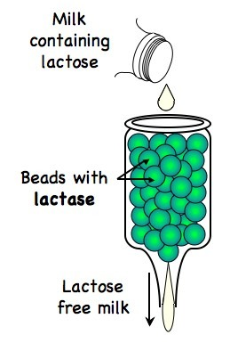
2.5.A1 Methods of production of lactose-free milk and its advantages.
Production of Lactose-free milk
Lactase obtained from commonly from yeast (bacteria is an alternative)
Lactase is bound to the surface of alginate beads
Milk is passed (repeatedly) over the beads
The lactose is broken down into glucose and galactose
The immobilized enzyme remains to be used again and does not affect the quality of the lactose free milk
Other uses of lactose free milk:
As a means to increase the sweetness of milk (glucose and galactose are sweeter in flavour), thus negating the need for artificial sweeteners
As a way of reducing the crystallisation of ice-creams (glucose and galactose are more soluble than lactose)
As a means of shortening the production time for yogurts or cheese (bacteria ferment glucose and galactose more readily than lactose)

Slide 6
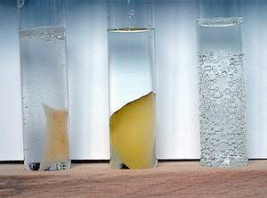
2.5.S1 Design of experiments to test the effect of temperature, pH and substrate concentration on the activity of enzymes. 2.5.S2 Experimental investigation of a factor affecting enzyme activity. (Practical 3)
Catalase is one of the most widespread enzymes. It catalyzes the conversion of hydrogen peroxide, a toxic by-product of metabolism, into water and oxygen.
Catalase
H₂O₂
H₂O + O₂
Possible research questions, what are you going to investigate (independent variable)?
What is the effect of substrate concentration?
What is the effect of temperature?
What is the effect of pH?
Which type of yeast has a higher concentration of catalase?
Important things to consider:
How are you going to vary the mass/volume/concentration of your variable?
What units will you be measuring your variable in?
Have you chosen an effect range or values to answer your question?
Are the concentrations/chemicals you are using safe to handle?
http://www.scienceexperimentsforkids.us/wp-content/uploads/2011/08/hydrogen-experiments-for-kids-3-img.jpg

Slide 7
2.5.S1 Design of experiments to test the effect of temperature, pH and substrate concentration on the activity of enzymes. 2.5.S2 Experimental investigation of a factor affecting enzyme activity. (Practical 3)
How are you going to measure your results (dependent variable)?
Are you measuring the increase of a product or the disappearance of a substrate?
Are you measuring directly (e.g. testing for the concentration of the product) or indirectly (change in pH)?
What equipment will you be using to measure your results?
What are the units and uncertainty given both the equipment and how you choose to use it?
What time period do you need to run the experiment for? How fast is the enzyme action likely to be?
How many repeats will you need to make sure your results are reliable?
http://www.scienceexperimentsforkids.us/wp-content/uploads/2011/08/hydrogen-experiments-for-kids-3-img.jpg

Slide 8
2.5.S1 Design of experiments to test the effect of temperature, pH and substrate concentration on the activity of enzymes. 2.5.S2 Experimental investigation of a factor affecting enzyme activity. (Practical 3)
How are you going to make sure it is a fair test (control variables)?
What variables other than your independent variable could affect the results?
Why would these variables affect the results?
How will you ensure each is kept constant and monitored?
What level should they be kept constant at? If a control variable is too far from it’s optimum then it could limit the enzyme action and no change would be seen in the results.
If a variable cannot be controlled it should still be discussed and considered as an uncontrolled variable.
Safety and ethics:
Are you using any equipment that may cause you or others harm? What steps have you taken to minimize this risk?
If you intend to use animals have you first considered alternative subjects?
If you still intend to use animals are subjects have you ensured both:
no harm comes to them as a result of the experiment
The experiment does not induce stress or conditions beyond that normally found in their natural environment
http://www.scienceexperimentsforkids.us/wp-content/uploads/2011/08/hydrogen-experiments-for-kids-3-img.jpg

