Slide 1
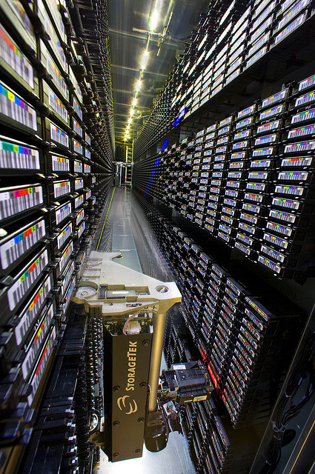
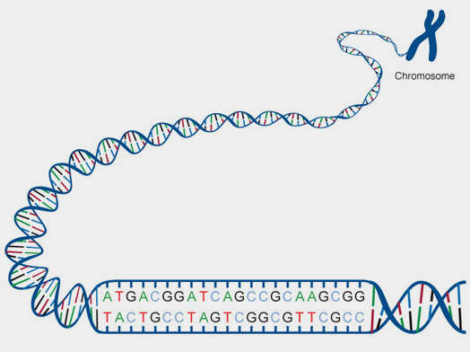
2.6 Structure of DNA and RNA
Essential idea: The structure of DNA allows efficient storage of genetic information.
There is 2m of DNA in each human cell, however the most cells in the human body have a diameter of 10 μm. This DNA is divided in chromosomes and coiled around proteins called histones to be efficiently stored in each cell's nucleus.
The human genome project which has decoded the base sequence for the whole 2m of the human genome requires a data warehouse (pictured) to store the information electronically. This should give a good idea of just how efficient DNA is at storing information and why it needs to be so.
http://www.britannica.com/blogs/2013/11/big-data-meets-tiny-storage/

Slide 2
2.6.U1 The nucleic acids DNA and RNA are polymers of nucleotides.
Some key points about the structure of DNA
DNA is a double helix; it has two strands that twist around each other. Each stand is made of single units called nucleotides.
It has a sugar-phosphate backbone.
Bases join the two strands by hydrogen bonds. These bases are cytosine, guanine, adenine and thymine
Complementary base paring is a key idea in genetics: C pairs with G, and T with A
Each strand of DNA can be millions of base-pairs in length and is coiled up to make chromosomes.

Slide 3
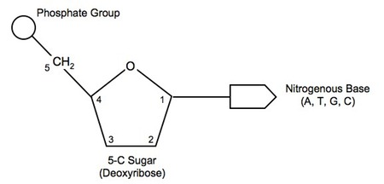
2.6.U1 The nucleic acids DNA and RNA are polymers of nucleotides.
A nucleotide: a single unit of a nucleic acid
Nucleic acids are very large molecules that are constructed by linking together nucleotides to form a polymer.
There are two types of nucleic acid: DNA and RNA.

Slide 4
2.6.U1 The nucleic acids DNA and RNA are polymers of nucleotides.
A nucleotide: a single unit of a nucleic acid
acidic
negatively charged
contains nitrogen
has one or two rings in it’s structure
covalent bond
five carbon atoms = a pentose sugar
If the sugar is Deoxyribose the polymer is Deoxyribose Nucleic Acid (DNA)
If the sugar Ribose the polymer is Ribose Nucleic Acid (RNA)
covalent bond

Slide 5
2.6.U1 The nucleic acids DNA and RNA are polymers of nucleotides.
There are four nitrogenous bases in DNA:
Adenine (A) Guanine (G) Thymine (T) Cytosine (C)
RNA Shares the same bases except that Uracil (U) replaces Thymine
n.b. when talking about bases always use the full name on the first instance

Slide 6
2.6.U1 The nucleic acids DNA and RNA are polymers of nucleotides.

Slide 7
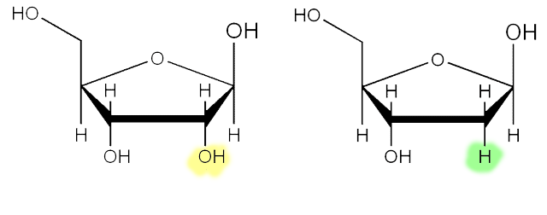
2.6.U2 DNA differs from RNA in the number of strands present, the base composition and the type of pentose.
 | RNA | DNA
Bases | Adenine (A) Guanine (G) Uracil (U) Cytosine (C) | Adenine (A) Guanine (G) Thymine (T) Cytosine (C)
Sugar | Ribose | Deoxyribose
Number of strands | Single stranded, and often, but not always, linear in shape | Two anti-parallel, complementary strands form a double helix

Slide 8
2.6.U3 DNA is a double helix made of two antiparallel strands of nucleotides linked by hydrogen bonding between complementary base pairs.

Slide 9
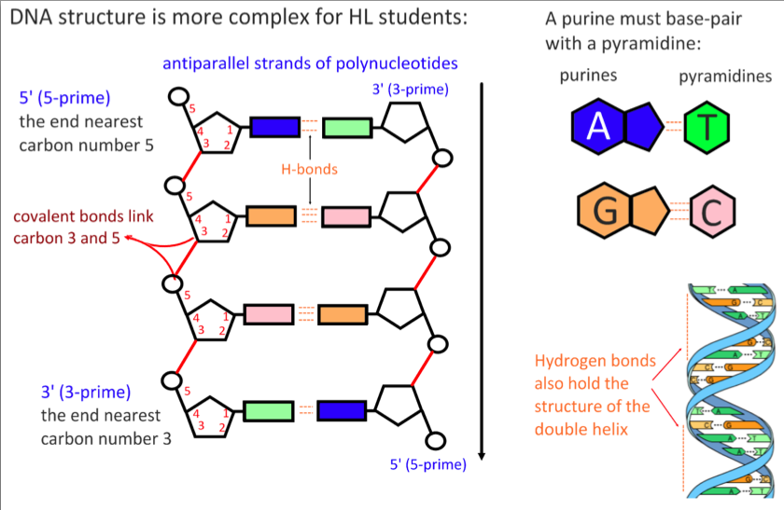
2.6.U3 DNA is a double helix made of two antiparallel strands of nucleotides linked by hydrogen bonding between complementary base pairs.

Slide 10
2.6.U3 DNA is a double helix made of two antiparallel strands of nucleotides linked by hydrogen bonding between complementary base pairs.

Slide 11
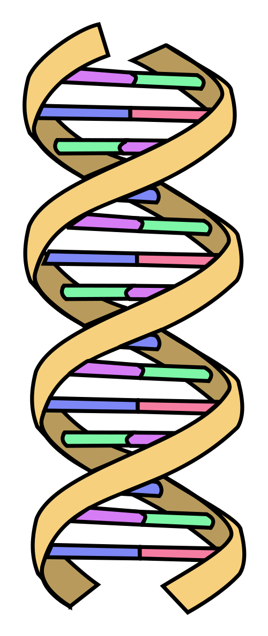
2.6.U3 DNA is a double helix made of two antiparallel strands of nucleotides linked by hydrogen bonding between complementary base pairs.
In Summary:
Each polynucleotide chain (strand) consists of a chain of nucleotides bonded covalently.
Two polynucleotide chains of DNA are held together by hydrogen bonds between complementary base pairs:
Adenine pairs with thymine (A=T) via two hydrogen bonds
Guanine pairs with cytosine (G=C) via three hydrogen bonds
In order for bases to be facing each other and thus able to pair, the two strands must run in opposite directions (i.e. they are anti-parallel)
As the polynucleotide chain lengthens, the atoms that make up the molecule will arrange themselves in an optimal energy configuration. This position of least resistance results in the double-stranded DNA twisting to form a double helix with approximately 10 - 15 bases per twist.

Slide 12
2.6.S1 Drawing simple diagrams of the structure of single nucleotides of DNA and RNA, using circles, pentagons and rectangles to represent phosphates, pentoses and bases.
Use this simple, but very effective You Tube video to learn how to draw the nucleotides making up a short section of a DNA molecule.
To make sure you have learn this skill you need to practice it repeatedly.
n.b. ideally label lines should be drawn with and ruler and should not have arrow heads.

Slide 13
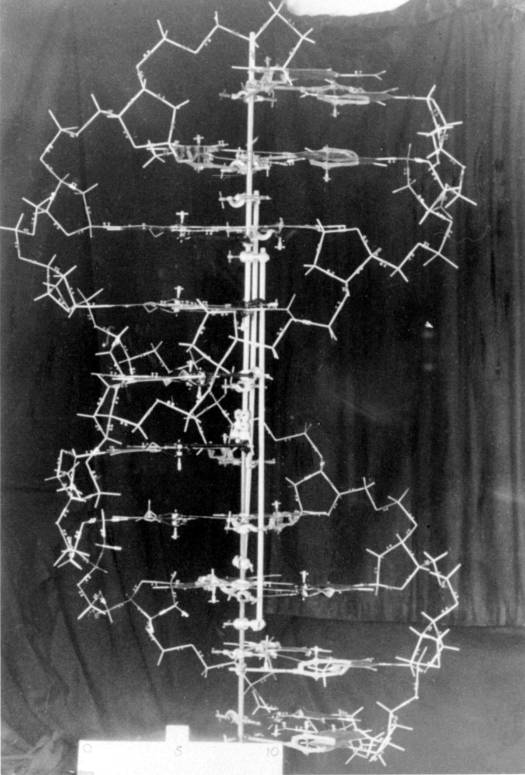
2.6.A1 Crick and Watson’s elucidation of the structure of DNA using model making.
Whilst others worked using an experimental basis Watson and Crick used stick-and-ball models to test their ideas on the possible structure of DNA. Building models allowed them to visualize the molecule and to quickly see how well it fitted the available evidence.
It was not all easy going however. Their first model, a triple helix, was rejected for several reasons:
The ratio of Adenine to Thymine was not 1:1 (as discovered by Chargaff)
It required too much magnesium (identified by Franklin)
From their setbacks they realized:
DNA must be a double helix.
The relationship between the bases and base pairing
The strands must be anti-parallel to allow base pairing to happen
Because of the visual nature of their work the second and the correct model quickly suggested:
Possible mechanisms for replication
Information was encoded in triplets of bases
http://scarc.library.oregonstate.edu/coll/nonspcoll/catalogue/picture-dnamodel-900w.jpg

Slide 14
2.6.A1 Crick and Watson’s elucidation of the structure of DNA using model making.
Watson and Crick gained Nobel prizes for their discovery. It should be remembered that their success was based on the evidence they gained from the work of others. In particular the work of Rosalind Franklin and Maurice Wilkins, who were using X-ray diffraction was critical to their success.
Find out more about the discovery of DNA:
http://www.nobelprize.org/educational/medicine/dna_double_helix/readmore.html
http://scarc.library.oregonstate.edu/coll/nonspcoll/catalogue/picture-dnamodel-900w.jpg
http://youtu.be/sf0YXnAFBs8

