Slide 1
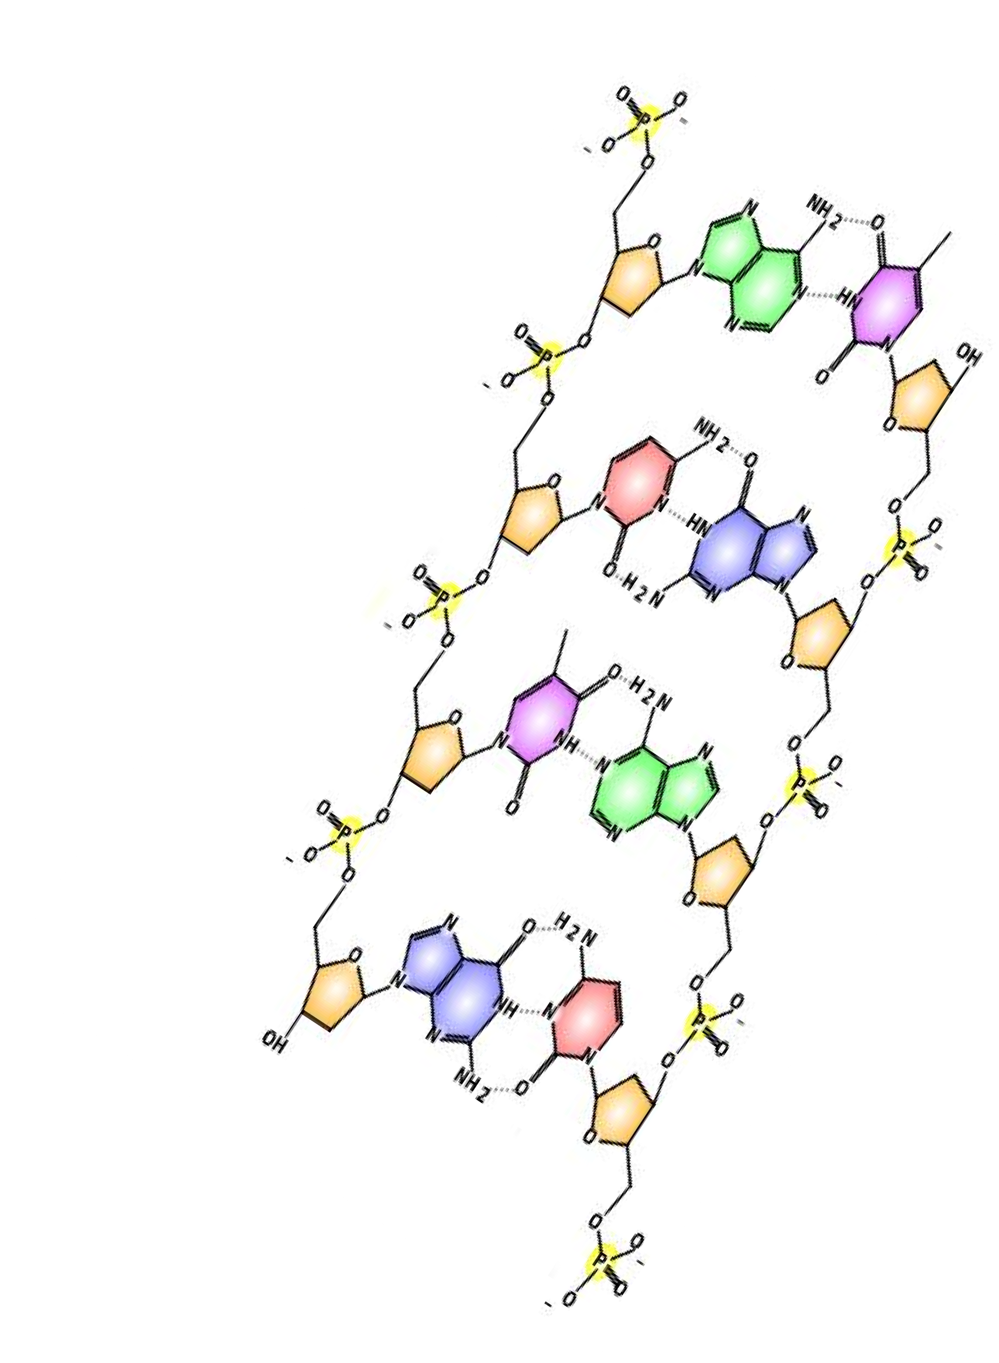
DNA Structure
Be able to label the following:
5’ end
3’ end
Phosphate (circled)
Deoxyribose (circled)
Purine
Pyrimidine
Deoxyribose carbon numbering
Hydrogen bond
Covalent bond
Adenine
Thymine
Guanine
Cytosine
Nucleotide

Slide 2
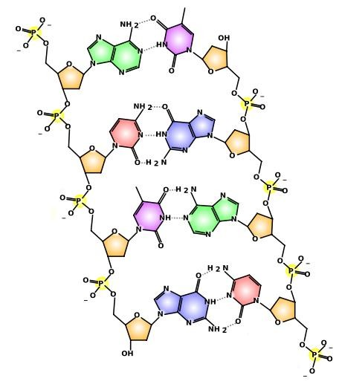
DNA Structure
Be able to label the following:
5’ end
3’ end
Five is the
phosphate end
1.
2.
3.
4.
5.
6.
Deoxyribose carbon numbering
Hydrogen bond
Covalent bond
Adenine
Thymine
Guanine
Cytosine
Nucleotide
5’ end
3’ end
Phosphate (circled) Deoxyribose (circled) Purine
Pyrimidine
Three rhymes with
“de”oxyribose
Video clip:
What do we mean when we
talk about the 3’ and 5’ ends of DNA?
3’ end

Slide 3
DNA Structure
Be able to label the following:
5’ end
3’ end
Phosphate (circled)
Deoxyribose (circled)
Purine
Pyrimidine
Deoxyribose carbon numbering
Hydrogen bond
Covalent bond
Adenine
Thymine
Guanine
Cytosine
Nucleotide
Phosphate
Include the
P and the 4 O
Deoxyribose
Include the kink for carbon 5 but NOT the O of the phosphate group

Slide 4
Pyrimidine
DNA Structure
Be able to label the following:
5’ end
3’ end
Phosphate (circled)
Deoxyribose (circled)
Purine
Pyrimidine
Deoxyribose carbon numbering
Hydrogen bond
Covalent bond
Adenine
Thymine
Guanine
Cytosine
Nucleotide
Any “single-ring” nitrogenous base
Cytosine and Thymine are both Pyrimidines
Purine
Any “two-ring” nitrogenous base

Slide 5
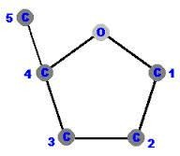
DNA Structure
Be able to label the following:
5’ end
3’ end
Phosphate (circled)
Deoxyribose (circled)
Purine
Pyrimidine
Deoxyribose carbon numbering
Hydrogen bond
Covalent bond
Adenine
Thymine
Guanine
Cytosine
Nucleotide

Slide 6
DNA Structure
Be able to label the following:
Covalent Bond:
Solid line
Connects base to sugar
Connects phosphate to sugar
5’ end
3’ end
Phosphate (circled)
Deoxyribose (circled)
Purine
Pyrimidine
Deoxyribose carbon numbering
Hydrogen bond
Covalent bond
Adenine
Thymine
Guanine
Cytosine
Nucleotide
Hydrogen Bond:
Dotted line
Connects base to base

Slide 7
Thymine
DNA Structure
Be able to label the following:
5’ end
3’ end
Phosphate (circled)
Deoxyribose (circled)
Purine
Pyrimidine
Adenine
The “double-ring” nitrogenous base that can make 2 H-bonds
The “single-ring” nitrogenous base that can make 2 H-bonds
7. Deoxyribose carbon numbering 8. Hydrogen bond
9. Covalent bond
Adenine
Thymine
Guanine
Cytosine
Nucleotide

Slide 8
DNA Structure
Be able to label the following:
5’ end
3’ end
Phosphate (circled)
Deoxyribose (circled)
Purine
Pyrimidine
Deoxyribose carbon numbering 8. Hydrogen bond
Covalent bond
Adenine
Thymine
Guanine
The “double-ring”
Cytosine
The “single-ring” nitrogenous base that can make 3 H-bonds
nitrogenous base that
can make 3 H-bonds
Guanine
Cytosine
Nucleotide

Slide 9
DNA Structure
Be able to label the following:
5’ end
3’ end
Phosphate (circled)
Deoxyribose (circled)
Purine
Pyrimidine
Deoxyribose carbon numbering 8. Hydrogen bond
Covalent bond
Adenine
Thymine
Guanine
Cytosine
14. Nucleotide
Nucleotide
One phosphate, sugar and base combination

Slide 10

DNA Structure
Be able to label the following:
5’ end
3’ end
Phosphate (circled)
Deoxyribose (circled)
Purine
Pyrimidine
Deoxyribose carbon numbering
Hydrogen bond
Covalent bond
Adenine
Thymine
Guanine
Cytosine
Nucleotide
Here’s a blank diagram for you to practice your labeling!

