Slide 1
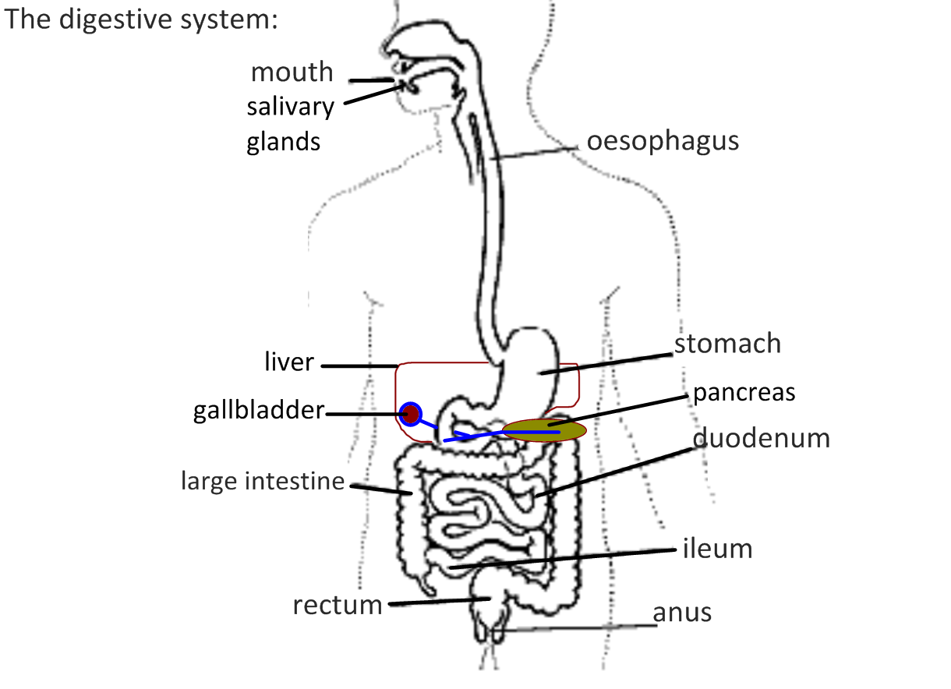
Digestion
Adapted from Stephen Taylor i-Biology

Slide 2
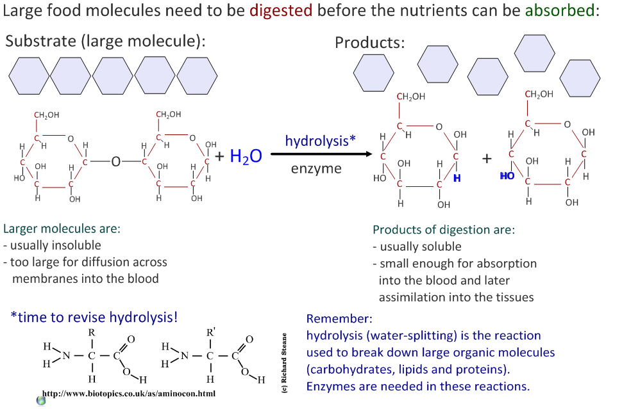

Slide 3
Digestion uses enzymes!

Slide 4
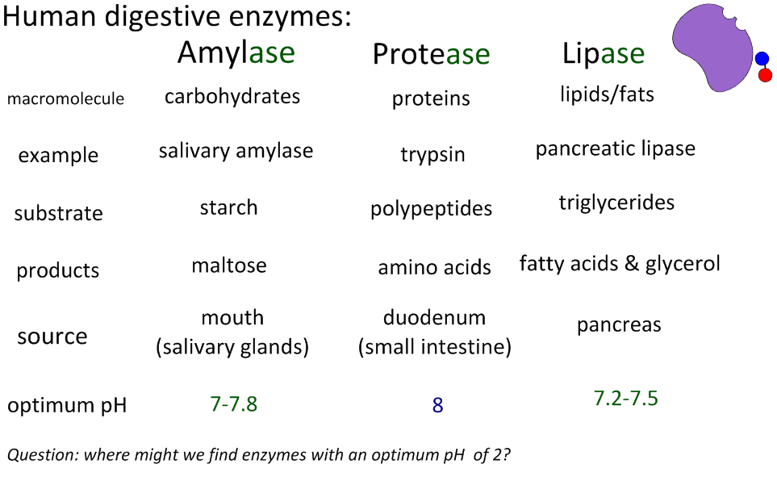
Enzyme substrate and products

Slide 5
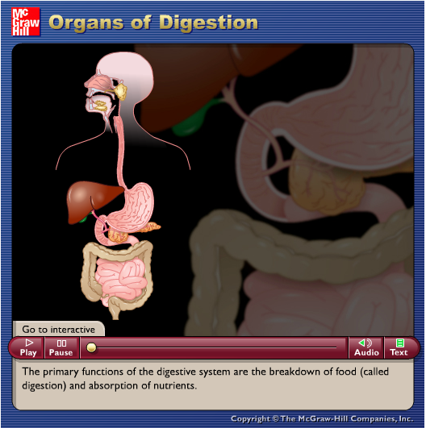
http://highered.mcgraw-hill.com/sites/0072495855/student_view0/chapter26/animation__organs_of_digestion.html

Slide 6
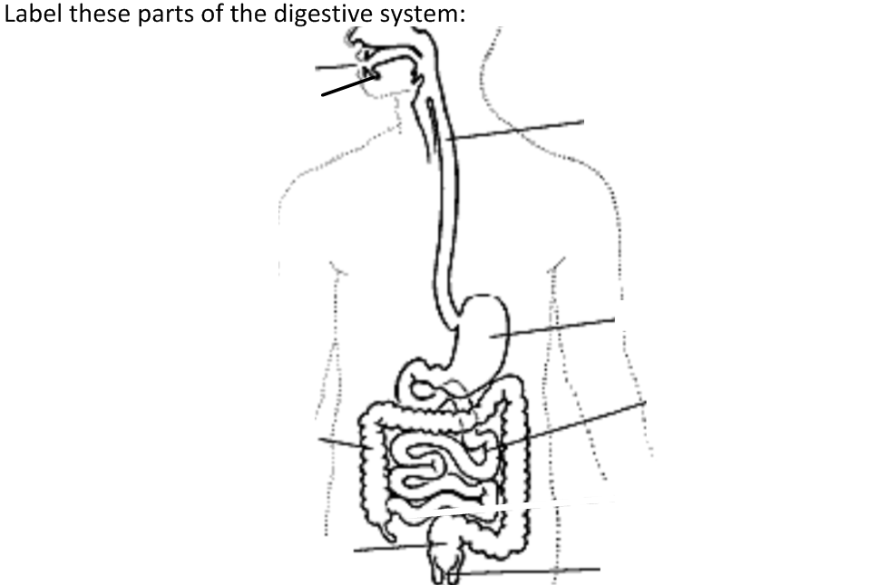

Slide 7
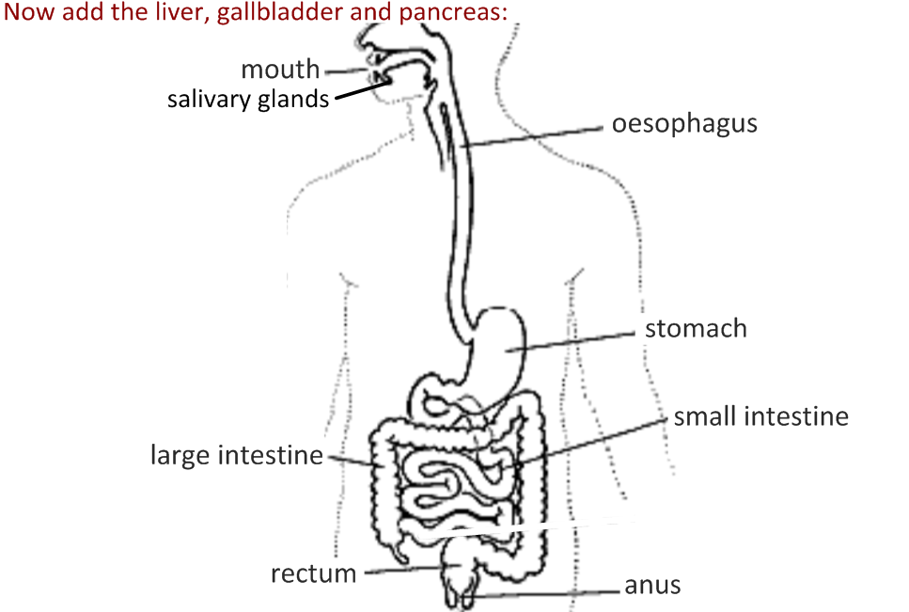

Slide 10
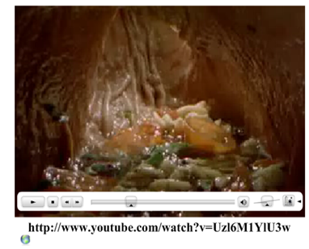

Slide 11
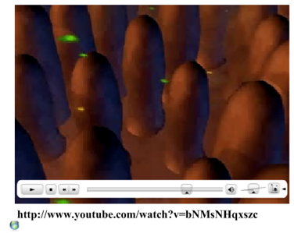

Slide 12
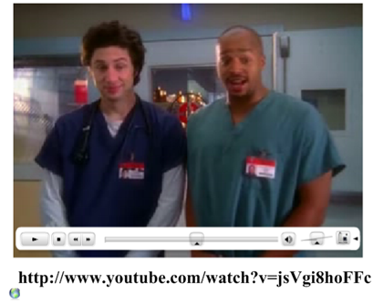

Slide 13
