Slide 1
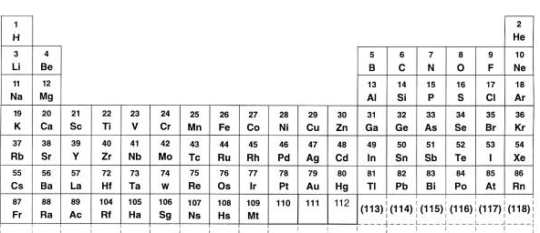
How does H₂O form??

Slide 2
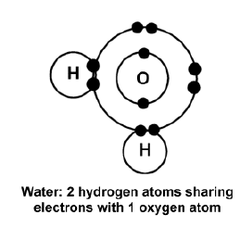

Slide 3
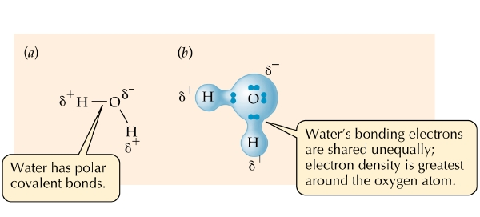
Polar covalent bond: covalent bond in which the electron pairs are unequally shared.

Slide 4
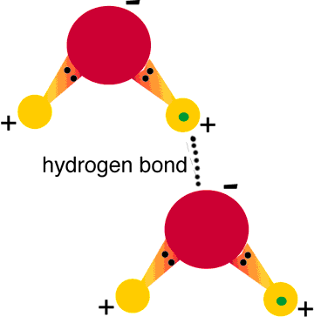
Water Molecules Attract each other by Means of Hydrogen Bonds
Hydrogen Bond: Attraction between the partial negative charge on O of one H₂O molecule and the partial positive charge on the H of another H₂O molecule

Slide 5
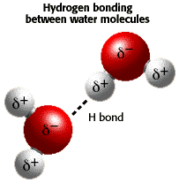

Slide 6
One water molecule is attracted to other water molecules by hydrogen bonds.

Slide 7
Since water is polar:
Water molecules are attracted to other water molecules – COHESION
Water molecules are attracted to other polar molecules - ADHESION

Slide 8
Water’s polarity and the hydrogen bonding that results:
give water unique properties which make water very important on Earth

Slide 9
Importance of Water to Life
Life on Earth began in water and evolved there for 3 billion years before spreading to land
Cells are 70-95% water
Most cells are surrounded by water

Slide 10
Importance of Water to Life, cont’d.
Although life adapts to its environment through natural selection, for life to exist at all, the environment must first be a suitable abode.
Water is such a habitat.

Slide 11
Unique Properties of Water
Surface tension
Water transport in plants
High specific heat
High heat of vaporization
Expansion upon freezing
Solvent of life
Transparency to visible light

Slide 12
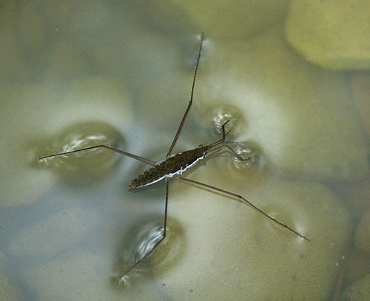
Exhibits Surface Tension
Result of hydrogen bonds pulling water on surface downward and sideways.
COHESION

Slide 13
Capillary Action
Tendency of water to rise in a thin tube. Result of:
Cohesion: attraction between one water molecule and another water molecule
Adhesion: attraction between water molecules and molecules of different substances

Slide 14
Capillary Action

Slide 15
Resists Temperature Change
Water has a high specific heat
Specific heat: amount of energy required to change temperature of a substance

Slide 16
Effect of Water’s High Specific Heat
Water can absorb a lot of heat without getting hot, and can lose a lot of heat without getting cold.

Slide 17
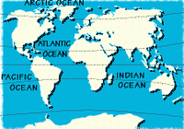
High Specific Heat:
Moderates Climate

Slide 18
High Specific Heat:
Allows organisms to maintain constant body temperature

Slide 19
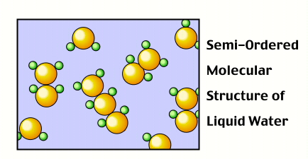
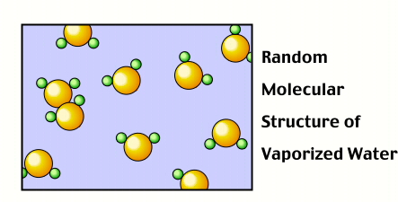
High Heat of Vaporization
It takes a lot of heat energy to change liquid water to gaseous water, because hydrogen bonds must be broken.
Evaporation of sweat takes heat from the body

Slide 20
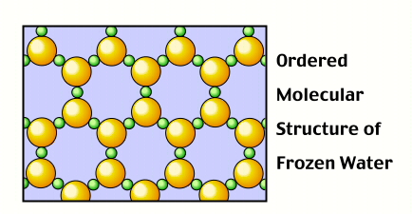
Expands upon Freezing

Slide 21
Importance of Expansion upon Freezing
Ice Floats!
Life at the bottom of bodies of water does not get crushed...it goes on even when the weather is very cold
Ice also serves as an insulator

Slide 22
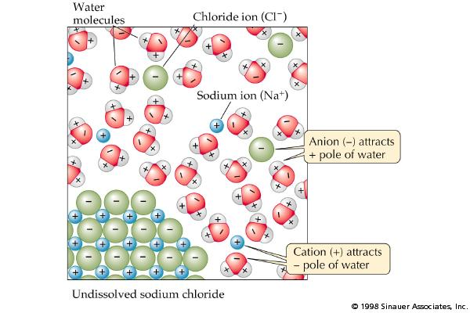
Is the Universal Solvent
Negative ion attracts positive pole of water
Positive ion attracts negative pole of water

Slide 23
Is transparent
Transparency is important to the growth of water plants
The clearer the water, the more sunlight can penetrate, and the greater the amount of photosynthesis that can take place

