Slide 1
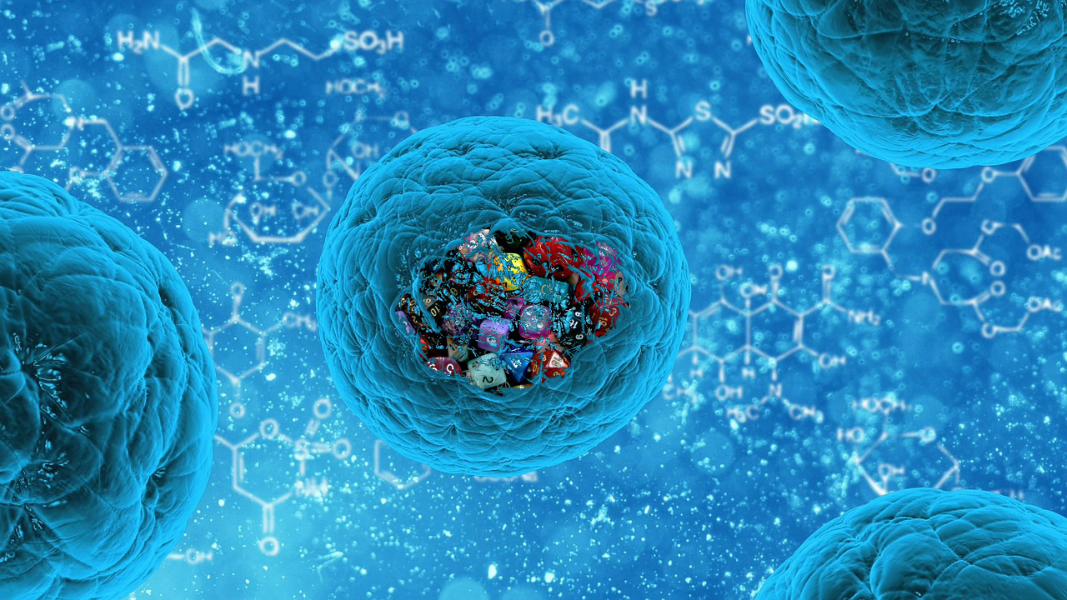
2.1 Molecules to metabolism
Essential idea: Living organisms control their composition by a complex web of chemical reactions.

Slide 2
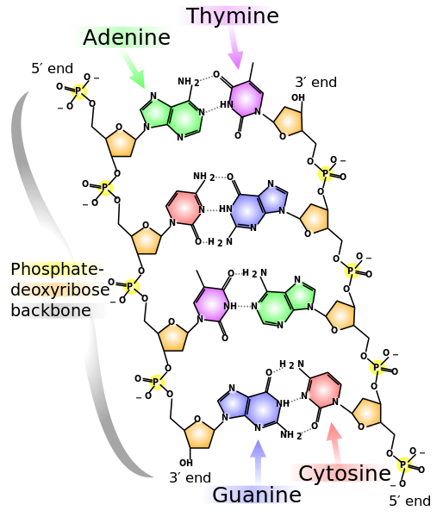
2.1.U1 Molecular biology explains living processes in terms of the chemical substances involved.
The structure of DNA was discovered in 1953, since then molecular Biology has transformed our understanding of living processes
The relationship between genes and the polypeptides they generate is at the heart of this science. The central idea can be simplified to “DNA makes RNA makes protein”. The information in this flow cannot be reversed and the protein generated cannot change the RNA or DNA.
https://en.wikipedia.org/wiki/File:DNA_chemical_structure.svg

Slide 3
2.1.U1 Molecular biology explains living processes in terms of the chemical substances involved.
The approach of a molecular Biologist is a reductionist one – they identify the steps in a metabolic pathway and breakdown each one into it’s component parts. This approach has been a very productive one. Our understanding of respiration (2.8) and photosynthesis (2.9) are good examples of the success of this approach.
Organic molecules, especially proteins, are very complex and varied. Hence organic compounds have a hugely varied roles within (and outside of) cells. There is a lot about organic molecules in cells we still have not discovered or understood.
Some scientists think that the reductionist approach alone is ultimately limited. Molecules can have dual roles (e.g. Melanin is the pigment that colours both skin and eyes) and also may interact with each other in ways that a reductionist approach overlooks.
https://en.wikipedia.org/wiki/File:DNA_chemical_structure.svg

Slide 4
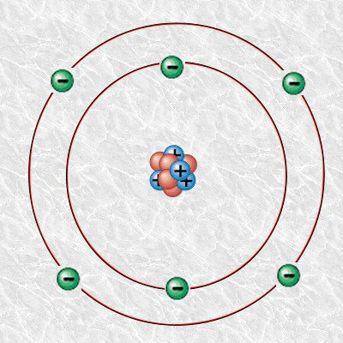
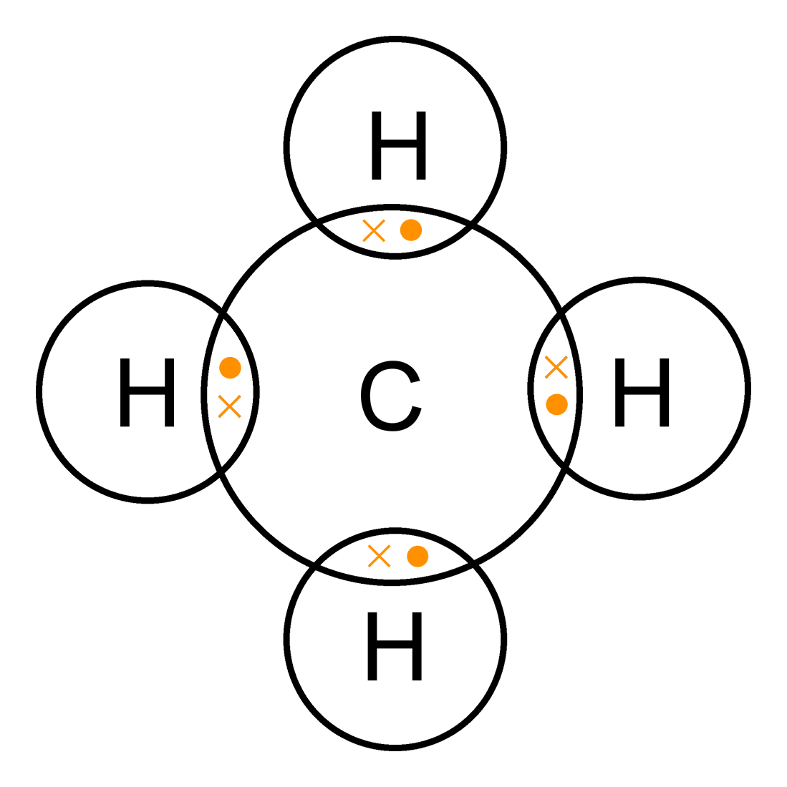
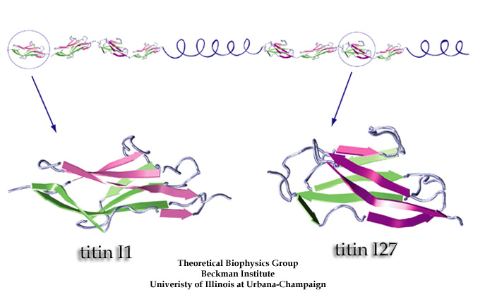
2.1.U2 Carbon atoms can form four covalent bonds allowing a diversity of stable compounds to exist.
Despite only being the 15th most abundant element on the planet carbon forms the backbone of every single organic molecule.
Carbon atoms contain four electrons in their outer shell allowing them to form four covalent bonds with potential four other different atoms, e.g. methane (CH₄).
Covalent bonds are the strongest type of bond between atoms. Stable molecules can be formed.
Because of the stability of covalent bonds large molecules with many bonds can be formed. Titin is the largest known protein and it contains 539,000 atoms (chemical formula C₁₆₉₇₂₃ H₂₇₀₄₆₄ N₄₅₆₈₈ O₅₂₂₄₃ S_{912.}). The image below show a small part of the Titin molecule.
The result of these properties is an almost infinite number of different possible molecules involving carbon.
http://commons.wikimedia.org/wiki/File:Carbon-atom.jpg
http://www.ks.uiuc.edu/images/ofmonth/2002-11/titin.jpg
http://upload.wikimedia.org/wikipedia/commons/3/3e/Methane-2D-dot-cross.png

Slide 5
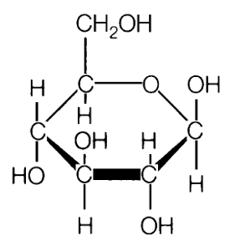
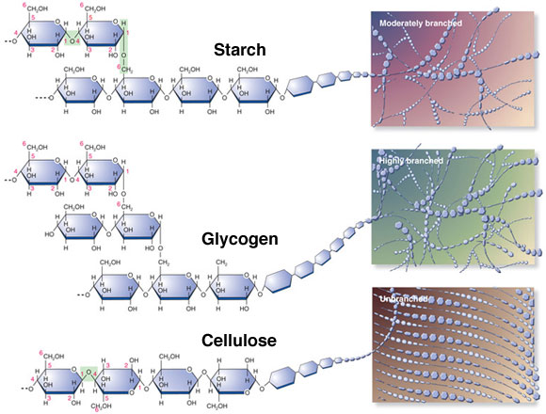
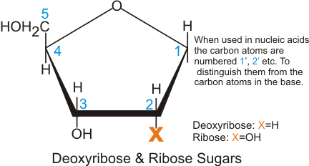
2.1.U3 Life is based on carbon compounds including carbohydrates, lipids, proteins and nucleic acids.
Carbohydrates
Contain carbon, hydrogen and oxygen
Organic compounds consisting of one or more simple sugars
Monomers follow the general basic formula of (CH2O)x
Monomers are commonly ring shaped molecules
Glucose – a hexose
(6 carbon) monomer
pentose (5 carbon) monomers
Note: Exceptions to this the basic formula and the inclusion of other elements (e.g. N) can occur
http://www.doctortee.com/dsu/tiftickjian/cse-img/biology/chemistry/polysaccharides.jpg

Slide 6
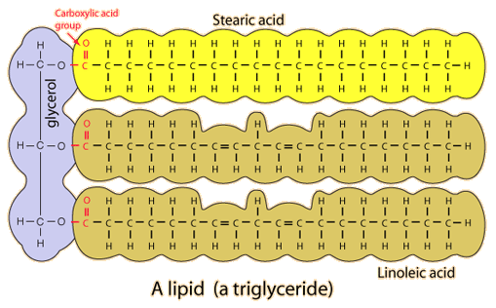
2.1.U3 Life is based on carbon compounds including carbohydrates, lipids, proteins and nucleic acids.
Lipids
Lipids are a group of organic molecules that are insoluble in water but soluble in non-polar organic solvents
Common lipids include triglycerides (fats – solid at room temperature and oils – liquid at room temperature), phospholipids and steroids
http://hyperphysics.phy-astr.gsu.edu/hbase/organic/imgorg/lipid.gif

Slide 7
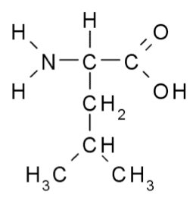
2.1.U3 Life is based on carbon compounds including carbohydrates, lipids, proteins and nucleic acids.
Proteins
Contain carbon, hydrogen, oxygen and nitrogen (additionally sulphur is common component, but it is not present in all proteins)
Proteins are large organic compounds made of amino acids arranged into one or more linear chains
Leucine – an amino acid

Slide 8
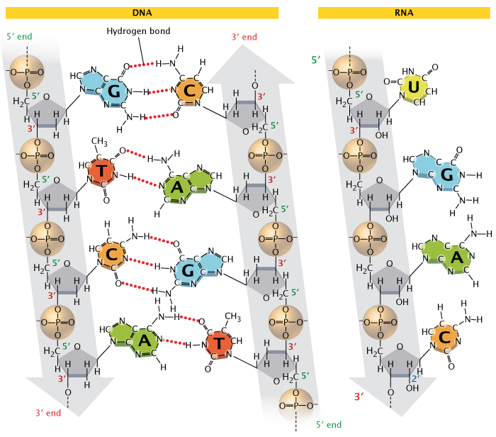
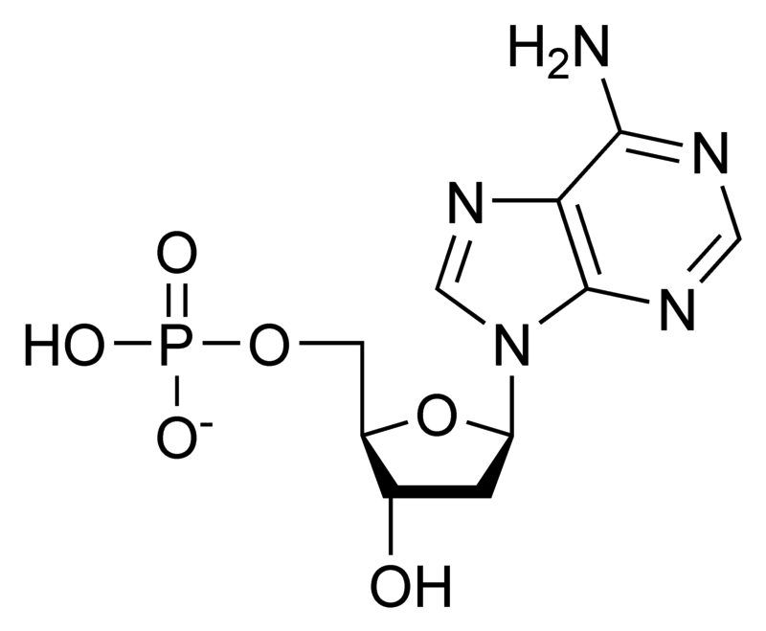
2.1.U3 Life is based on carbon compounds including carbohydrates, lipids, proteins and nucleic acids.
Nucleic acids
Contain carbon, hydrogen, oxygen, nitrogen and phosphorus
Chains of sub-units called nucleotides
Nucleotides consist of base, sugar and phosphate groups covalently bonded together
If the sugar is ribose then the nucleic acid formed is RNA if the sugar is deoxyribose then DNA is formed
phosphate
base
sugar
http://www.nature.com/scitable/topicpage/Chemical-Structure-of-RNA-348

Slide 9
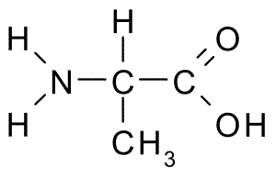
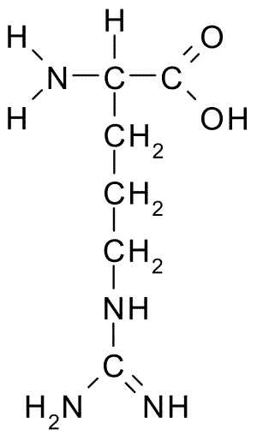
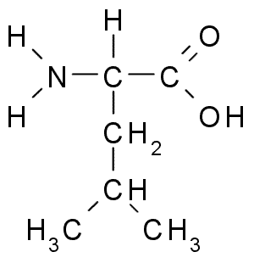
2.1.S2 Identification of biochemicals such as sugars, lipids or amino acids from molecular diagrams.
Alanine
Arginine
Leucine
Here are three of the twenty-one amino acids found in eukaryotes. Identify what parts of their structures are identical.
http://commons.wikimedia.org/wiki/File:Alanine.png
http://commons.wikimedia.org/wiki/File:Arginine.png
http://commons.wikimedia.org/wiki/File:Leucine.png

Slide 10
2.1.S2 Identification of biochemicals such as sugars, lipids or amino acids from molecular diagrams.
Alanine
Arginine
Leucine
Yeah, that bit…

Slide 11
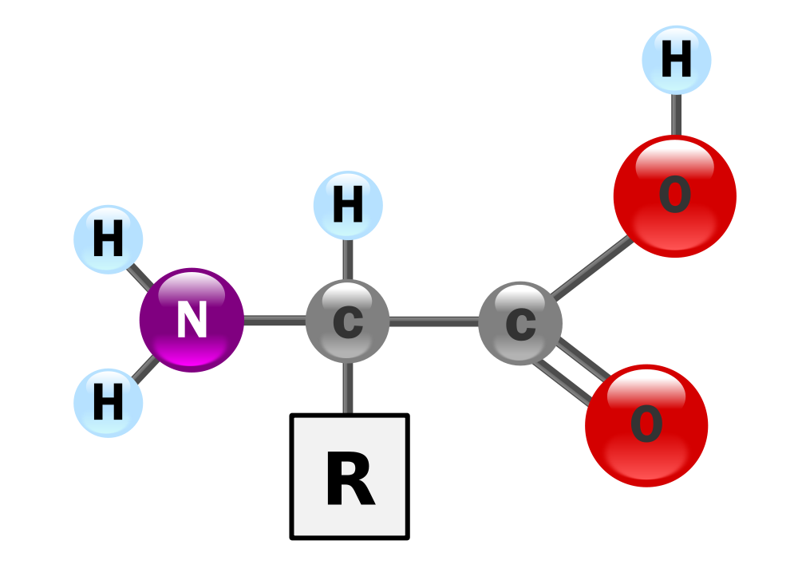
2.1.S2 Identification of biochemicals such as sugars, lipids or amino acids from molecular diagrams.
Drawn slightly differently you can see the bit that is always the same and the R Group.
The R group is like x in an equation. It is a variable that stands in for a bunch of different side chains
http://commons.wikimedia.org/wiki/File:AminoAcidball.svg

Slide 12
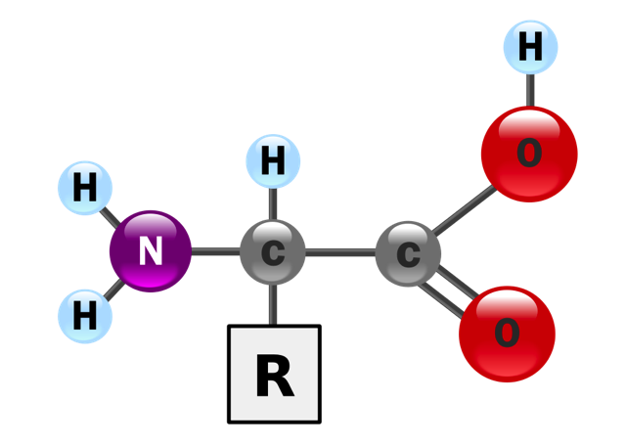
2.1.S2 Identification of biochemicals such as sugars, lipids or amino acids from molecular diagrams.
A simple H group
Central carbon atom
The amine group (NH₂)
The carboxyl group (COOH)
n.b. this is an acidic group
Look out for this structure

Slide 13
Hmmm… an amine group and an acid group…
What shall we
call this class
of molecule?
http://commons.wikimedia.org/wiki/File:Filos_tercer_logo.JPG

Slide 14
2.1.S2 Identification of biochemicals such as sugars, lipids or amino acids from molecular diagrams.
The amine and acid groups could be at opposite ends, the R could be on top, bottom or side depending on orientation.

Slide 15
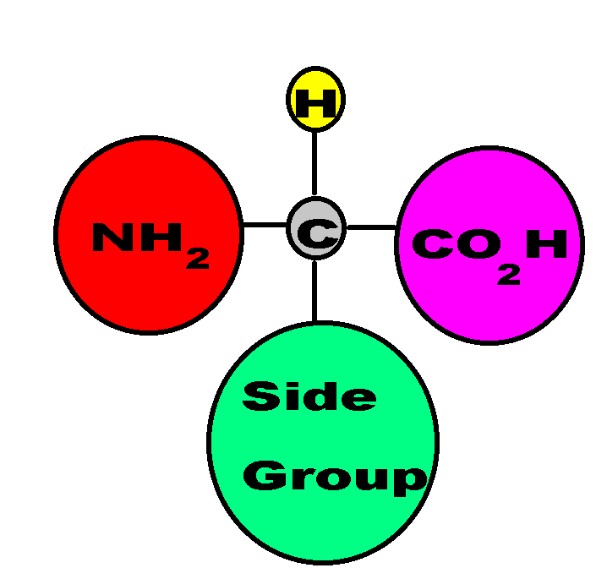
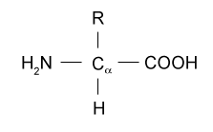
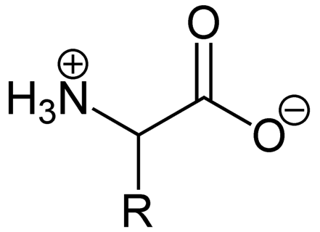
2.1.S2 Identification of biochemicals such as sugars, lipids or amino acids from molecular diagrams.
Or it could be represented differently:

Slide 16
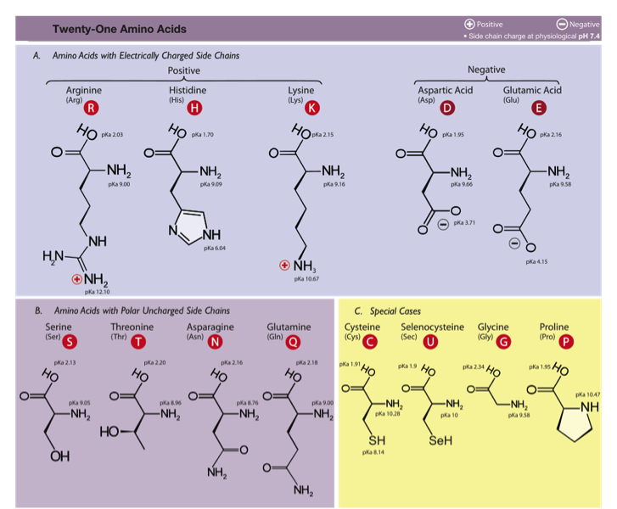
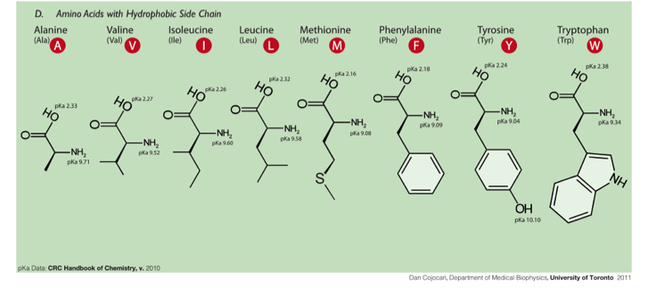
Don’t freak out, you don’t need to know them all, just the general formula
http://commons.wikimedia.org/wiki/File:Amino_Acids.svg

Slide 17
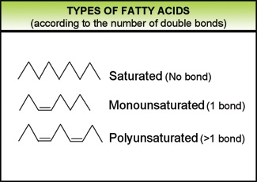
2.1.S2 Identification of biochemicals such as sugars, lipids or amino acids from molecular diagrams.
General structural formula for a fatty* acid
O
H₃C (CH₂)_{n} C
OH
Chain (or ring) of carbon and hydrogen atoms
Carboxylic group
*I prefer “big boned”
http://www.eufic.org/article/pt/nutricao/gorduras/expid/23/

Slide 18
2.1.S2 Identification of biochemicals such as sugars, lipids or amino acids from molecular diagrams.

Slide 19
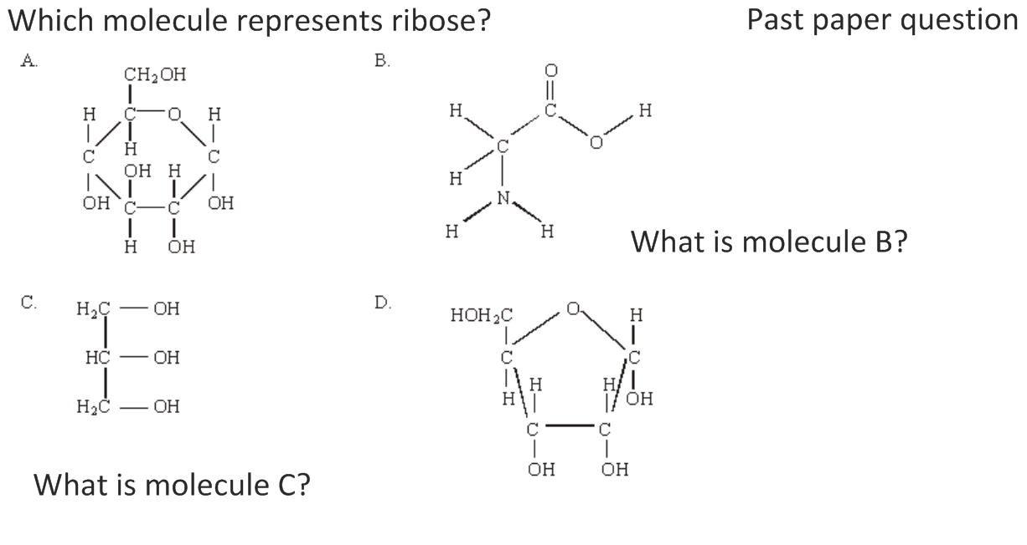
2.1.S2 Identification of biochemicals such as sugars, lipids or amino acids from molecular diagrams.

Slide 20
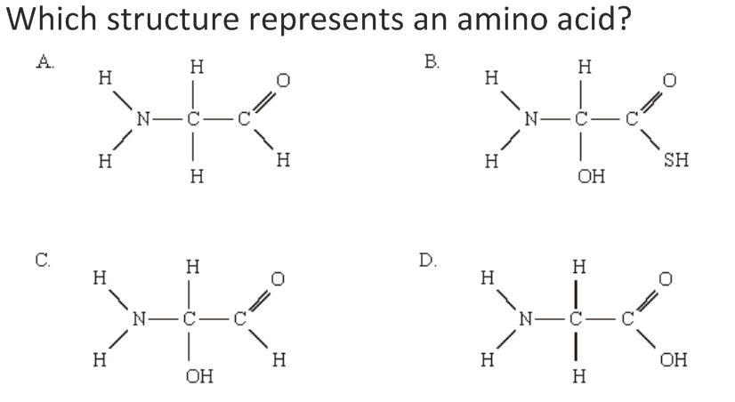
2.1.S2 Identification of biochemicals such as sugars, lipids or amino acids from molecular diagrams.

Slide 21
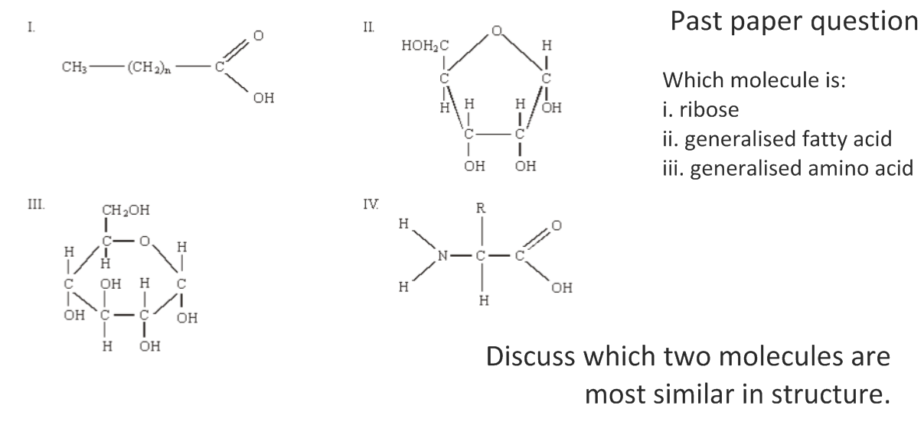
2.1.S2 Identification of biochemicals such as sugars, lipids or amino acids from molecular diagrams.

Slide 22
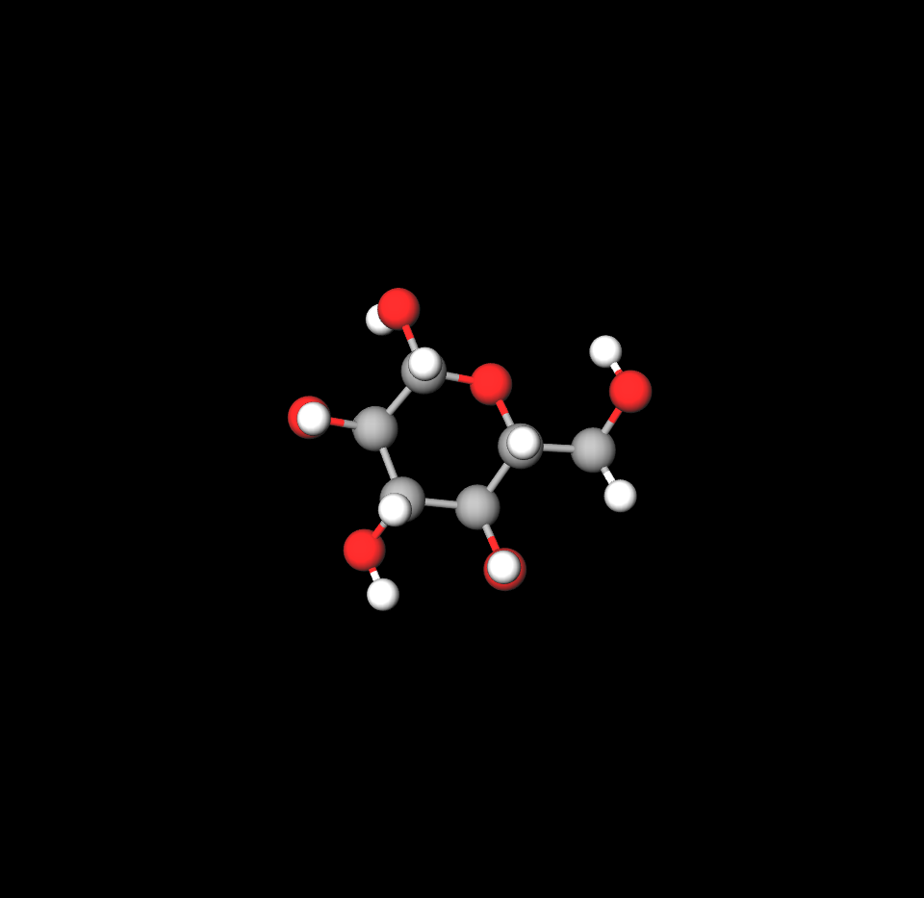
2.1.S1 Drawing molecular diagrams of glucose, ribose, a saturated fatty acid and a generalized amino acid.
Chem sketch or Mol view online drawing tool
Try drawing by hand (or on Chem sketch or Mol view) the following molecules:
Glucose
Ribose
A generalised saturated fatty acid
A generalised amino acid
An example amino acid e.g. Alanine (the simplest)
n.b. you also need to test yourself 15 mins, 1 day and one week later to make sure you remember

Slide 23
2.1.U4 Metabolism is the web of all the enzyme-catalysed reactions in a cell or organism.
Revisit the essential idea of this topic.
Explore the IUBMB-Sigma-Nicholson Metabolic Pathways Chart and realise that most cells use the majority of the pathways and that every path is controlled by a different enzyme. The metabolism as a concept is the sum of all the pathways used in a particular cell.

Slide 24
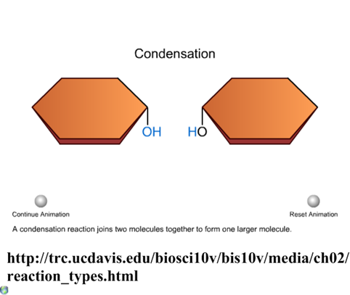
2.1.U5 Anabolism is the synthesis of complex molecules from simpler molecules including the formation of macromolecules from monomers by condensation reactions. 2.1.U5 Catabolism is the breakdown of complex molecules into simpler molecules including the hydrolysis of macromolecules into monomers.

Slide 25
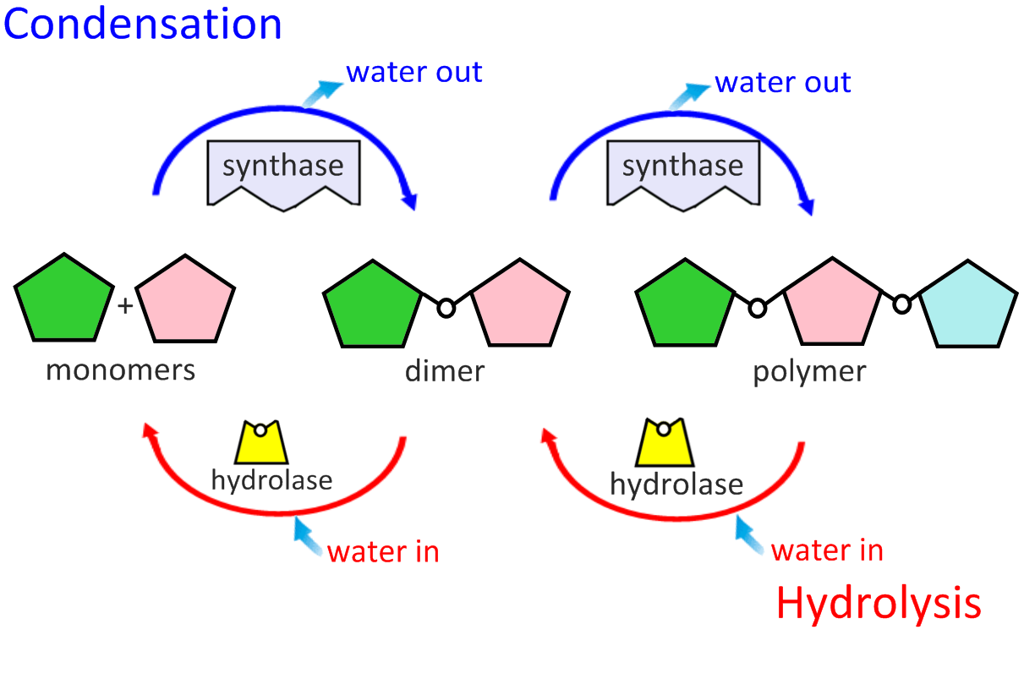
2.1.U5 Anabolism is the synthesis of complex molecules from simpler molecules including the formation of macromolecules from monomers by condensation reactions. 2.1.U5 Catabolism is the breakdown of complex molecules into simpler molecules including the hydrolysis of macromolecules into monomers.

Slide 26
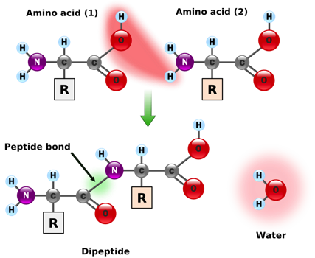
2.1.U5 Anabolism is the synthesis of complex molecules from simpler molecules including the formation of macromolecules from monomers by condensation reactions.
Examples of anabolism by condensation
Maltose synthase condenses two molecules of glucose into maltose forming a glycosidic bond
A ribosome condenses two amino acids into a dipeptide forming a peptide bond
The bonds formed are types of covalent bonds.
Bonding monomers together creates a polymer (mono = one, poly = many)
http://commons.wikimedia.org/wiki/File:Peptidformationball.svg

Slide 27
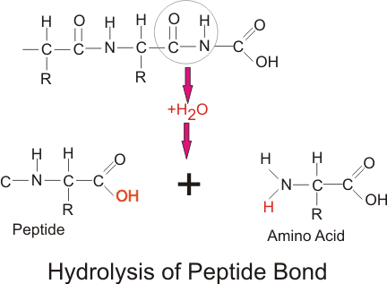
2.1.U5 Catabolism is the breakdown of complex molecules into simpler molecules including the hydrolysis of macromolecules into monomers.
Examples of catabolism by hydrolysis
A protease hydrolyses a dipeptide into two amino acids breaking the peptide bond
Lactase hydrolyses Lactose into Glucose and Galactose breaking the glycosidic bond
http://commons.wikimedia.org/wiki/File:Lactose_hydrolysis.svg
http://commons.wikimedia.org/wiki/File:Amino_acid4.png

Slide 28
You might see the term “dehydration reaction” mentioned interchangeably with condensation reaction.
Technically a dehydration reaction is when the water molecule has come from one of the reactants.
Whereas for a condensation reaction, part of each water molecule has come from each reactant.
In the case of the previous slide, OH from one glucose and H from the other.
http://www.flickr.com/photos/zachd1_618/5738829330/

Slide 29
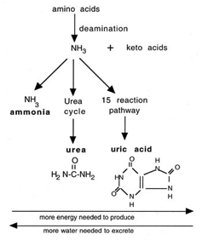
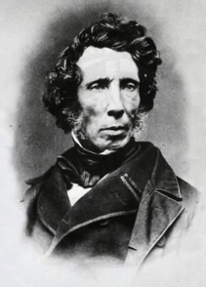
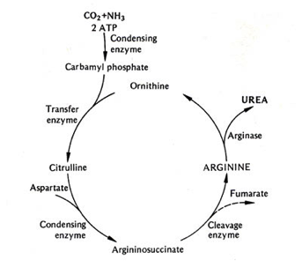
2.1.A1 Urea as an example of a compound that is produced by living organisms but can also be artificially synthesized.
Nature of Science: Falsification of theories—the artificial synthesis of urea helped to falsify vitalism. (1.9)
Wöhler accidentally synthesised urea in 1828, whilst attempting to prepare ammonium cyanate. In a letter to a colleague he says “I can no longer, so to speak, hold my chemical water and must tell you that I can make urea without needing a kidney, whether of man or dog". This is supposed to undermine vitalism as organic chemicals were previously thought to be synthesised only by organisms.
Vitalism nowadays has no credit as a theory, but above statement is seen by many from a historical perspective to be untrue. For an outline on vitalism read this article by William Betchel. The application statement above implies that the central tenet Vitalism is ‘only organisms can synthesise organic compounds’. This is not accurate, in essence vitalism proposes that an unknowable factor is essential in explaining life. Vitalism on this premise is both unscientific and and unfalsifiable.
Source: http://en.wikipedia.org/wiki/File:Friedrich_woehler.jpg
Source: http://www.biog1445.org/demo/08/nitrogenouswastes.html

